Slide 1

Rhino Early 2022 Update
WORKING in A HIGH-Vol environment

Slide 2
Like the trend, volatility is your friend, or is it…
- Unknown VEGA TRADER ☺

Slide 3
Preamble
No strategy works forever, unless one narrows down its principles to the core, in adequation with one’s trading style and objectives;
My ruling conservative Rhino principle is a stripped down version of the original one (~2014) with one prevailing guideline:
Keep a flattish Delta over the largest possible range
Initiate trades in a typical Rhino style fashion, with a caveat however
Adapt to the environment
Know your stuff: Greeks, Greeks and more Greeks
(cf. previous presentation for the Raleigh-Durham group at Aeromir)

Slide 4
The Current Trading Environment
Professional Routine
Working in a high volatility environment
Using professional benchmarks
Conservative Rhino trading
Conclusion

Slide 5
Does the standard Rhino work?
The standard Rhino near ATM entry would fare OK as long as one assumes a stable bullish market:
High volatility tends to provide a pressurised T+0 with a more positive Delta initially.
High volatility would obviously translate into larger expected moves in either direction
It is more prone to following a quasi directional “buy in the dip” approach
However markets are treacherous and the VIX term structure has at best been flaky lately.
VIX9D and VVIX are worth monitoring too.
IV versus RV also

Slide 6
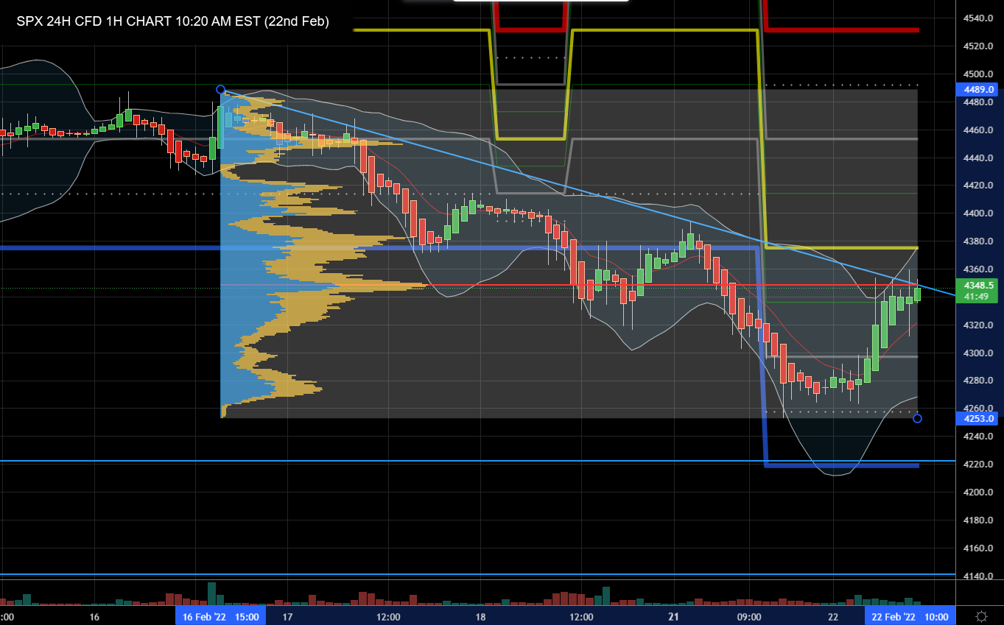
Market Reading
Check driving correlations:
SPX-VIX Correlation: -93.05% SPX-NDX Correlation: +95.09% SPX-DJI Correlation: +96.9% (Feb 22nd)
Monitor the Tech Titans; they are the bellwether for major equity indices (except for RUT)
Trading View

Slide 7
Adapting to higher volatility
Normal BWB Wing Size: 100/75 (PCS to PDE Ratio = 4/3)
Increase BWB wing sizes so that the PCS/PDS ratio decreases a little Rule of thumb: when VIX is in top historical quartile, use 125/100 or larger
Place the BWB further OTM to keep Delta flat to slightly negative
Combine BWB with Balanced Fly when volatility spikes, or when capital is tight
This helps managing both downside and upside risks.
All of the above are moderate variations

Slide 8
Typical Cycle
The market has been bullish since the Covid crisis, yet with volatility remaining quite high.
The entry is still around 77DTE, only OTM versus ATM in the regular Rhino
One may look for a support level to lower chances of “cognitive dissonance”
A OTM entry is less sensitive to the “vol pop” one often looks for.
Pricing is 2-dimensional, the best environment being market up / vol up
Relax or even ignore Delta rules for alerts on either side. Instead use:
Margin Management
Capital Re-Allocation

Slide 9
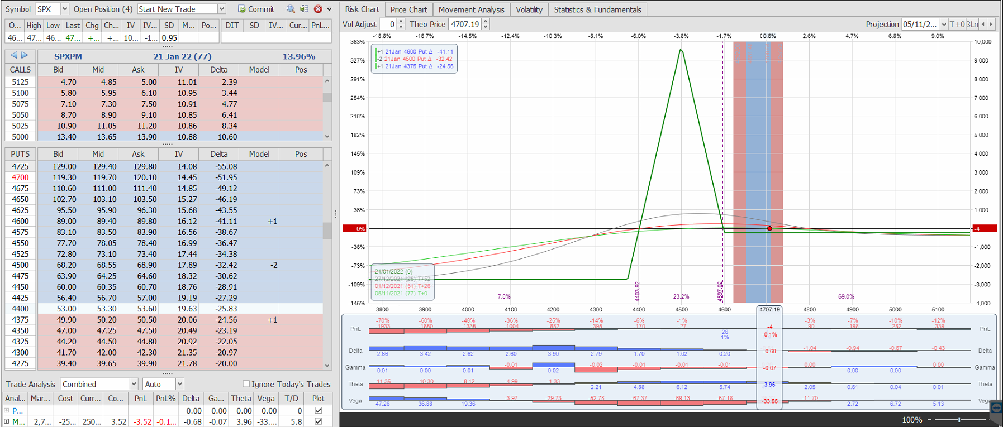
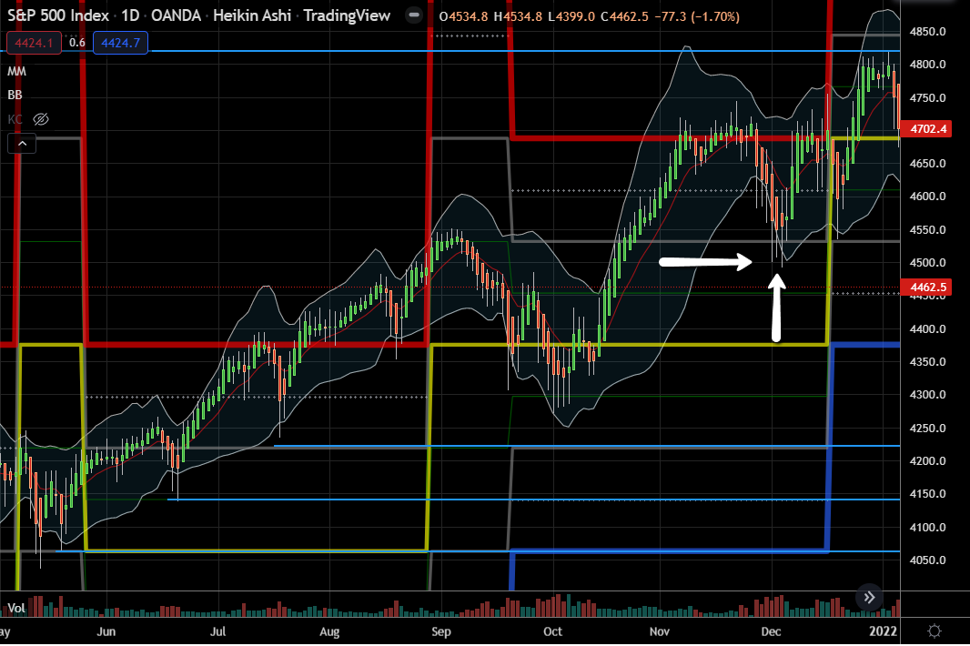
A typical entry in high vol
Using larger BWB wing sizes when VIX is above the 3rd quartile (currently ~19.75):
Ensuring flattish negative Delta
Entry early December for the FEB cycle SPX-VIX ~90% anticorrelated

Slide 10
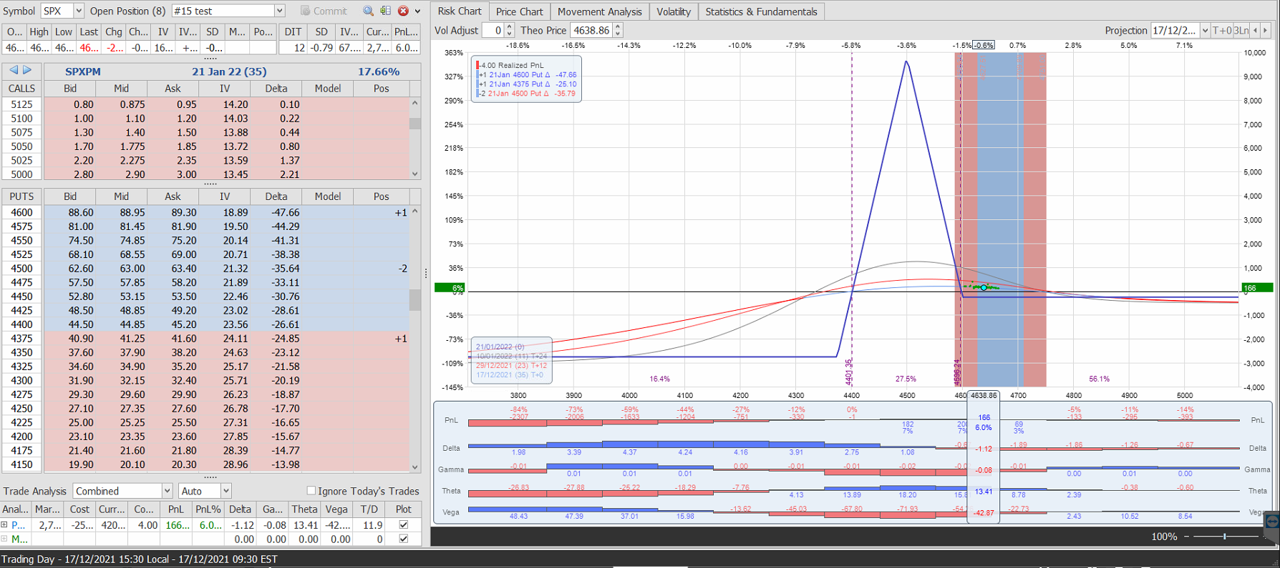
2 weeks later
The trade still has early downside resilience (generally down to ~49 DTE)
The sweet spot is monitored
Theta remains above 10, or at the very least positive.

Slide 11
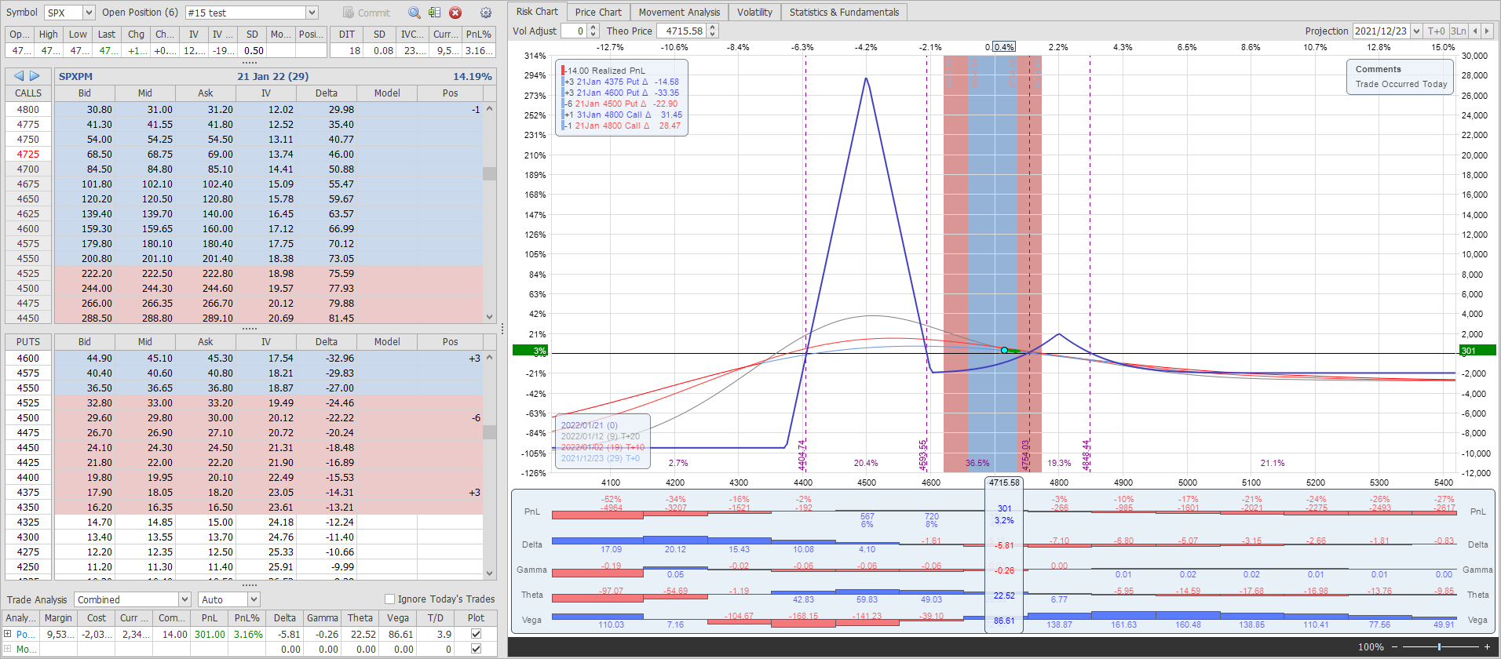
Upside adjustment
In “bullish - high vol” mode, a Delta rule becomes largely irrelevant to trigger an upside hedge.
Extend your tent with a “speedbump” narrow Call Calendar on the upside. There is no rule for ratios, here 1 Calendar for 3 BWB.
30 Delta is a good measure for the Calendar.
Keep monitoring your Greeks and T+0 and T+14 Hedges cost money…

Slide 12
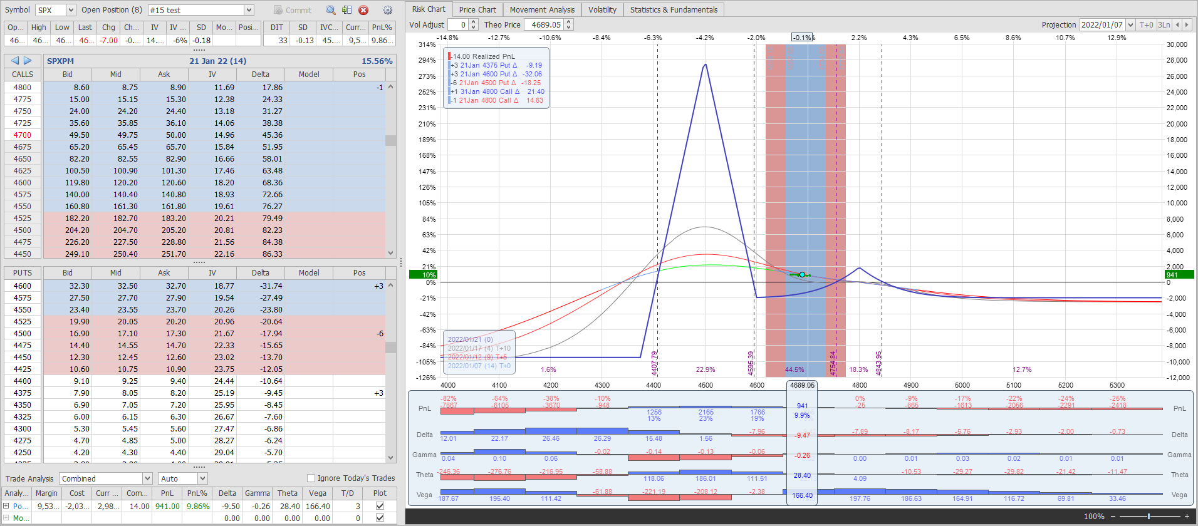
Seek a Profit Target
2% on Planned Capital is adequate.
Exit the trade (14DTE) or
Reduce exposure to max ¼ of Planned Capital, not to impede newer cycles.

Slide 13
First Takeaway
The conservative Rhino works generally well in this market.
Other alternative management:
Use CCS with PCS Rolls (Short Put Condor) or straight PCS
To be on the safe side: place your CCS above the IV Trough
The standard Rhino with a Call Calendar “speed bump” highlights the need to react without a definite Delta rule.
Use common sense
Trial and error is necessary in a new market environment.

Slide 14
No strict Delta Alert (upside)
In the previous example, a narrow Call Calendar was used as a “speedbump” on the upside
On the downside, a 1 month wide Put Calendar is preferable.
A note on Calendars:
Some other variations allow entering a Call Calendar at inception In my view it is preferable to enter them later when Theta drops. Place a Call Calendar around 30 Delta and above a strong resistance level.
In a high vol environment, do not let the market pass the Calendar strike
More forgiving in low volatility
Check the horizontal skew
Backwardation is generally beneficial to Calendars
Little vol clustering (GARCH) in the last few years

Slide 15
When to adjust then?
Many strategies do not include capital management, except for a Max Planned Capital
It is preferable to always consider all cycles together
It is also recommended to transfer capital gradually from cycle to cycle
Follow the 2 phases of a trade: Build-up up to ~49DTE, Cruising up to 28DTE, Descent up to 10DTE
Each action is an occasion to tweak the position’s risk (starting with Delta)
Use a PM MtE target, even if you are on RegT (use the -12% rule for guidance)
Conservative: 35% with occasional peaks to 45%
Balanced: 50% with occasional peaks to 60%
Aggressive 65% with occasional peaks to 70%
Control your position Gamma, particularly in the Descent phase
Theta and Gamma are related, so forfeit some Theta if need be.

Slide 16
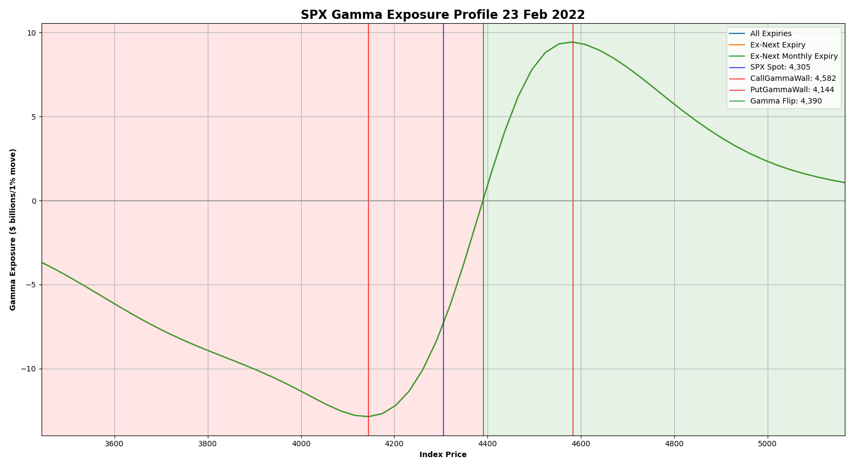

SPX is a dealers’ market
What are Market Makers doing ?
They need to balance their books with futures after selling Puts or buying Calls in general.
So, calculate GEX (Gamma Exposure) and VEX (Vanna Exposure) once or twice a day if you can*
Gamma Flip or Zero Gamma
Gamma Put & Call Walls.
* GEX Python script available on Perfiliev.co.uk

Slide 17
Specificities of pro trading
You can use moderate leveraging instead of loading up capital on positions
Currently: 1.5 to 1.6
Slippage (bad fills) are part of life
Follow the Mark price, and hope for the best
The Mid is harder to get when trading 50+ tranches
When the market becomes too erratic: hedge your Vega momentarily
That said, VIX does not seem to cluster anymore.
Monitor your MtE constantly
Allow yourself an acceptable VaR level
Most of my adjustments, capital increase/decrease are now based on portfolio management

Slide 18
Conclusion
There are many possible variations on the Rhino theme. This Conservative Rhino is only one of them.
This strategy is still relatively simple
The initial routine and the basic building blocks haven’t changed at all.
Do not necessarily follow strict Delta alerts, and instead stick to the prevailing principle: flat Delta over the largest possible range.
Managing Vega can be helpful to contain pressure on the T+0
The flip side is that High Vol will naturally reduce Gamma, and make adjustments effective until late in the trade’s life.
Capital Management can replace Delta Alerts.
Be more attuned to market dynamics if you have a low tolerance for risk (MtE, VaR)
Market reading, including FAANG, Treasuries, GEX etc.

