Slide 1


An Evolving Rhino
Survival of the fittest

Slide 2
Adapting to Ever Changing Markets
What is the RHINO’s prevailing principle?
01
How to deal with higher volatility?
02
Specificities to trading larger amounts.
03

Slide 3
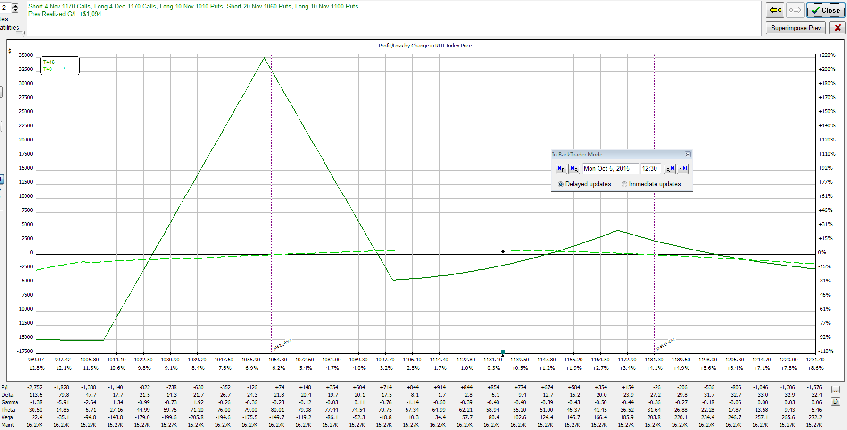
A Rhino Reminder (1)
ATM Put BWB strategy
With upper long Puts just above the money
Scaled in near original position
Hedged on the upside by Call Calendars (or Call BWB)
Other typical adjustments: Put spreads, rolls (Put Condors)
Same Planned Capital (< $40K).
Max $25K per cycle
What is the essence of this trade?
Old RUT Rhino

Slide 4
A Rhino Reminder (2)
The original Rhino guidelines had several flaws
Overly “sold” as a quasi-mechanical strategy (typical mentor marketing bias…)
Yet missing a few branches in the decision tree
And not quite suitable for runaway markets
No Delta build-up
Theta dwindling to potentially turning negative.
Some branches have been addressed such as scaling in on either up or downside
Ongoing comfortability issue with Call Calendars
And possible debate about trading the hedge actively or not.

Slide 5
01.1 Prevailing Principle
“A flattish Delta over the largest possible range”
Flattish: preferably slightly negative if Vega is also negative
Still entirely based on Put BWB
SPX is favoured.
More flexibility on the adjustment / scaling toolset.
Improved adaptiveness to the volatility environment
“Go with the flow”
Don’t fight the market
“Old” RUT Rhino

Slide 6


01.2 A quick aside
What does “being market neutral” really mean?
Some ability to read the market is highly recommended
Part of the daily routine (trader’s discipline)
Too many look at an oversimplified Delta-neutral strategy as if there were only one Greek dimension
Rhino traders should never ignore IV’s effect on Delta, or Vega more generally.
Keeping some negative D/V hedge may be useful (at least later in the trade).
Check Vanna also called DdeltaDvol if you have it in your toolset.
Source: Wikipedia

Slide 7
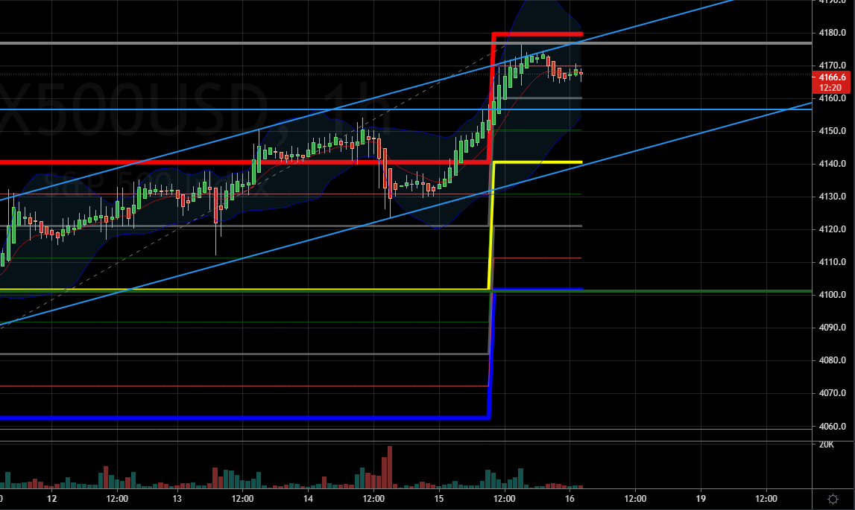
Homework*
Stats since Jan 1st ‘14
As of Friday April 9th
Daily routine
Since there is no such thing as being truly “market neutral”,
Check for salient support / resistance levels.
Check Greeks 1SD / 2SD projections
Know your toolset well: spreads, flies, etc.
Select those you are most comfortable with.
Decompose your trade
Analyse each combo element separately
Be consistent
Last SPX-VIX Correlation | -87.31%
Long-term Correlation Avg | -74.41%
Last VIX | 16.69
Long-term VIX Average | 17.22
Long-term VIX Median | 14.74
Lower Quartile | 12.615
Higher Quartile | 19.66
Avg Covariance | -139.76
Last Covariance | -113.85
* Too many spoon-fed traders become complacent…
Apr 15th

Slide 8
Capital Allocation (1)
Trading with cycle overlaps (generally overlooked in strategy rules and guidelines)
This becomes an integral part of the Rhino strategy
3 phases in the life of a trade, from an entry around 77DTE:
Take-off (build-up or capital injection) until 49 DTE
Generally resilient
Cruising altitude (constant capital) until 28 DTE
More sensitive to turbulences
Descent (capital reduction) until 14 DTE or closing
Sensitive to potentially very sensitive to turbulences
Using each capital reallocation step to rebalance Greeks
Adjustment Alert Level becomes a measure of last resort.

Slide 9
Capital Allocation (2)
Probably nothing wrong with reducing overlaps or keeping capital reallocation process to a minimum. Keep in mind however that:
The trade dynamics changes over time
The market often changes rapidly
This approach controls the overall Delta and Gamma also.
With a negative side effect of Theta
Consequently, original profit targets are more difficult to reach
Accept to extend the trade’s phases when volatility drops.
Check individual combo contributions

Slide 10
Common Sense
This environment is either a momentary deviation away from “normalcy” or a more permanent mutation of the Rhino
When the market environment appears new (e.g., insanely Bullish + Higher Vol):
Set a more reasonable (achievable) profit target.
This depends on the trading style, risk profile and confidence in market reading ability.
Reduce capital usage
Develop a mild form of schizophrenia…
Going with the flow yet keep in mind that the market reversals can be painful.

Slide 11
02 Higher Volatility
Higher Volatility is a more effective trading environment
Reminder: Nothing can be worse than an ultra low volatility environment
Painful memories of the early 2018 Vomma-Geddon.
Is there a maximum volatility level a strategy can handle ? Always
Can your strategy adapt ?
The tighter the rules, the more rigid the strategy is.
The Rhino can adapt better than most to various volatility environments.
Larger BWB wing sizes may be an element of response.

Slide 12
02 OTM Entry
Something had to give in order to conform the ruling principle.
A regular ATM entry exhibits a positive Delta
What can we do about it ?
Larger BWB wing sizes
Move your entry further OTM
Do nothing in case of a strong conviction of a directional market
No defined precise rule
Common sense would be to protect a strong support

Slide 13
02 OTM Entry
An OTM entry is generally less sensitive to the popular “vol pop”
NB: there is more to it than the so called vol pop.
“Sticky vol” in a bullish market is also favourable.
The PDS side of the OTM Put BWB is less powerful
In a bull market, it fades even quicker
Theta is however reduced, and the trade’s transitions are often delayed.
The original scaling in rule falls away
Replaced by Add-ons
Put BWB, Credit Spreads, Iron Condors

Slide 14
02 Enrich your toolset
The combo of choice remains the Put BWB
Return to regular size BWB when:
From larger size if volatility falls (and from narrower if vol picks up) or when
The trade has moved from build up to cruising to descent (i.e., passage of time)
Otherwise use Call and Put Spreads and wide Iron Condors
The Call side is almost inevitable in this trading style.
Be however prepared to return closer to standard Rhino management
When the market appears to return to some normalcy
And again, assess whether the adjustment conforms the ruling principle
Do not over-trade

Slide 15
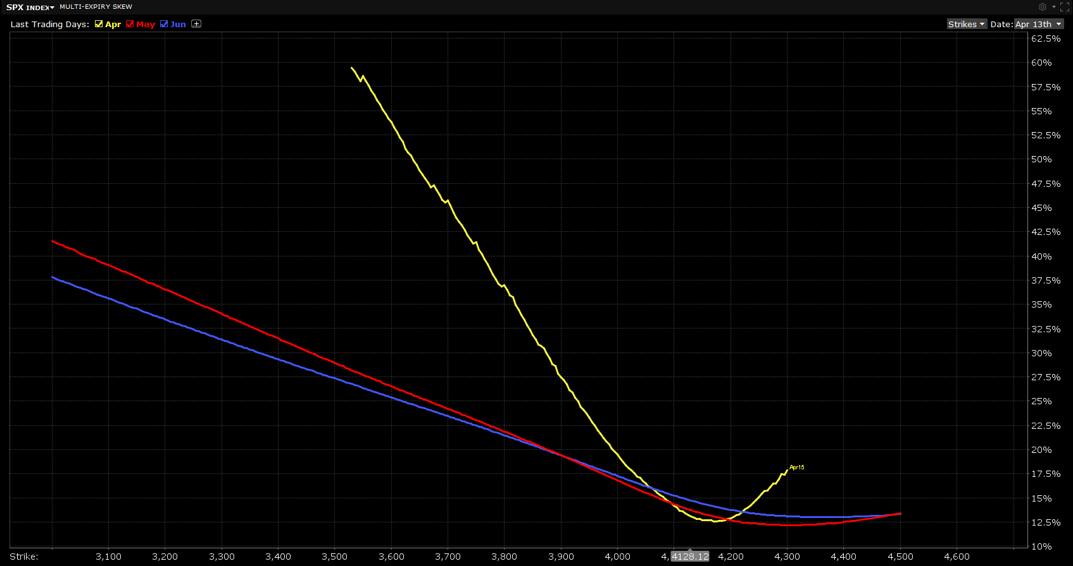
02 Vertical Vol Skew
The toolset often includes the Call side, hence checking the Vertical Skew is a precautionary measure.
Spreading Vega across
It is reasonable to keep vertical Call Credit Spreads north of the convexity, unless of a strong bearish conviction
The Vol Skew forms later in a lower volatility environment.
The IV trough moves towards ATM as time goes by.
Typical adjustment: Bullish Risk Reversal
Time

Slide 16
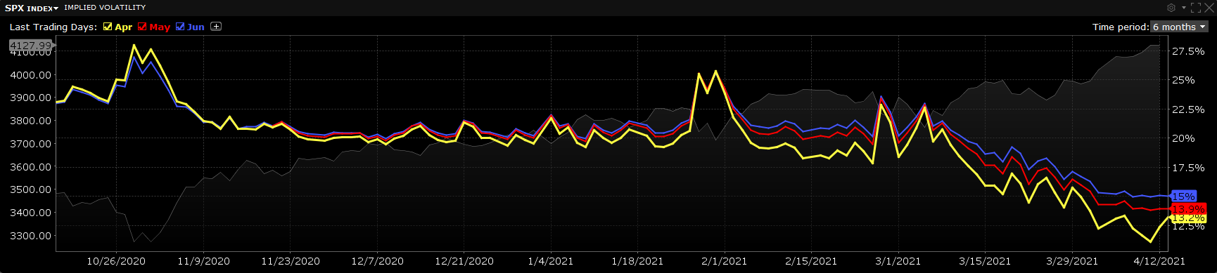
02 Horizontal Vol Skew
Horizontal Spreads work fine when the Skew is negative or flat
They fare better while in backwardation
Horizontal Spreads can however otherwise sometimes be tricky
The original guidelines suggested trading the Calendar hedge: beware of vol crush situations.
Maybe consider reducing adjustment level (alert level) when the market runs away.
No more time value in MAR

Slide 17
02 Another Aside
What if the market falls like a knife? Don’t try and catch it!
The conservative stance (OTM entry) should give you more time to assess the situation
Reduce exposure i.e., capital
Prepare a “Roll In One Go” adjustment (+1/-2/+2/-1)
Strike selection may be difficult
Enter the inner PDS before the outer PCS
Place a Put Calendar below your lowest short Puts
Have a Put buy-back conditional order ready

Slide 18
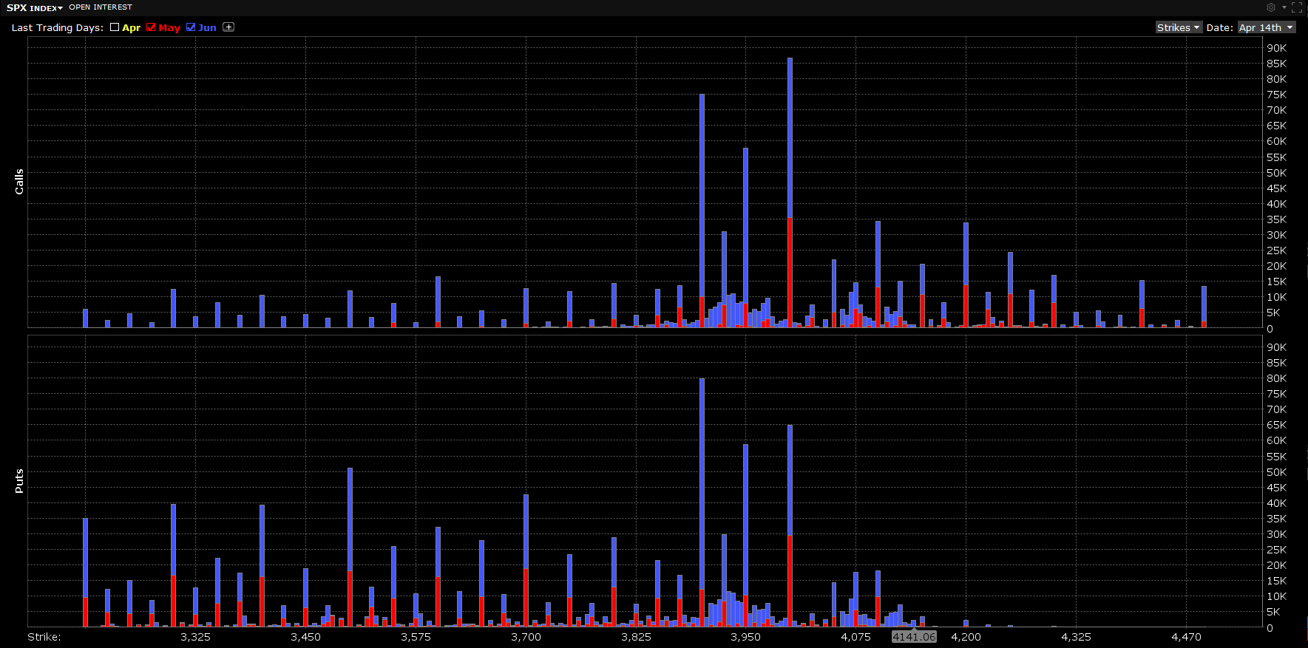
03 Pro Trading
SPX Liquidity (O.I.) is much larger on multiples of 50
Except for ITM Puts
Balanced flies fill quicker than BWB or any other more complex Combo.
Favour verticals if MM don’t play ball.
This OTM Rhino is efficient on PM Margin, with due caveat that Margin would of course shoot up upon a hard reversal.
Keep your NAV in check, without however falling into the over-trading trap.
Reallocating capital is not over-trading
Forfeiting Theta is acceptable, and overall Gamma is better controlled.
Check O.I.

Slide 19
Major Changes (1)
BWB Wing Sizes are now Volatility dependent. A rule of thumb could be:
High Vol (VIX above 3rd quartile, around 19.5): larger wing sizes e.g., 125/100
Normal Vol: standard wing sizes, e.g., 100/75
Low Vol (VIX below 1st quartile, around 12.5): reduced wing sizes, e.g., 75/50
PCS/PDS wing ratio: around 1.2
PCS Wing – PDS Wing: constant, same for capital usage
This is not a prerequisite : just simpler this way.
Again, OTM PDS are weaker.

Slide 20
Major Changes (2)
Wider Wing BWB are always more expensive, however affordable to cheap in a high vol environment.
PCS/PDS size ratio is slightly lower: more resilient on the downside
More conservative stance
OTM positioning or
Stay (closer to) ATM and keep increasing wing sizes
Within reason
Or: Go OTM with large wing sizes.
Spread Vega risk across the whole range.

Slide 21
Is the Rhino a generic BWB trade?
Not quite so:
It is still based on the same principle i.e., a flattish Delta over the largest possible range.
It is important to cautiously tread outside one’s comfort zone
Use Spreads and Combos you know best.
Are these conservative measures however specific to the Rhino ? No.
Volatility is mean reverting hence this approach is not meant to become the norm.
More aggressive traders may be satisfied with a more bullish Rhino.
This would however embed more downside risk, as seen with the RTT.

Slide 22
Conclusion
It is recommended the Rhino be adapted to personal trading style
These proposed amendments are not specific to the Rhino
And they are conservative in nature
This presentation definitely relates to the current environment
It however provides pointers towards increased adaptability of the strategy.
Keep learning and Thank you !

