Slide 1
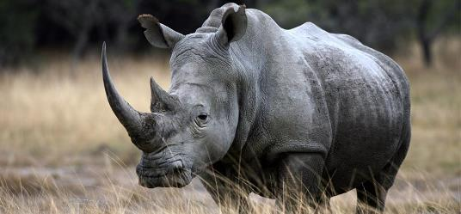
The Rhino Strategy
A versatile market neutral BWB strategy
BY Bruno & Mike

Slide 2
MAIN CONCEPT
A Delta neutral trading strategy over the largest possible price range
Low stress
  Slow moving trade
Low maintenance
  Few adjustments where timing is not essential
Conservative
  Capital preservation is paramount
  Risk control is key (low drawdowns)
Versatile
  Variety of adjustments at the trader’s discretion
Evolutive toward generic BWB trading

Slide 3
Underlying Instruments
SPX
  SPY ETF
RUT
  IWM ETF
ES Futures
Other
Has not been tested yet on other instruments where the volatility behaviour (skew) could be vastly different (FX or Commodities)

Slide 4
Summary of the last 3 years
Markets have evolved
  Larger moves / swings
  Higher volatility (with more frequent gyrations)
  Volatility behaviour: HV > IV over long periods of time
Modelling Software has been disappointing
  OptionVue issues
All strategies have to be adapted to
  Changing environments
  Personal Trading Styles

Slide 5
The Rhino Family (2019)
The Monthly Rhino (The “Original” Rhino)
  From ~ 77 DTE to ~14 DTE
    Standard “By The Book” Rhino or
    Slightly more advanced Rhino
      Vertical layering
The Giant Rhino
  From 100-120 DTE to ~35 DTE
  Slow moving “no touch” trade
    Horizontal layering
The Baby Rhino
  From 14 DTE to 7 DTE
    More dynamic, quicker returns.

Slide 6
TARGET AUDIENCE
All options traders with a fair understanding of Greeks
  Simple guidelines, essentially based on Delta alerts
Conservative traders
  Low Risk – High Probability trades
More advanced traders willing to explore BWB trading further
Guidelines can be adapted according to trading style
  Longer or shorter dated variations
  Delta alerts can be tuned to personal preferences

Slide 7
Coaching
Bruno Voisin
  Long experience
  Has been providing the Rhino expert service since mid 2016
  Taking after Brian Larson, original Rhino designer
Michael Schwartz

Slide 8
Coaching style
Bruno
  Balanced approach between “aim” & “shoot”
    Learning by examples (standard alert service) has its limits.
  Interest in modelling (pricing, volatility surface etc.)
  Audience amongst more advanced traders
    No sugar coating !
Michael

Slide 9
Service Description
Morning Notes
  Trading Plan for the day
    Market view
    Selection of possible adjustments
Alert Messages on Slack and Aeromir
  PLAN, ORDER, FILL
    Indicative pricing information only
Weekly Recap Video
  Including Market Outlook for the coming week.

Slide 10
Service Description
Weekly Meetings (every Monday 11AM Eastern)
  On demand
Group discussions on “Rhino & Flies” Slack
Personal assistance (one on one chat on Slack)
  Rhino
  Other BWB variations

Slide 11
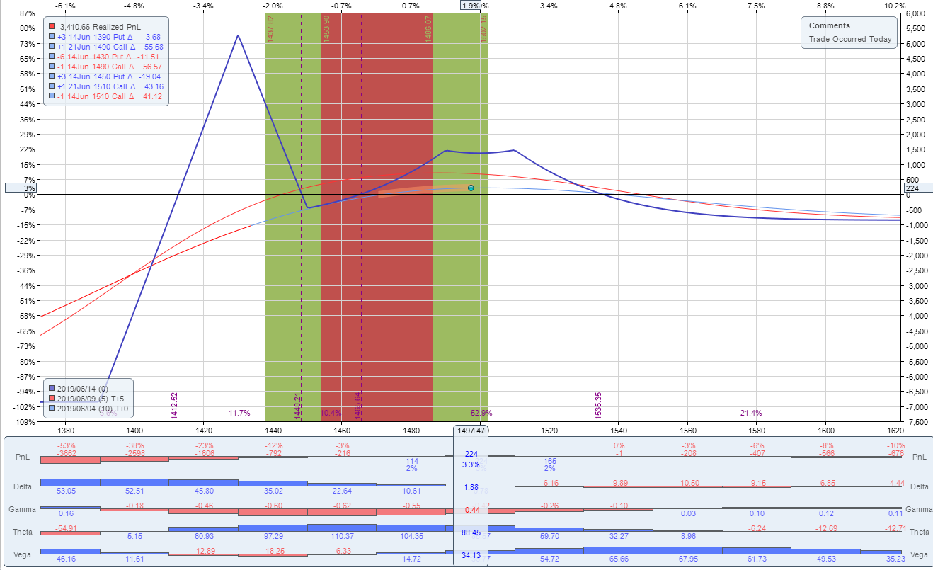
BABY RHINO (current 0614)

Slide 12
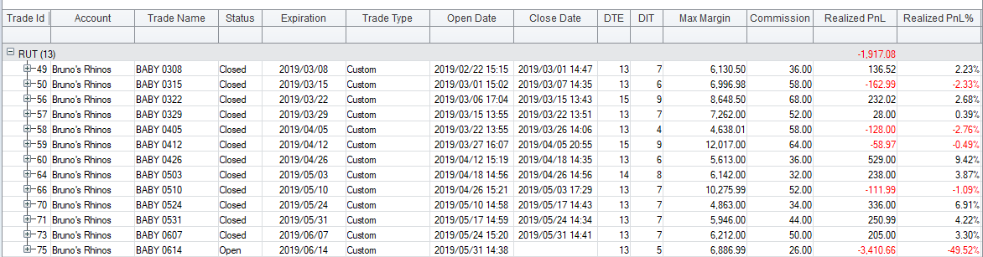
BABY RHINO
ONE does not provide reports with unrealised profits.
Current BABY 0614: ~ $250
Total so far: ~$1750, or ~$135/week.

Slide 13
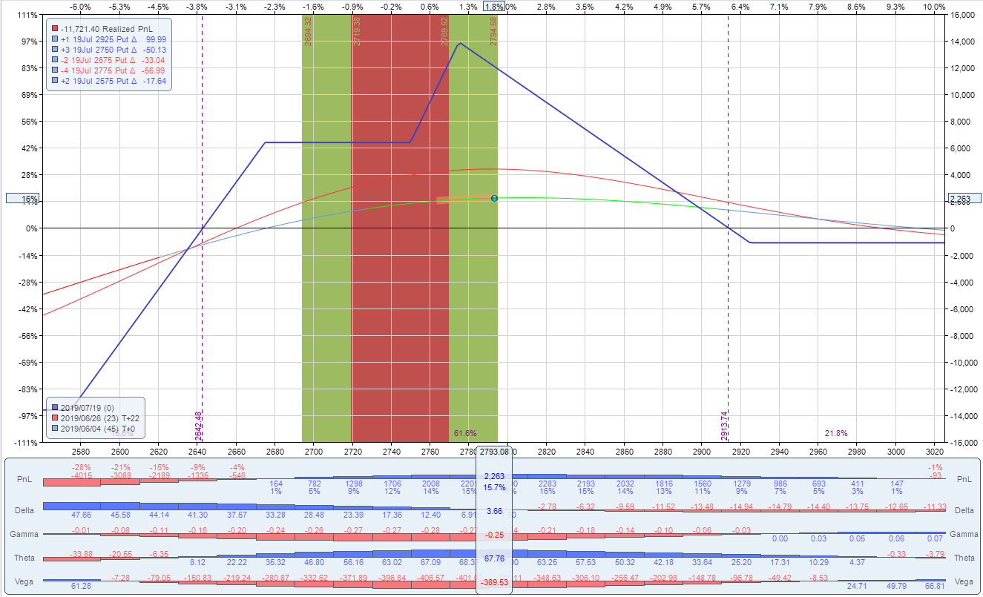
STANDARD SPX RHINO (“BTB”)

Slide 14
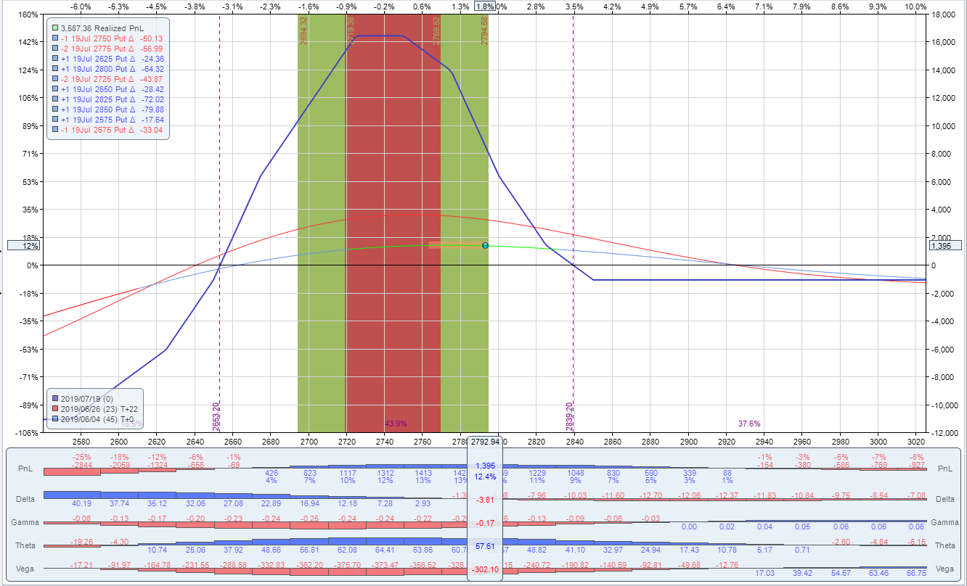
STANDARD SPX RHINO (“REG”)

Slide 15
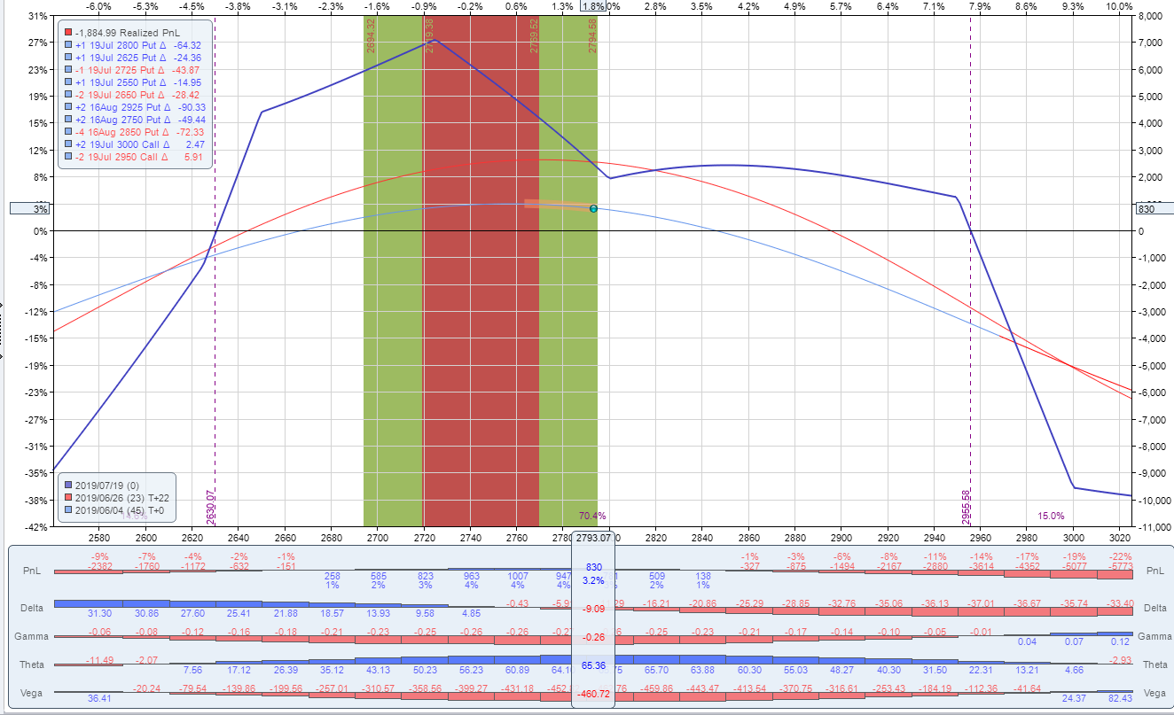
GIANT RHINO

Slide 16
Summary
Simple yet evolutive trade family
  3 trades
  2 underlying symbols
More than a standard alert service on Slack
  Group Q&A
  Direct messages
Team effort

