Slide 1
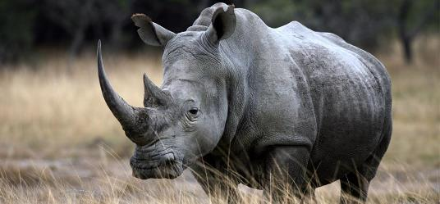
The Rhino Trade
African White Rhino
A conservatively hedged Broken Wing Butterfly
August 1st 2018 Update

Slide 2

Qui suis je ?
Long trading experience as a quant
(pattern matching, AI) as well as trading
various asset classes.
Any strategy is always a reflection of its designer’s then its user’s personality i.e. learn over time to make it your own. I live by that rule.
Rhino mentor for CD then Aeromir

Slide 3
Today’s Presentation
Short recap on the Rhino Trade
  Definition of a Rhino
  Trading Discipline, Rules and Market View
  Daily Management
Variations on the original Rhino
  Using a market view
  Adding branches to the decision tree
  Special cases e.g. low IV

Slide 4
So, what is a Rhino?
The Rhino is part of the large family of hedged butterflies e.g. M3, RTT, Kevlar, X4 etc.
  A BWB is a BWB is a BWB or is it really ?
It starts with a slightly OTM Put Broken Wing Butterfly (main “horn”)
And typically an upside hedge in the form of OTM Call Calendars (second “horn”)
  Some rather hedge the upside with a second Call BWB

Slide 5
What makes the Rhino different?
It is a conservative trade
  Capital preservation is paramount
It is a “flat Delta no Gamma” strategy.
  Alerts are lower than most other Butterfly / BWB strategies
It is relatively easy to manage (this is of course a subjective matter)
  Timing not essential (hardly ever a need to adjust rapidly).

Slide 6
What makes the Rhino different?
The Rhino is versatile and relatively simple
One can start trading it using strict guidelines then
Grow into it, and start using a variety of setups of adjustments according to personality, lifestyle and risk profile
  “Everything under the sun” ?
The Rhino is one of the best foundation possible on BWB trading.

Slide 7
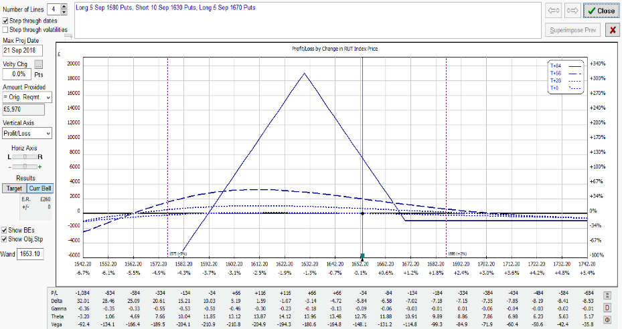
A typical RUT Entry
Please note that the prices and other statistics on this page are hypothetical, and do not reflect the impact, if any, of certain market factors such as liquidity, slippage and commissions.
TYPICAL RUT RHINO AT INCEPTION:
A FLAT T+0 LINE (84DTE)
5 RUT 50/40 Put BWB
(here 1580/1630/1670)
Good downside cover (5%)
Limited upside risk
IV Skew

Slide 8
RUT Rhino Entry
Five RUT 50/40 Put BWB
  Upper longs 1/2% to 1% above the money (ITM)
  Wider wings also possible (60/50 or 70/50)
Preferably 77 DTE for a calmer kick-off (flat T+0)
  This may engage capital early but one then slowly builds into the trade (“cognitive dissonance”)
  Can start 84-56 DTE or even later but a delta hedge is often necessary if late (e.g. Baby Rhino)
  A down day (Vol Pop) is always preferable

Slide 9
SPX Rhino Entry
Three SPX 80/60 or 100/75 or 75/50 PUT BWB
  Upper longs 0.5% to 1% above the money (ITM)
  Keep wing size ratio similar
  Same entry i.e. preferably around 77 DTE
  Same optimal conditions (Vol Pop)
Larger Wings = Larger Skew
  More resilient on the downside
  More work on the upside

Slide 10
Scaling In
Add 5 Put 50/40 BWB (for the RUT)
  Original guidelines
    When the underlying leaves the tent (~10-15 points past the upper longs)
    20 points (i.e. ±1%) above the initial ones
      Inside the tent ?
  New guidelines: more efficient use of capital
    Add Theta to the trade by 56 DTE or 2-3 weeks after entry
    Up or down, and again preferably on a down day.
    Scaling-in is also an opportunity to keep Delta flatter

Slide 11
Reminder: Ruling Concept
A BWB is a BWB is a BWB, or is it really ?
  The Rhino is safe in most environments
  The Rhino can be expanded into generic BWB trading
Prevailing Rules
  Capital Preservation
  Flat Delta, low Gamma
  Same wing size ratio for all underlying symbols
  Easy management (yet, not quite mechanical ! )
Trade like a pro i.e. discipline (daily routine etc.)

Slide 12
Typical Adjustments
Cut negative Delta by half: buy OTM Call calendar spreads, selling put verticals or condors, additional small Put BWB
  Delta Limit: -5 per BWB
  After 35-28DTE, calendars are often substituted for Call BWB to mitigate upside risk and flatten T+0 line, or be taken off (RTT mutation).
Cut positive delta by half: first remove upside combos, scaling back to original entry setup, scaling in or rolling back lower:
  Delta Limit: +25 irrespective of position size i.e. 5 per BWB or less

Slide 13
Rhino Exit Rules
Planned Capital = $25,000 (without any allowance for overlap) otherwise $37,500
  A position generally is closed before the next one is scaled in to full size, yet not always so in low IV environments.
Profit Targets
  • > 35 DTE : $2500 (10% on PC)
  • 28 - 35 DTE : $2000 (8% on PC)
  • 21 - 27 DTE : $1500 (6% on PC)
  • < 21 DTE : $1000 (4% on PC)
  Then for the brave, when Gamma starts kicking in…
Loss Control
  Exit on 10% loss (or less)

Slide 14
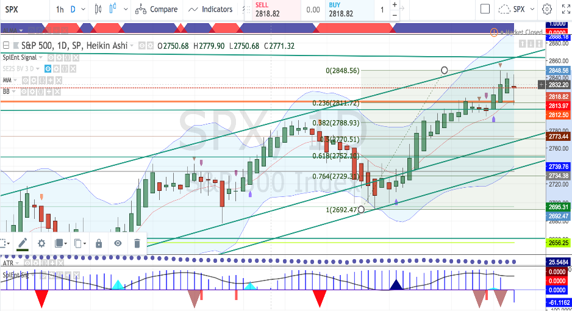
Market View
Jul 27th after the close
Tools:
ALMA, BB, Fibs and common
Graphical patterns (e.g. channels, pennants etc.)
?
(AAPL)

Slide 15
Daily Routine
  Check futures market for overnight gap
  Economic News (… and tweets …)
  Volatility Regime
  If managed once a day (10 AM or 3 PM):
  Stick to the rules (no specific market view)
  Recommended for beginners or traders who have a day job
  Trade / Adjust when market has settled
If managed twice a day (recommended):
  10 AM and 3 PM

Slide 16
Can we adapt alert levels ?
Market Neutral = “Theta play” under the tent
  Some traders may accept more volatile P&L or
  Use more TA (e.g. support/resistance levels as shown on previous slide) to adjust delta limits and alerts.
  Also note that indices follow the general mean reversion rule.
Optimal range : between the “horns”
Use common sense !
  This comes with experience (alert service?)

Slide 17
End of Part 1
We have seen the following in Part 1:
  The Rhino is a versatile hedged Put BWB
    Applicable to RUT, SPX, ES as well as related trackers.
  Managed by Greeks, assisted by a market view.
  Simple Delta guidelines to keep T+0 to T+7 flat.
  Scale-in by 56 DTE to add Theta to the trade.
  Most usual upside adjustment: Call Calendars.
  Recommended management: Twice a day.

Slide 18
The Rhino Trade
African White Rhino
A conservatively hedged Broken Wing Butterfly
Part 2 August 9th 2018

Slide 19
Part 2: Trade Evolution
  Digging deeper
    A Rhino is a Rhino is a Rhino, or is it ?
  Dynamics for the two major underlying symbols (RUT and SPX) are slightly different
    SPX exhibits more skew than RUT, and more so on larger wing sizes.
  Does one want to “trade the hedge” ?
    A BWB strategy can be assisted by a good tent-widening technique, but how far are we prepared to go ?
  Incorporating adjustments or even setups from “like-minded” strategies.
    For instance RTT in its original format.

Slide 20
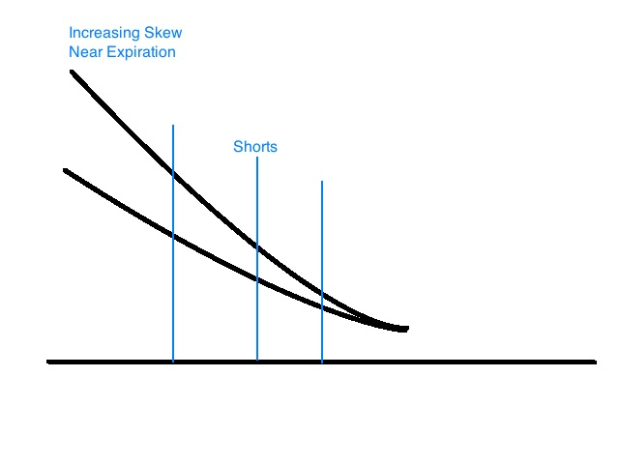
A quick aside on Skew
  B&S (1973) assumes constant IV across the whole chain, and that was actually about valid until the 1987 crash
    A lot of developments
    have since attempted
    to model options pricing
    better, for instance the
    seminal
    work of Steven Heston
    (1993) on stochastic
    volatility: V(X,t)
    following what is
    called a
    VOLATILITY SURFACE

Slide 21
A quick aside on Skew
  Puts and Calls have their own skew although the Put-Call Parity is always valid for European options.
    In 1st approximation: C – P = F
      F is a synthetic Forward for the underlying
  However Puts and Calls do have different dynamics (supply & demand)
  Equidistant OTM Puts and Calls will have different prices
    Example on BIBOP or OV

Slide 22
Rollback Risk
Cost ?
What if/when the market bounces (whipsaw) ?
IV Versus DTE | Young ( > 56DTE ) | Mid-Life ( 56-28 DTE) | Ageing ( < 28 DTE )
LOW | LOW-MEDIUM | MEDIUM | HIGH
MEDIUM | LOW | LOW-MEDIUM | HIGH
HIGH | VERY LOW | LOW | LOW-MEDIUM

Slide 23
Reminder: Rollover Risk
Rollover is not part of the Rhino rules
  Pricing issues are still relevant (scaling in)
IV Versus DTE | Young ( > 56DTE ) | Mid-Life ( 56-28 DTE) | Ageing ( < 28 DTE )
LOW | MEDIUM | HIGH | VERY HIGH
MEDIUM | LOW | MEDIUM | HIGH
HIGH | VERY LOW | LOW | MEDIUM

Slide 24
Real Issues with Rolls
What is a normal IV level ?
Should we be more careful when IV < SV ?
  Most traders seem to ignore this unusual situation
Don’t trust examples that only show the safer cases
  If you apply a rollover / rollback rule only in « young » trades, there is a substantial chance you have the previous cycle still on and struggling !

Slide 25
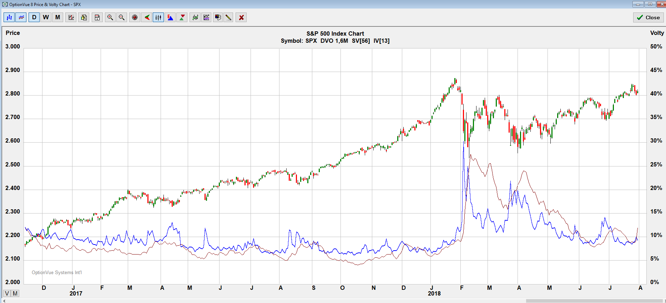
Volatility Environment
Many traders choose to ignore an environment where SV > IV.
Should we really ?
The Rhino can gain from occasional Vega hedging with Put Calendars.

Slide 26
Recap: Delta Alerts
  ALERTS
    UPSIDE
      Delta > -5 per BWB inside the tent
      Delta > -4 per BWB outside the tent
    DOWNSIDE
      Delta < 25 irrespective of position size i.e.
        5 or less per BWB
      Warning when the lowest shorts are being passed
    Same for RUT and SPX ?
      In normal IV environments otherwise account for skew (SPX) hence reduce Delta alerts for SPX.

Slide 27
3 Phases in the Trade
  GROWTH (Take-Off and Rising)
    From inception to 56 sometimes 49 DTE
  MATURITY (Cruise Altitude)
    Until 35 sometimes 28 DTE
  GETTING OLD (Descent, Approach and Landing)
  Issues potentially affecting the phases
    Tight capital (leading to unsolicited layering)

Slide 28
Adjusting after Take-Off (77-56DTE)
Depending on IV environment
  Scale-In
    By 56 DTE, and preferably not too early either
    A down day is preferable
  Move shorts up or down
    If IV is very low, sometimes pull upper longs back (RH)
  Close trade and reposition
    The Rhino is naturally resilient on the downside (5 to 7%) so a good chance a rollback will be above breakeven point and sometimes nicely profitable.

Slide 29
At Cruising Altitude
(56-35DTE)
Check Greeks
  Market outlook (Daily Chart)
  Alerts
  Choice of adjustments (Calendars?)
Check IV Skew
Dissect your position
  Analyse verticals’ behaviour: PCS and PDS
    Particularly if/when entering BWB as verticals

Slide 30
Descent and Approach
(35-21DTE)
Protect profit
  Keep T+0 flat
    Avoid overloading your position (Gamma may hit you)
  Peel off
  Maintain / Release capital for next position (capital management)
    Do not add capital into the trade
  Think out the box (dynamics are changing)
    You may allow your trade to go more directional
    Turn the trade into a RTT-style trade
  Do as little as possible…

Slide 31
Differences from Brian’s Rhino
Epilogue:
Let’s not spend hours debating this topic
  A Rhino *IS* a Rhino, i.e. same flat Delta objective
A Rhino is a great way to learn to trade Put BWBs.
  I took over from Brian mid 2016
  Brian came back to the Rhino and most probably took from my presentations in the last couple of years.
In the end, you’ll trade *YOUR* Rhino !

Slide 32
Differences from Brian’s Rhino
Both (now) agree that the trade is meant to do well “in between the horns” (shorts or combo peaks)
  Alerts may slightly differ
One can choose to trade the (upside) hedge
  I generally don’t or moderately at best
  In most cases when the hedge is also a BWB
Some traders are averse to horizontal spreads e.g. Calendars, in particular Call Calendars.
  Stay in your comfort zone

Slide 33
Differences from Brian’s Rhino
The original (or say “standard”) Rhino:
  Does not take any market view into consideration
  Tries to be as mechanical as possible (… a myth …)
    77DTE entries
    Always the same position size
  Does not explicitly look at the change in dynamics during the course of the trade
  Does not propose a RTT mutation

Slide 34
Differences from Brian’s Rhino
The original (or say “standard”) Rhino:
  Does not trade on Planned Capital across all open cycles
  Does not adapt to volatility regime

Slide 35
Differences from Brian’s Rhino
I don’t agree:
  We all have some market bias
  We are humans, not machines !
And sometimes I can’t stick to strict Rhino rules:
  Tight capital when 3 cycles are overlapping particularly in low IV environments
As an aside, many of you are also familiar with my ongoing ranting against back-tests…

Slide 36
Differences from Brian’s Rhino
The Rhino trade is relatively simple yet
A simple trade is NEVER an excuse NOT
  TO THINK
  TO DO YOUR HOMEWORK
  TO STAY WITHIN YOUR PLANNED CAPITAL
As mentioned earlier in the presentation:
  Apply the discipline of a pro trader
  This is not a hobby !

Slide 37
Mea Culpa,
Reflections and Inspirations
Was (or is) a SPX 100/75 Rhino i.e. larger skew a good idea?
  The RUT Rhino is probably a simpler trade.
  This has motivated the occasional RTT mutation or mix.
Should I also more systematically trade the upside hedge ?
  Maybe !
Does an evolution to more generic BWB trading deter beginners to embark into a strategy nonetheless relatively simple ?
Capital Management has been critical in the last two years, hence why not introducing:
  Layering
  Bear Hedges.

Slide 38
Summary
Better general capital usage
  A second batch of 5 additional BWB (for RUT) is always added (2 for 100/75 wing size, 3 for 80/60 on SPX)
More variations on both sides
Use of a market view
A bit more maintenance
  Checking the market twice a day is recommended
Be realistic
Keep learning !
  The smarter you trade, the simpler !

Slide 39
A Final Word
I am terrible as a mentor ☺ however:
  I send a daily plan every morning
  Often an update around the open
  Alerts are always in the PLAN, ORDER, FILL format
  Also interaction on the Rhino Slack group
  And I apologise when I mess up…
I confess I tend to also ask members to know their stuff and do their homework (no sugar-coating)
  This is a simple trade, an ambitious strategy yet
  NOT A TEXTBOOK RECIPE !

Slide 40
Thank you
“The whole problem with the world is that fools and fanatics are so certain of themselves but wiser people so full of doubts”
Bertrand Russell (1872-1970)
British philosopher, mathematician etc…
He also said:
“To conquer fear is the beginning of wisdom” and
“There is much pleasure to be gained from useless knowledge”

