Slide 1
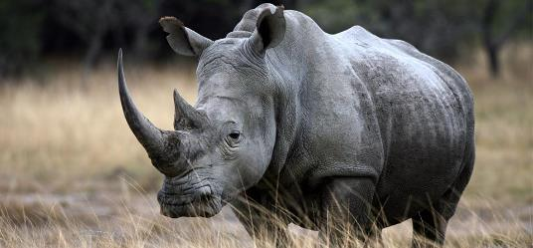
The Rhino Trade
African White Rhino
A conservatively hedged Broken Wing Butterfly
August 1st 2018 Update

Slide 2

Qui suis je ?
Long trading experience as a quant (pattern matching, AI) as well as trading various asset classes.
Any strategy is always a reflection of its designer’s then its user’s personality i.e. learn over time to make it your own. I live by that rule.
Rhino mentor for CD then Aeromir

Slide 3
Today’s Presentation
Short recap on the Rhino Trade
Definition of a Rhino
Trading Discipline, Rules and Market View
Daily Management
Variations on the original Rhino
Using a market view
Adding branches to the decision tree
Special cases e.g. low IV

Slide 4
So, what is a Rhino?
The Rhino is part of the large family of hedged butterflies e.g. M3, RTT, Kevlar, X4 etc.
A BWB is a BWB is a BWB or is it really ?
It starts with a slightly OTM Put Broken Wing Butterfly (main “horn”)
And typically an upside hedge in the form of OTM Call Calendars (second “horn”)
Some rather hedge the upside with a second Call BWB

Slide 5
What makes the Rhino different?
It is a conservative trade
Capital preservation is paramount
It is a “flat Delta no Gamma” strategy.
Alerts are lower than most other Butterfly / BWB strategies
It is relatively easy to manage (this is of course a subjective matter)
Timing not essential (hardly ever a need to adjust rapidly).

Slide 6
What makes the Rhino different?
The Rhino is versatile and relatively simple
One can start trading it using strict guidelines then
Grow into it, and start using a variety of setups of adjustments according to personality, lifestyle and risk profile
“Everything under the sun” ?
The Rhino is one of the best foundation possible on BWB trading.

Slide 7
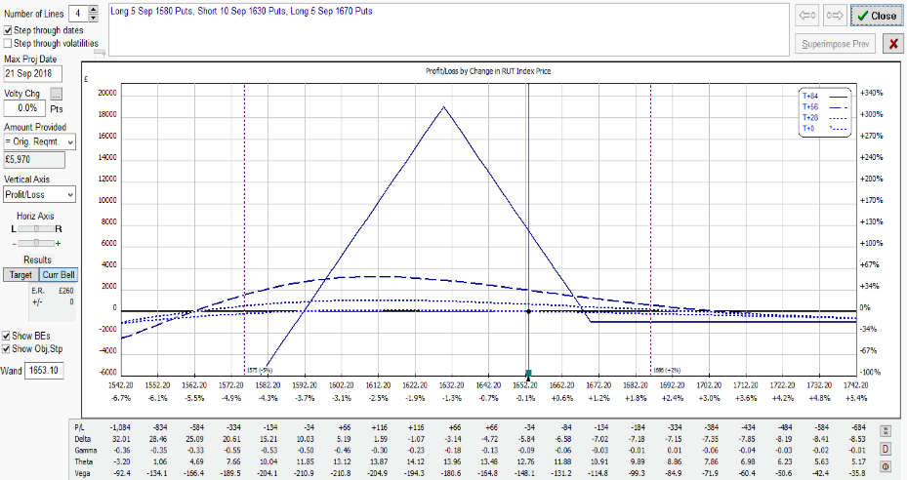
A typical RUT Entry Please note that the prices and other statistics on this page are hypothetical, and do not reflect the impact, if any, of certain market factors such as liquidity, slippage and commissions.
TYPICAL RUT RHINO AT INCEPTION: A FLAT T+0 LINE (84DTE)
5 RUT 50/40 Put BWB
(here 1580/1630/1670)
Good downside cover (5%)
Limited upside risk
IV Skew

Slide 8
RUT Rhino Entry
Five RUT 50/40 Put BWB
Upper longs 1/2% to 1% above the money (ITM)
Wider wings also possible (60/50 or 70/50)
Preferably 77 DTE for a calmer kick-off (flat T+0)
This may engage capital early but one then slowly builds into the trade (“cognitive dissonance”)
Can start 84-56 DTE or even later but a delta hedge is often necessary if late (e.g. Baby Rhino)
A down day (Vol Pop) is always preferable

Slide 9
SPX Rhino Entry
Three SPX 80/60 or 100/75 or 75/50 PUT BWB
Upper longs 0.5% to 1% above the money (ITM)
Keep wing size ratio similar
Same entry i.e. preferably around 77 DTE
Same optimal conditions (Vol Pop)
Larger Wings = Larger Skew
More resilient on the downside
More work on the upside

Slide 10
Scaling In
Add 5 Put 50/40 BWB (for the RUT)
Original guidelines
When the underlying leaves the tent (~10-15 points past the upper longs)
20 points (i.e. ±1%) above the initial ones
Inside the tent ?
New guidelines: more efficient use of capital
Add Theta to the trade by 56 DTE or 2-3 weeks after entry
Up or down, and again preferably on a down day.
Scaling-in is also an opportunity to keep Delta flatter

Slide 11
Reminder: Ruling Concept
A BWB is a BWB is a BWB, or is it really ?
The Rhino is safe in most environments
The Rhino can be expanded into generic BWB trading
Prevailing Rules
Capital Preservation
Flat Delta, low Gamma
Same wing size ratio for all underlying symbols
Easy management (yet, not quite mechanical ! )
Trade like a pro i.e. discipline (daily routine etc.)

Slide 12
Typical Adjustments
Cut negative Delta by half: buy OTM Call calendar spreads, selling put verticals or condors, additional small Put BWB
Delta Limit: -5 per BWB
After 35-28DTE, calendars are often substituted for Call BWB to mitigate upside risk and flatten T+0 line, or be taken off (RTT mutation).
Cut positive delta by half: first remove upside combos, scaling back to original entry setup, scaling in or rolling back lower:
Delta Limit: +25 irrespective of position size i.e. 5 per BWB or less

Slide 13
Rhino Exit Rules
Planned Capital = $25,000 (without any allowance for overlap) otherwise $37,500
A position generally is closed before the next one is scaled in to full size, yet not always so in low IV environments.
Profit Targets
• > 35 DTE : $2500 (10% on PC)
• 28 - 35 DTE : $2000 (8% on PC)
• 21 - 27 DTE : $1500 (6% on PC)
• < 21 DTE : $1000 (4% on PC)
Then for the brave, when Gamma starts kicking in…
Loss Control
Exit on 10% loss (or less)

Slide 14
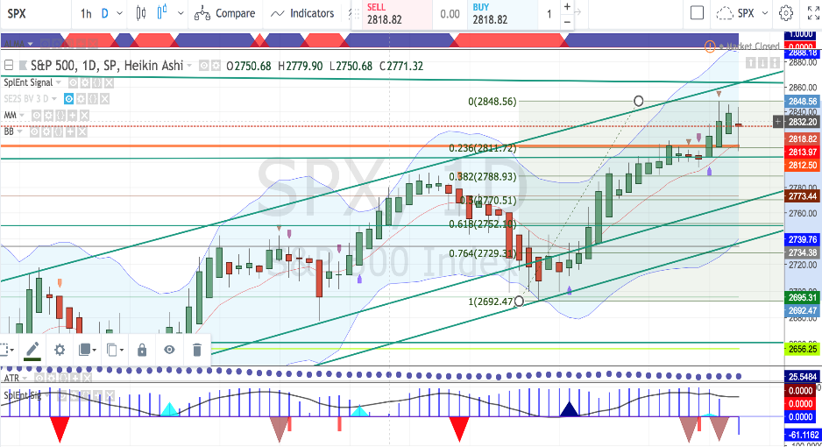
Market View
Jul 27th after the close
Tools:
ALMA, BB, Fibs and common
Graphical patterns (e.g. channels, pennants etc.)
? (AAPL)

Slide 15
Daily Routine
Check futures market for overnight gap
Economic News (… and tweets …)
Volatility Regime
If managed once a day (10 AM or 3 PM):
Stick to the rules (no specific market view)
Recommended for beginners or traders who have a day job
Trade / Adjust when market has settled
If managed twice a day (recommended):
10 AM and 3 PM

Slide 16
Can we adapt alert levels ?
Market Neutral = “Theta play” under the tent
Some traders may accept more volatile P&L or
Use more TA (e.g. support/resistance levels as shown on previous slide) to adjust delta limits and alerts.
Also note that indices follow the general mean reversion rule.
Optimal range : between the “horns”
Use common sense !
This comes with experience (alert service?)

Slide 17
End of Part 1
We have seen the following in Part 1:
The Rhino is a versatile hedged Put BWB
Applicable to RUT, SPX, ES as well as related trackers.
Managed by Greeks, assisted by a market view.
Simple Delta guidelines to keep T+0 to T+7 flat.
Scale-in by 56 DTE to add Theta to the trade.
Most usual upside adjustment: Call Calendars.
Recommended management: Twice a day.

Slide 18
Part 2: Trade Evolution
Digging deeper
A Rhino is a Rhino is a Rhino, or is it ?
Dynamics for the two major underlying symbols (RUT and SPX) are slightly different
SPX exhibits more skew than RUT, and more so on larger wing sizes.
Does one want to “trade the hedge” ?
A BWB strategy can be assisted by a good tent-widening technique, but how far are we prepared to go ?
Incorporating adjustments or even setups from “like-minded” strategies.
For instance RTT in its original format.

Slide 19
Rollback Risk
Cost ?
What if the market bounces (whipsaw) ?
IV Versus DTE | Young ( > 56DTE ) | Mid-Life ( 56-28 DTE) | Ageing ( < 28 DTE )
LOW | LOW-MEDIUM | MEDIUM | HIGH
MEDIUM | LOW | LOW-MEDIUM | HIGH
HIGH | VERY LOW | LOW | LOW-MEDIUM

Slide 20
Reminder: Rollover Risk
Rollover is not part of the Rhino rules
Pricing issues are still relevant (scaling in)
IV Versus DTE | Young ( > 56DTE ) | Mid-Life ( 56-28 DTE) | Ageing ( < 28 DTE )
LOW | MEDIUM | HIGH | VERY HIGH
MEDIUM | LOW | MEDIUM | HIGH
HIGH | VERY LOW | LOW | MEDIUM

Slide 21
Real Issues with Rolls
What is a normal IV level ?
Should we be more careful when IV < SV ?
Most traders seem to ignore this unusual situation
Don’t trust examples that only show the safer cases
If you apply a rollover / rollback rule only in « young » trades, there is a substantial chance you have the previous cycle still on and struggling !

Slide 22
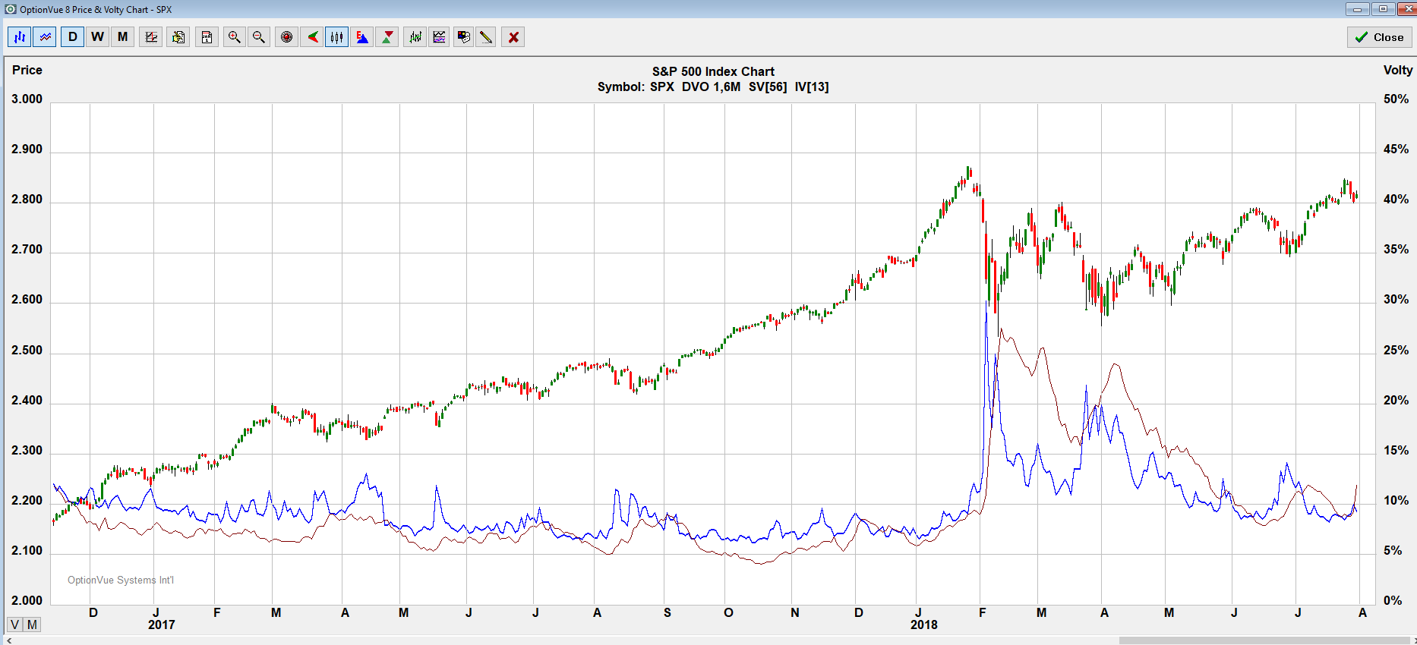
Volatility Environment
Many traders choose to ignore an environment where SV > IV. Should we really ?
The Rhino can gain from occasional Vega hedging with Put Calendars.

Slide 23
Recap: Delta Alerts
ALERTS
UPSIDE
Delta > -5 per BWB inside the tent
Delta > -4 per BWB outside the tent
DOWNSIDE
Delta < 25 irrespective of position size i.e.
5 or less per BWB
Warning when the lowest shorts are being passed
Same for RUT and SPX ?
In normal IV environments otherwise account for skew (SPX) hence reduce Delta alerts for SPX.

Slide 24
Adjusting after Take-Off (77-56DTE)
Depending on IV environment
Scale-In
By 56 DTE, and preferably not too early either
A down day is preferable
Move shorts up or down
If IV is very low, sometimes pull upper longs back (RH)
Close trade and reposition
The Rhino is naturally resilient on the downside (5 to 7%) so a good chance a rollback will be above breakeven point and sometimes nicely profitable.

Slide 25
At Cruising Altitude (56-35DTE)
Check Greeks
Market outlook (Daily Chart)
Alerts
Choice of adjustments (Calendars?)
Check IV Skew
Dissect your position
Analyse verticals’ behaviour: PCS and PDS
Particularly if/when entering BWB as verticals

Slide 26
Descent and Approach (35-21DTE)
Protect profit
Keep T+0 flat
Avoid overloading your position (Gamma may hit you)
Peel off
Release capital for next position (capital management)
Think out the box (dynamics are changing)
You may allow your trade to go more directional
Turn the trade into a RTT-style trade
Do as little as possible…

Slide 27
Differences from Brian’s Rhino
Let’s not spend hours debating this topic
A Rhino *IS* a Rhino
A Rhino is a great way to learn to trade Put BWBs.
I took over from Brian in 2016
Brian came back to the Rhino and most probably took from my presentations in the last couple of years.
In the end, you’ll trade *YOUR* Rhino !

Slide 28
Differences from Brian’s Rhino
Both (now) agree that the trade is meant to do well “in between the horns” (shorts or combo peaks)
Alerts may slightly differ
One can choose to trade the (upside) hedge
I generally don’t or moderately at best
In most cases when the hedge is also a BWB
Some traders are averse to horizontal spreads e.g. Calendars, in particular Call Calendars.
Stay in your comfort zone

Slide 29
Differences from Brian’s Rhino
The original (or say “standard”) Rhino:
Does not take any market view into consideration
Tries to be as mechanical as possible (… a myth …)
77DTE entries
Always the same position size
Does not explicitly look at the change in dynamics during the course of the trade
Does not propose a RTT mutation

Slide 30
Differences from Brian’s Rhino
I don’t:
We all have some market bias
We are humans, not machines !
And sometimes I can’t:
Tight capital when 3 cycles are overlapping particularly in low IV environments
As an aside, many of you are also familiar with my ongoing ranting against back-tests…

Slide 31
Differences from Brian’s Rhino
The Rhino trade is relatively simple yet
A simple trade is NEVER an excuse NOT
TO THINK
TO DO YOUR HOMEWORK
TO STAY WITHIN YOUR PLANNED CAPITAL
As mentioned earlier in the presentation:
Apply the discipline of a pro trader
This is not a hobby !

Slide 32
Mea Culpa, Reflections and Inspirations
Was (or is) a SPX 100/75 Rhino i.e. larger skew a good idea?
The RUT Rhino is probably the simplest one.
This has motivated the occasional RTT mutation or mix.
Should I also more systematically trade the upside hedge ?
Does an evolution to more generic BWB trading deter beginners to embark into a strategy nonetheless relatively simple ?
Capital Management has been critical in the last two years, hence why not introducing:
Layering
Bear Hedges.

Slide 33
Summary
Better general capital usage
A second batch of 5 additional BWB (for RUT) is always added (2 for 100/75 wing size, 3 for 80/60 on SPX)
More variations on both sides
Use of a market view
A bit more maintenance
Checking the market twice a day is recommended
Be realistic
Keep learning !
The smarter you trade, the simpler !

