Slide 1
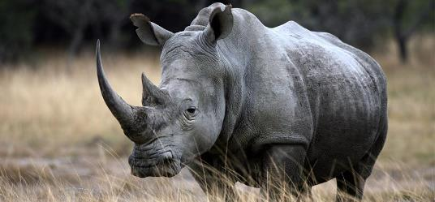
The Rhino Trade
African White Rhino
A conservatively hedged Broken Wing Butterfly
July 2018 Update

Slide 2
Disclaimer
1. SMB TRAINING is NOT a Broker Dealer. SMB Training engages in trader education and training. SMB TRAINING offers a number of products and services, both electronic (over the internet through smbtraining.com) and in person. SMB TRAINING also offers web-based, interactive training courses on demand.
2. The seminars given by SMB TRAINING are for educational purposes only. This information neither is, nor should be construed, as an offer, or a solicitation of an offer, to buy or sell securities. You shall be fully responsible for any investment decision you make, and such decisions will be based solely on your evaluation of your financial circumstances, investment objectives, risk tolerance, and liquidity needs.
3. This material is being provided to you for educational purposes only. No information presented constitutes a recommendation by SMB TRAINING or its affiliates to buy, sell or hold any security, financial product or instrument discussed therein or to engage in any specific investment strategy. The content neither is, nor should be construed as, an offer, or a solicitation of an offer, to buy, sell, or hold any securities. You are fully responsible for any investment decisions you make. Such decisions should be based solely on your evaluation of your financial circumstances. Such decisions should be based solely on your evaluation of your financial circumstances, investment objectives, risk tolerance and liquidity needs.
4. SMB Training and SMB Capital Management, LLC are separate but affiliated companies.
5. No relevant positions
6. Please note: Hypothetical computer simulated performance results are believed to be accurately presented. However, they are not guaranteed as to accuracy or completeness and are subject to change without any notice. Hypothetical or simulated performance results have certain inherent limitations. Unlike an actual performance record, simulated results do not represent actual trading. Since, also, the trades have not actually been executed; the results may have been under or over compensated for the impact, if any, of certain market factors such as liquidity, slippage and commissions. Simulated trading programs in general are also subject to the fact that they are designed with the benefit of hindsight. No representation is being made that any portfolio will, or is likely to achieve profits or losses similar to those shown. All investments and trades carry risks.

Slide 3

Me & My Trades
Long trading experience as a quant (pattern matching, AI) as well as trading various asset classes.
Any strategy is always a reflection of its designer’s then its user’s personality i.e. learn over time to make it your own. I live by that rule.
Rhino mentor for Aeromir

Slide 4
Credits… to yourself
Capital Discussions, now Aeromir and its great Trading Community
Brian Larson, the “Rhino” designer
Many great traders that have inspired me.
Master your own fate ! Avoid confusion listening to many experts, and in the end apply credits to yourself !

Slide 5
Acting for Rhino conservation
The Rhino has become a generic name for a new type of Butterfly trade. Let’s however remind ourselves of the plight of this beautiful creature
  Rhinos are poached for their horns, made of keratin like finger nails
  Yet, too many Asians are still deluded about fake aphrodisiac virtues…
Spread the word, donate, just do not stand and let Nature be destroyed by greed and ignorance
  http://www.limpopo-lipadi.org

Slide 6
Today’s Presentation
Short recap on the Rhino Trade
  Philosophy & Guidelines
  Trading Psychology, Rules and Market View
  Daily Management
Variations on the original Rhino
  Using a market view
  Adding branches to the decision tree
  Special cases e.g. low IV

Slide 7
So, what is a Rhino?
The Rhino is part of the large family of hedged butterflies e.g. M3, RTT, Kevlar etc.
  A BWB is a BWB is a BWB or is it really ?
It starts with a slightly OTM Put Broken Wing Butterfly (main “horn”)
And typically an upside hedge in the form of OTM Call Calendars (second “horn”)
  Some rather hedge the upside with a second Call BWB

Slide 8
What makes the Rhino different?
It is a conservative trade
  Capital preservation is paramount
It is a “flat Delta no Gamma” strategy.
  Alerts are lower than most other Bfly / BWB strategies
It is relatively easy to manage (this is of course a subjective matter)
  Timing not essential (hardly ever a need to adjust rapidly).

Slide 9
What makes the Rhino different?
The Rhino is versatile, relatively simple
One can start trading it using strict guidelines then
Grow into it, and start using a variety of setups of adjustments according to personality, lifestyle and risk profile
  “Everything under the sun” ?
The Rhino is one of the best foundation possible on BWB trading.

Slide 10
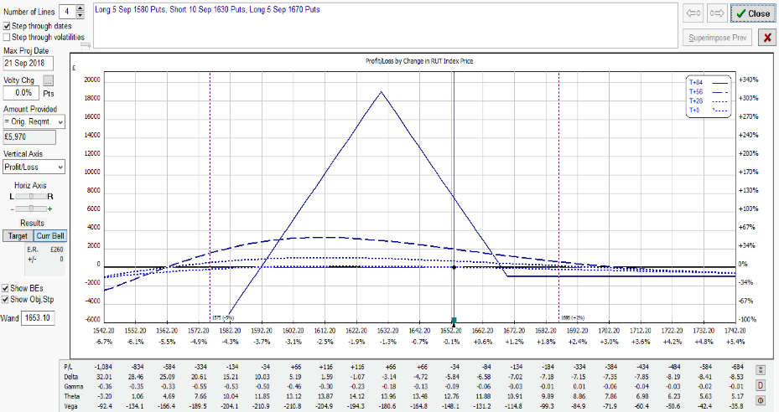
A typical RUT Entry
Please note that the prices and other statistics on this page are hypothetical, and do not reflect the impact, if any, of certain market factors such as liquidity, slippage and commissions.
TYPICAL RUT RHINO AT INCEPTION:
A FLAT T+0 LINE (84DTE)
5 RUT 50/40 Put BWB
(here 1580/1630/1670)
Good downside cover (5%)
Limited upside risk
IV Skew

Slide 11
RUT Rhino Entry
Five RUT 50/40 Put BWB
  Upper longs 1/2% to 1% above the money (ITM)
  Wider wings also possible (60/50 or 70/50)
Preferably 77 DTE for a calmer kick-off (flat T+0)
  This may engage capital early but one then slowly builds into the trade
  Can start 84-56 DTE or even later but a delta hedge is often necessary if late (e.g. Baby Rhino)
  A down day (Vol Pop) is always preferable

Slide 12
SPX Rhino Entry
Three SPX 80/60 or 100/75 or 75/50 PUT BWB
  Upper longs 0.5% to 1% above the money (ITM)
  Keep wing size ratio similar
  Same entry i.e. preferably around 77 DTE
  Same optimal conditions (Vol Pop)
Larger Wings = Larger Skew
  More resilient on the downside
  More work on the upside

Slide 13
Scaling In
Add 5 Put 50/40 BWB (for the RUT)
  Original guidelines
    When the underlying leaves the tent (~10-15 points past the upper longs)
    20 points (i.e. ±1%) above the initial ones
      Inside the tent ?
  New guidelines: more efficient use of capital
    Add Theta to the trade by 56 DTE or 2-3 weeks after entry
    Up or down, and again preferably on a down day.
    Scaling-in is also an opportunity to keep Delta flatter

Slide 14
Reminder: Trade Philosophy
A BWB is a BWB is a BWB, or is it really ?
  The Rhino is safe in most environments
  The Rhino can be expanded into generic BWB trading
Prevailing Rules
  Capital Preservation
  Flat Delta, low Gamma
  Same wing size ratio for all underlying symbols
  Easy management (yet, not quite mechanical ! )
Trade like a pro i.e. discipline (daily routine etc.)

Slide 15
Typical Adjustments
Cut negative Delta by half: buy OTM Call calendar spreads, selling put verticals or condors, additional small Put BWB
  Delta Limit: -5 per BWB
  After 35-28DTE, calendars are often substituted for Call BWB to mitigate upside risk and flatten T+0 line, or be taken off (RTT mutation).
Cut positive delta by half: first remove upside combos, scaling back to original entry setup, scaling in or rolling back lower:
  Delta Limit: +25 irrespective of position size i.e. 5 per BWB or less

Slide 16
Rhino Exit Rules
Planned Capital = $25,000 (without allowance for overlap) otherwise $37,500
  A position generally is closed before the next one is fully scaled in, yet not always in low IV environments.
Profit Targets
  • > 35 DTE : $2500 (10% on PC)
  • 28 - 35 DTE : $2000 (8% on PC)
  • 21 - 27 DTE : $1500 (6% on PC)
  • < 21 DTE : $1000 (4% on PC)
  Then for the brave, when Gamma starts kicking in…
Loss Control
  Exit on 10% loss (or less)

Slide 17
Trading Psychology
Knowledge: Learn the Greeks, aim for the flattest possible T+0 line, and try and project T+7 and further with OV/ONE
Self-Confidence: Keep the trade as simple as possible, adapt the trade to your lifestyle (or vice versa !), have reasonable goals.
Market View: Technically not necessary but really useful. Have as much a bias as a contingency plan.

Slide 18
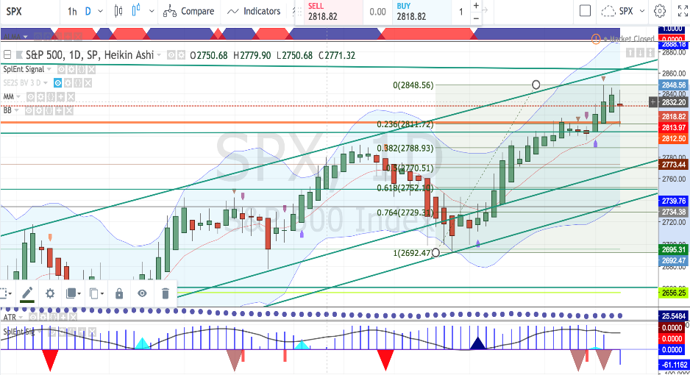
Market View
Jul 27th after the close
Tools:
ALMA, BB, Fibs and common
Graphical patterns (e.g. channels, pennants etc.)
?
(AAPL)

Slide 19
Daily Routine
  Check futures market for overnight gap
  Economic News (… and tweets …)
  Volatility Regime
  If managed once a day (10 AM or 3 PM):
  Stick to the rules (no specific market view)
  Recommended for beginners or traders who have a day job
  Trade / Adjust when market has settled
If managed twice a day (recommended):
  10 AM and 3 PM

Slide 20
Can we adapt alert levels ?
Market Neutral = “Theta play” under the tent
  Some traders may accept more volatile P&L or
  Use more TA (e.g. support/resistance levels as shown on previous slide) to adjust delta limits and alerts.
  Also note that indices follow the general mean reversion rule.
Optimal range : between the “horns”
Use common sense !
  This comes with experience (alert service?)

Slide 21
End of Part 1
We have seen the following in Part 1:
  The Rhino is a versatile hedged Put BWB
    Applicable to RUT, SPX, ES as well as related trackers.
  Managed by Greeks, assisted by a market view.
  Simple Delta guidelines to keep T+0 to T+7 flat.
  Scale-in by 56 DTE to add Theta to the trade.
  Most usual upside adjustment: Call Calendars.
  Recommended management: Twice a day.

Slide 22
Part 2: Trade Evolution
  A Rhino is a Rhino is a Rhino, or is it ?
  Dynamics for the two major underlying symbols (RUT and SPX) are slightly different
    SPX exhibits more skew than RUT, and more so on larger wing sizes.
  Does one want to “trade the hedge” ?
    A BWB strategy can be assisted by a good tent-widening technique, but how far are we prepared to go ?
  Incorporating adjustments or even setups from “like-minded” strategies.
    For instance RTT in its original format.

Slide 23
Rollback Risk
Cost ?
What if the market bounces (whipsaw) ?
IV Versus DTE | Young ( > 56DTE ) | Mid-Life ( 56-28 DTE) | Ageing ( < 28 DTE )
LOW | LOW-MEDIUM | MEDIUM | HIGH
MEDIUM | LOW | LOW-MEDIUM | HIGH
HIGH | VERY LOW | LOW | LOW-MEDIUM

Slide 24
Reminder: Rollover Risk
Rollover is not part of the Rhino rules
However pricing issues are still relevant (scaling in)
IV Versus DTE | Young ( > 56DTE ) | Mid-Life ( 56-28 DTE) | Ageing ( < 28 DTE )
LOW | MEDIUM | HIGH | VERY HIGH
MEDIUM | LOW | MEDIUM | HIGH
HIGH | VERY LOW | LOW | MEDIUM

Slide 25
Real Issues with Rolls
What is a normal IV level ?
Should we be more careful when IV < SV ?
  Most traders seem to ignore this unusual situation
Don’t trust examples that only show the safer cases
  If you apply a rollover / rollback rule only in « young » trades, there is a substantial chance you have the previous cycle still on !

Slide 26
Recap: Delta Alerts
  ALERTS
    UPSIDE
      Delta > -5 per BWB inside the tent
      Delta > -4 per BWB outside the tent
    DOWNSIDE
      Delta < 25 irrespective of position size i.e.
        5 or less per BWB
      Warning when the lowest shorts are being passed
    Same for RUT and SPX ?
      In normal IV environments otherwise account for skew (SPX) hence reduce Delta alerts for SPX.

Slide 27
Adjusting after Take-Off (77-56DTE)
Depending on IV environment
  Scale-In
    By 56 DTE, and preferably not too early either
    A down day is preferable
  Move shorts up or down
    If IV is very low, sometimes pull upper longs back (RH)
  Close trade and reposition

Slide 28
At Cruising Altitude (56-35DTE)
Check Greeks
  Market outlook
  Alerts
  Choice of adjustments (Calendars?)
Check IV Skew
Dissect your position
  Analyse verticals’ behaviour: PCS and PDS
    Particularly if/when entering BWB as verticals

Slide 29
Descent and Approach
(35-21DTE)
Protect profit
  Keep T+0 flat
    Avoid overloading your position (Gamma may hit you)
  Peel off
  Release capital for next position (capital management)
  Think out the box (dynamics are changing)
    You may allow your trade to go directional
    Turn the trade into a RTT-style trade
  Do as little as possible…

Slide 30
Differences from Brian’s Rhino
Upside adjustments
  In low IV environments, margin requirements are higher and profits take longer to reach their target
  Chasing the market may cost / immobilise a substantial amount.
    In a runaway or grinding market: RH upper puts
    Roll shorts or sometimes bear spreads (PDS) up
    Sometimes diagonalise but avoid adding more calendars further up
  However beware of whipsaws

Slide 31
Differences from Brian’s Rhino
Upside adjustments
  Check Call Calendars’ ability to hedge Delta - Vega (horizontal skew)
    Also consider diagonals, but avoid double calendars
    Keep in mind the weighted Vega effect
  RH upper long puts (e.g. Sep Rhino) or
  Add an unbalanced Put or Iron condor (check Reg. T margin)
  Don’t let the market go passed your second horn.

Slide 32
Differences on the original Rhino
Downside adjustments
  Scaling in to full position is often the first adjustment
    Either up or down
  Start rolling a few shorts down when passing them
    Unless IV skew is strong enough to provide sufficient negative Delta i.e. good Delta-Vega compensation
  Roll back Put Bull Spreads
    More often than entire BWB (easier too)
    Never let the RUT pass your lowest shorts.
  Beware of whipsaws (e.g. Brexit…)
    IV Skew can backfire on you…

Slide 33
Other variations on the Rhino
There are many many other BWB variations, often quite interesting to take cues from:
  Different DTE entries
    Some trade it from 35 DTE or later
    Weekly (Baby Rhino)
  Possible re-entries on smaller profit target
  No Vega hedge (single horn)
Example: White Rhino (Call Butterfly + optional repo)
Some also add Call Vertical Spreads

Slide 34
Differences on the original Rhino
Summary
  Better capital usage
    A second batch of 5 additional BWB (for RUT) is always added (2 for SPX)
  More variations on both sides
  Use of a market view
  A bit more maintenance
    Two market checks a day
  Two levels of understanding
    Trading the plan or
    Taking IV and IV Skew into consideration

Slide 35
Conclusion
Let’s remind ourselves of what a Rhino is made of:
  All BWB combos make money with the PCS side
  The Call Calendar Hedge is there to mitigate loss on the Put Debit Spread
    Don’t be afraid of Calendars…
  Check position profile based on analysis of the 3 basic components: PCS + PDS + Hedge
  More advanced traders look at IV Skew
Look at additional bear hedges such as STT (Ron Bertino)

