Slide 1
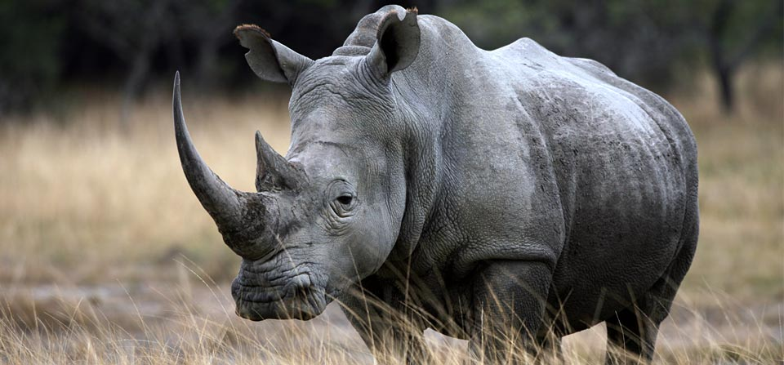
The Rhino Trade
African White Rhino
A conservatively hedged Broken Wing Butterfly
April 2017

Slide 2

Me & My Trades
Long trading experience as a quant as well as trading various asset classes. Still working on automated trading systems on the side.
Any strategy is always a reflection of its designer’s then its user’s personality i.e. learn over time to make it your own. I live by that rule.
Providing the Rhino alert service since July 2016

Slide 3
Acting for Rhino conservation
The Rhino has become a generic name for a new type of Butterfly trade. Let’s however remind ourselves of the plight of this beautiful creature
Rhinos are poached for their horns, made of keratin like finger nails
Yet, too many Asians are still deluded about fake aphrodisiac virtues…
Spread the word, donate, just do not stand and let Nature be destroyed by greed and ignorance
http://www.limpopo-lipadi.org

Slide 4
Today’s Presentation
Recap on the Rhino Trade
Guidelines
Trading Psychology, Rules and Market View
Daily Management
Variations on the original Rhino
Using a market view
Adding branches to the decision tree
Special cases e.g. low IV
The Baby Rhino (time permitting)

Slide 5
So, what is a Rhino?
The Rhino is part of the large family of hedged butterflies e.g. M3, RTT etc.
It starts with a slightly OTM Put Broken Wing Butterfly (main “horn”)
Most often complemented with OTM Call Calendars (second “horn”)
Some rather hedge the upside with a second Call BWB
Ref: Brian Larson on YouTube and Options Tribe

Slide 6
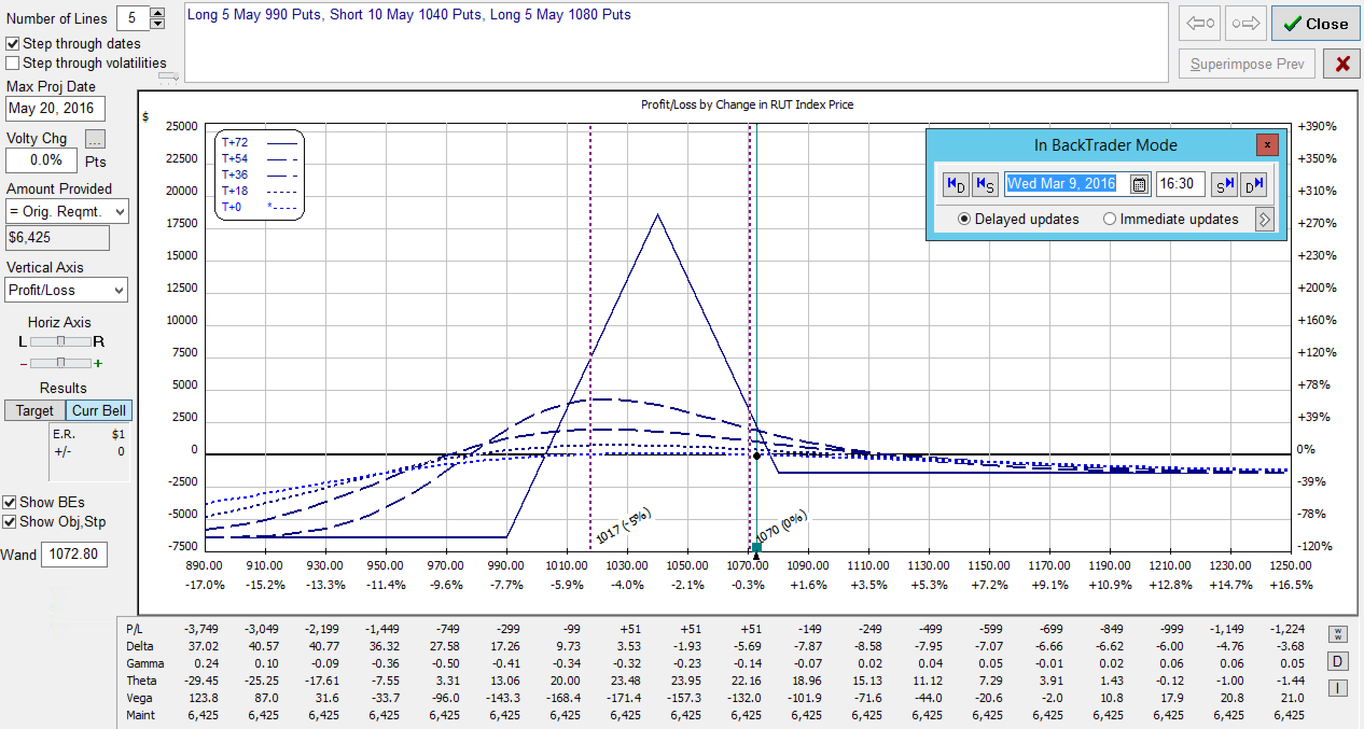
A First Look at the main Horn
TYPICAL RUT RHINO AT INCEPTION: A FLAT T+O LINE
5 RUT 50/40 Put BWB
(here 1090/1140/1180)
Good downside cover
Limited upside risk
IV Skew

Slide 7
RUT Rhino Entry
Five RUT 50/40 Put BWB
Upper longs 10-15 points above the money
Iron Butterflies also possible (IV skew)
Wider wings also possible (60/50 or 70/50)
Preferably 77 DTE for a calmer kick-off (flat T+0)
This may engage capital early but one then slowly builds into the trade
Can start 84-56 DTE but hedge often necessary if late
A down day is always preferable (IV pop)

Slide 8
SPX Rhino Entry
Three SPX 80/60 PUT BWB
Upper longs 10-20 points above the money
Iron Butterflies also possible (IV skew)
Wider wings also possible (100/75)
Same entry i.e. preferably around 77 DTE
SPX flies have Generally fared better in the last 18 months

Slide 9
Scaling In (RUT)
Add 5 Put 50/40 BWB (for the RUT)
Original guidelines
When the underlying leaves the tent (~10-15 points past the upper longs)
20 points (sometimes even 30) above the initial ones
Updated guidelines: more efficient use of capital
Add Theta to the trade by scaling in by 56 DTE or 2-3 weeks after entry
Up or down, and again preferably on a down day.

Slide 10
Scaling In (SPX)
Add 2 or 3 Put BWB
Original guidelines
When the underlying leaves the tent (~25 points past the upper longs)
50 points above the initial ones
Updated guidelines: more efficient use of capital
Add Theta to the trade by scaling in by 56 DTE or 2-3 weeks after entry
Up or down, and again preferably on a down day.

Slide 11
IV Considerations & generalities
Initial skew i.e. Flat T+0 determines the initial setup
Low IV environment means:
Earlier entries
More chances of overlaps across cycles
Mid IV: The ideal Rhino’s PLAY ground
High IV: Consider wider wings + hedges

Slide 12
Typical Adjustments
Reduce negative delta by buying OTM call calendar spreads, selling put verticals, or selling put condors
Delta Limit: -25 half position (-50 full & inside tent)
Late in the trade, if price is threatening to move through calendars, can switch from calendars to a call broken-wing butterfly to mitigate upside risk and flatten T+0 line, or RH (see variations later)
Reduce positive delta by removing calendars, rolling back put butterflies, OR removing upper put butterflies if fully scaled in
Delta Limit: +25

Slide 13
Rhino Profit / exit Guidelines
Planned Capital = $25,000 (without allowance for overlap) otherwise $37,500
Generally a position is closed prior to the next one is fully scaled in.
Profit Targets
> 35 DTE : $2500 (10% on PC)
28 - 35 DTE : $2000 (8% on PC)
21 - 27 DTE : $1500 (6% on PC)
< 21 DTE : $1000 (4% on PC)
Then for the brave, hang in there until Gamma gets bad…
(EXTENDED TRADE NOW OFFERED IN CD RHINO ALERTS)

Slide 14
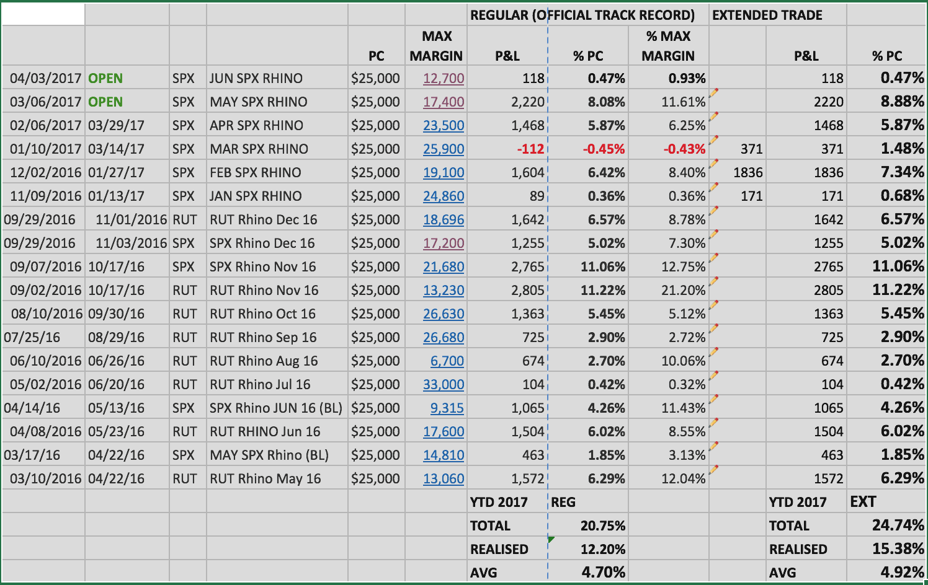
TRACK RECORD

Slide 15
Trading Psychology
Knowledge: Learn the Greeks, aim for the flattest possible T+0 line, and try and project T+7 and further with OV/ONE
Self-Confidence: Keep the trade as simple as possible, adapt the trade to your lifestyle (or vice versa), have reasonable goals.
Market View: Not necessary but useful. Have as much a bias as a contingency plan.

Slide 16
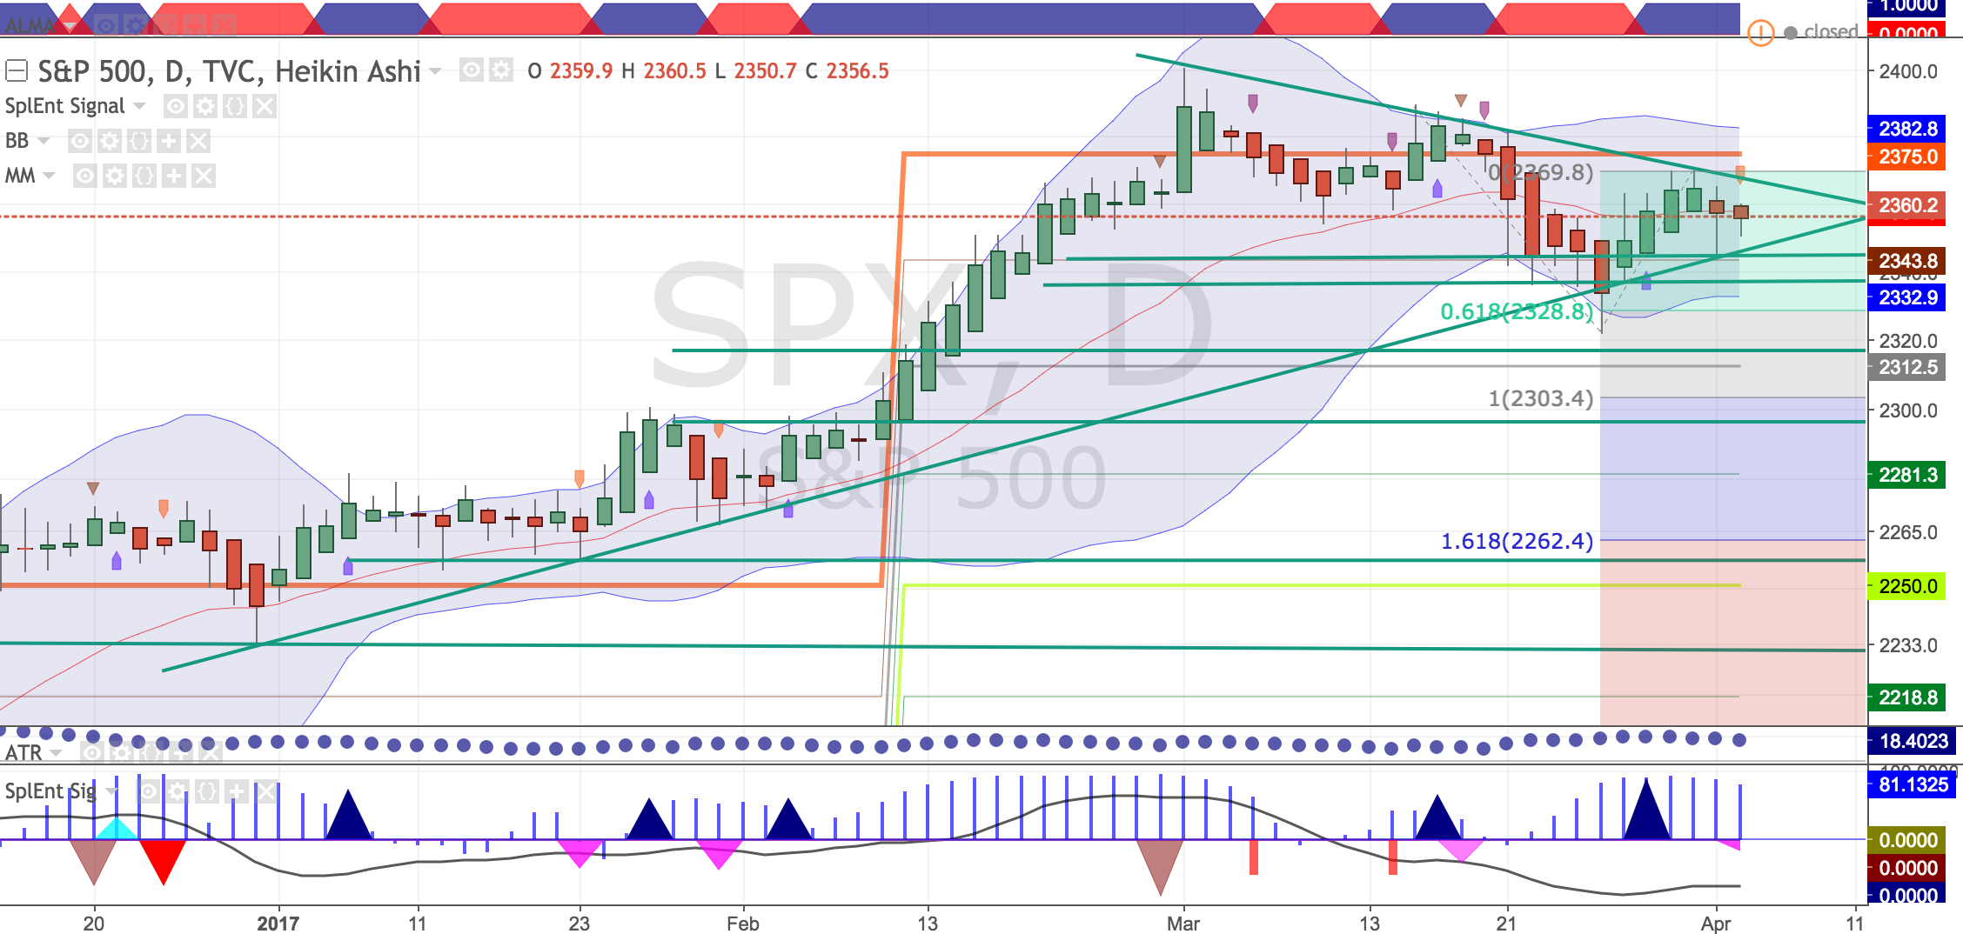
Market View
Teusday Apr 4th at the close
https://goo.gl/GPcuqr)
Tools:
ALMA, BB, Fibs and common
Graphical patterns (e.g. channels)

Slide 17
Daily Routine
If managed once a day (10 AM or 2 PM):
Stick to the rules (no specific market view)
Recommended for beginners or traders who have a day job
Trade / Adjust when market has settled
Fills are easier near the close of the day
If managed twice a day (recommended):
10 AM and 2 PM
All day ? Careful not to over-trade!

Slide 18
Differences on the original Rhino
Upside adjustments
In low IV environments, margin is higher and profits take longer to reach their target
Chasing the market may cost / immobilise a substantial amount.
RH upper puts when possible
Roll shorts or bear spreads (PDS) up
Avoid rolling Calendar hedges unless IV is rock-bottom low
However beware of whipsaws (calendars more forgiving)

Slide 19
Differences on the original Rhino
Downside adjustments
Start rolling a few shorts down when passing them
Unless IV skew is strong enough to provide sufficient negative Delta i.e. good Delta-Vega compensation
Roll back Put Bull Spreads
More often than entire BWB (easier too)
Scale-in on the way down as well
RH lower longs
Particularly to lock profits in.
Beware of whipsaws (e.g. Brexit…)
IV Skew can backfire on you…

Slide 20
Differences on the original Rhino
Upside adjustments
Check Calendars’ ability to hedge Delta - Vega (horizontal skew)
Also consider diagonals
Keep in mind weighted Vega effect
RH upper long puts (e.g. Sep Rhino) or
Add an unbalanced Put condor
Don’t let the market go passed your second horn.

Slide 21
Differences on the original Rhino
Summary
Better capital usage
A second batch of 5 additional BWB is always added
More variations on both sides
A bit more maintenance
Two market checks a day
Two levels of understanding
Trading the plan or
Taking IV and IV Skew into consideration

Slide 22
Conclusion
Let’s remind ourselves of what a Rhino is made of:
All BWB combos make money with the PCS side
The Calendar Hedge is there to mitigate loss on the Put Debit Spread
Don’t be afraid of Calendars…
Check position profile based on analysis of the 3 basic components: PCS + PDS + Hedge
More advanced traders look at IV Skew
Look at additional bear hedges such as STT (Ron Bertino)

Slide 23
Appendix: The Baby Rhino
Weekly variation of the “Big Daddy” Rhino
Essentially a Theta game i.e. neutralising other Greeks
Entry = 14 DTE, Exit = 7 DTE i.e. no planned overlap
Occasionally, leave it to 4-3 DTE
Planned Capital: $10K per tranche
More flexibility though on multiple tranches
Overlap is generally possible

Slide 24
The Baby Rhino Setup
Underlying: RUT (SPX should work just as well)
40/30 Rhino-like Put BWB (3)
Upper long Puts slightly above the money
Can also use a “regular” Rhino 50/40 BWB (higher margin)
Or any other unbalanced fly for that matter
Call Calendar hedge (max 3)
~ 10 - 20 points above the money

Slide 25
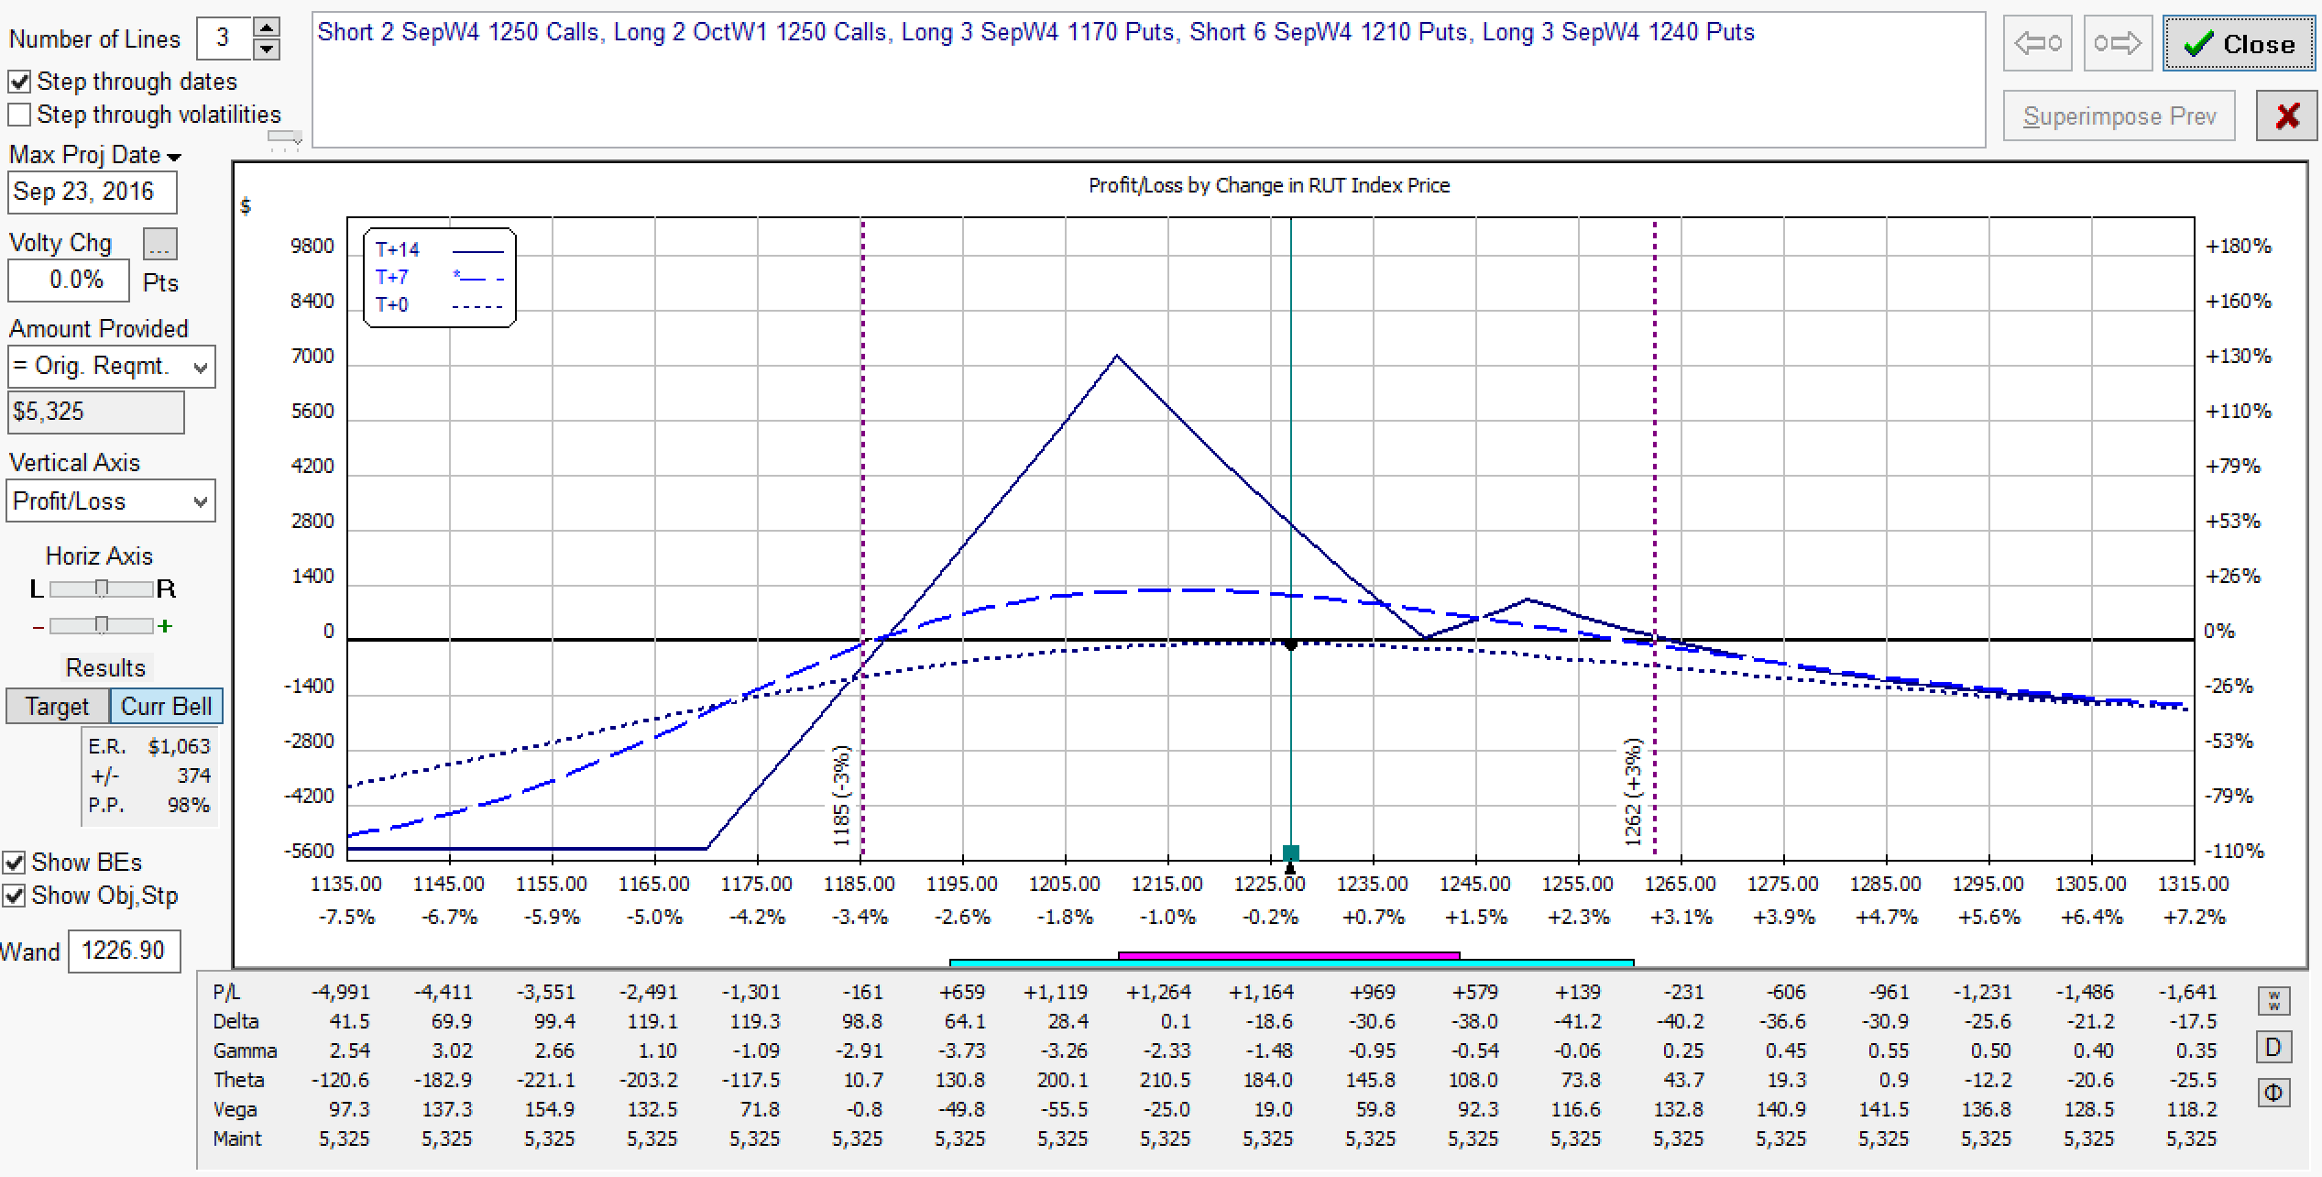
Baby Rhino
Flat T+0 & T+7 lines
Delta & Vega neutralised
5% Profit Target
Good Profit Range
Greeks still looking good on T+7 !

Slide 26
The Baby Rhino Setup
Loose or say “flexible” guidelines, sometimes allowing evolution into weird shapes but:
D / T < 20 - 25%
V / T < 50% (max 100%)
A little more sensitive to a given market view (30mins chart)
Sometimes a bit more difficult to trade for beginners
Peeling can however often be done while keeping Greeks in balance

Slide 27
Baby Rhino Performance
At least 75% success rate
+/- 10% depending on execution quality
Average weekly gain : 2-3 %
Usual profit target: 5%
Usual stop loss: 5% (I don’t use fixed stop losses)
Major risk: weekend large gap down

Slide 28
ADDITIONAL SLIDES

Slide 29
Can we ignore limits / alerts?
Market Neutral = “Theta play” under the tent
Some accept more/less volatile P&L or
Use more TA (e.g. support/resistances) to adjust delta limits and alerts or
Adjust delta alerts according to trade shape after adjustments
Also note that indices follow the general mean reversion rule
Example: using price alerts e.g. 1SD to review position otherwise leave it alone…

Slide 30
Variations on the original Rhino
There are many many BWB variations, often quite interesting to take cues from:
Different DTE entries
Possible re-entries on smaller profit target
No Vega hedge

Slide 31
Can we ignore limits / alerts?
Market Neutral = “Theta play” under the tent
Some accept more/less volatile P&L or
Use more TA (e.g. support/resistances) to adjust delta limits and alerts or
Adjust delta alerts according to trade shape after adjustments
Also note that indices follow the general mean reversion rule
Example: using price alerts e.g. 1SD to review position otherwise leave it alone…

