Slide 1
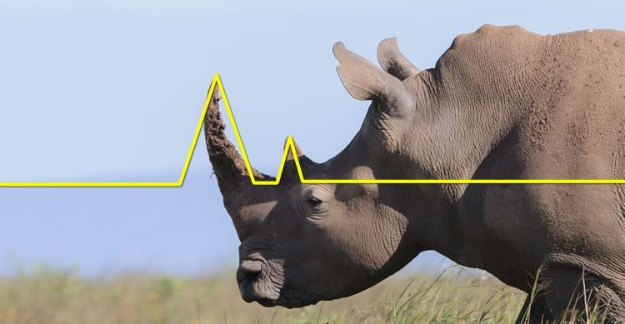
The Rhino Trade
Bruno Voisin
September, 2016
The Classic Setup from Brian Larson Original Rhino Designer

Slide 2
Trade Intent
Priority #1 – Preserve Capital
Rhino trade is extremely robust against both up and down moves
Delta-neutral, low-gamma trade
Usually exit >21 DTE
Priority #2 – Easy to Manage
Only monitor once/twice per day
Timing of adjustments not critical
Priority #3 – Profits
Profit Target = 10% ROC
Averages 5-6% ROC per trade
Can safely overlap two monthly trades

Slide 3
Trade Design
Utilizes a combination of 3 spreads:
Put broken-wing butterflies (main structure)
Call calendars (upside hedge)
Call broken-wing butterflies (upside hedge)
Trade on RUT or SPX
Enter 56-84 DTE (pref. 77 DTE)
Market dictates which adjustments are made and when to make them
Has delta guidelines, but shape of P&L curve and trader risk tolerance is more important
Exit before gamma gets “hard to handle”

Slide 4
Trade Guidelines
Planned Capital = $25,000
Profit Targets
>35 DTE: $2500 (10%)
28-35 DTE: $2000 (8%)
21-27 DTE: $1500 (6%)
<21 DTE: $1000 (4%)
RUT – 77 Days to Expiration (flexible)
Start with (5) 40/50 put broken-wing butterflies with upper long strike 5-15 points ITM
Add (5) more butterflies if price >10 points above long strike

Slide 5
Trade Guidelines (Continued)
Reduce negative delta by buying OTM call calendar spreads, selling put verticals, or selling put condors
Delta Limit: -25 half position (-50 full & inside tent)
Late in trade, if price is threatening to move through calendars, can switch from calendars to a call broken-wing butterfly to mitigate upside risk and flatten T+0 line
Reduce positive delta by removing calendars, rolling back put butterflies, OR removing upper put butterflies if fully scaled in
Delta Limit: +25

Slide 6
Trade Examples
Significant Down Move
November 2014
Significant Up Move
April 2015
Whipsaw
November 2015
Appendix – “The Big Crash”
November 2008

Slide 7
Significant Down Move
November 2014
Days in Trade = 53
Profit = 7.3%

Slide 8
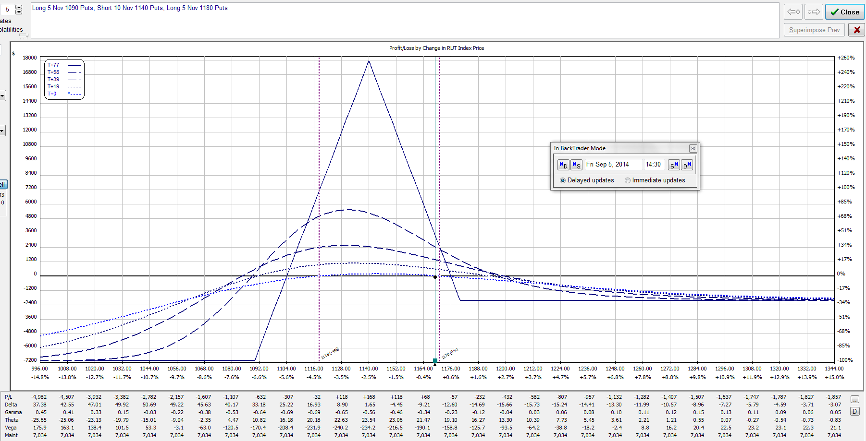
September 5, 2014 – RUT = 1169.0
Bought (5) 1180/1140/1090 put BWB’s
Delta = -11

Slide 9
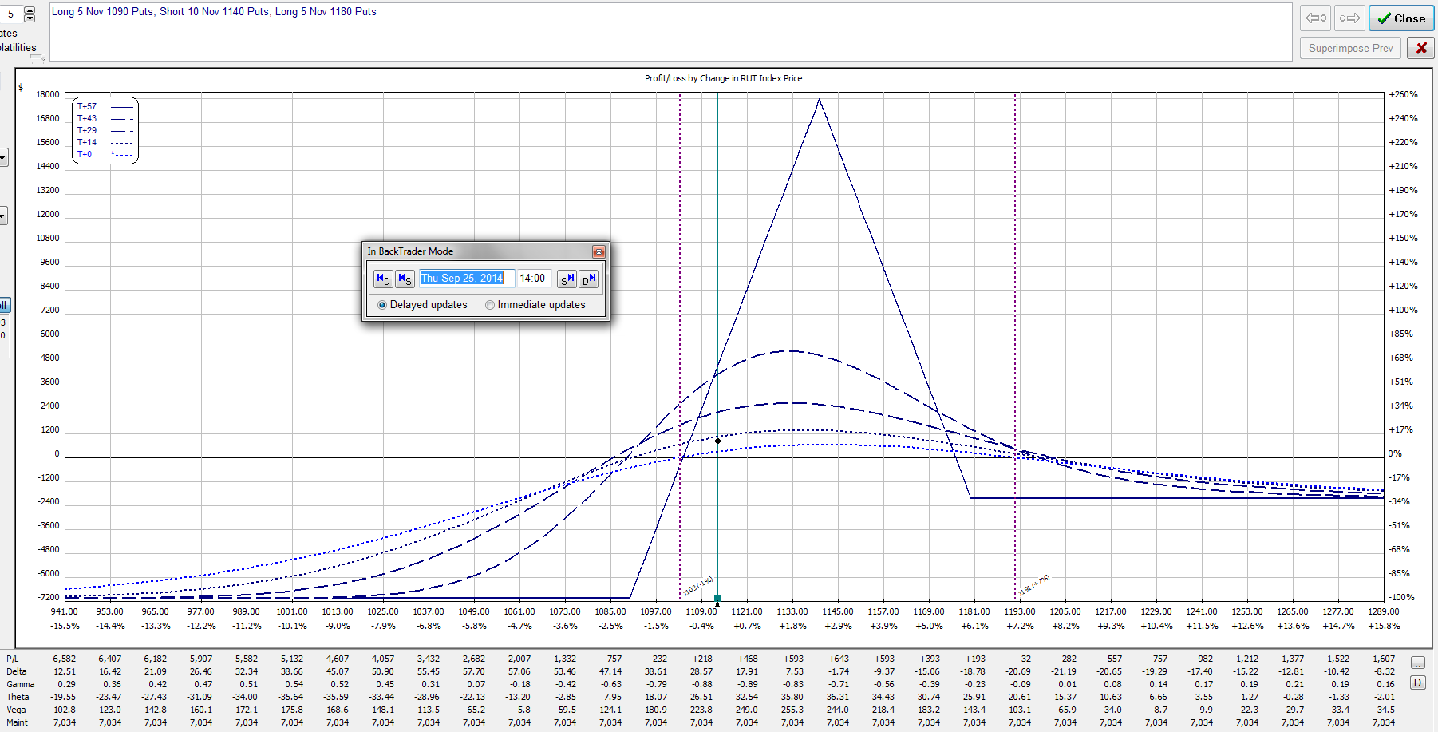
September 25, 2014 – RUT = 1111.5
Delta = +25
Time to roll the butterflies back ALERT WHEN PASSING SHORTS / DELTA POSITIVE ALWAYS ROLL BACK / RESET WHEN DTE > 56

Slide 10
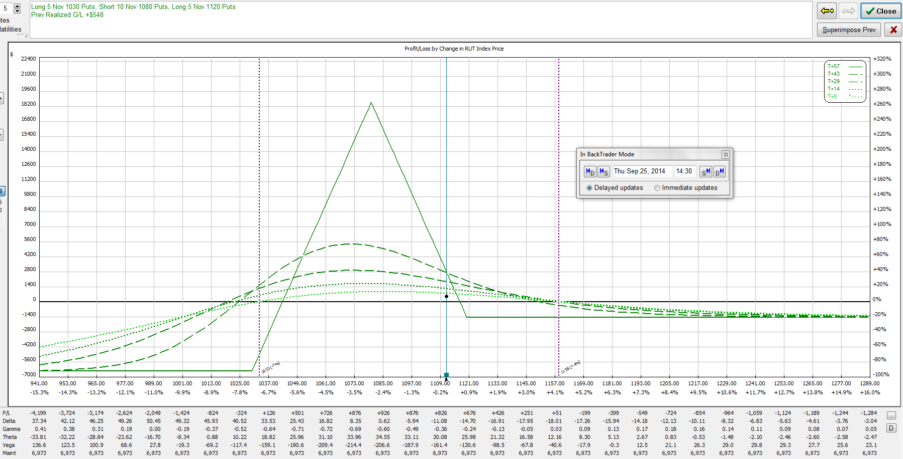
September 25, 2014 – RUT = 1111.5
Sold (5) 1180/1140/1090 Put BWB’s
Bought (5) 1120/1080/1030 Put BWB’s
Delta = -12

Slide 11
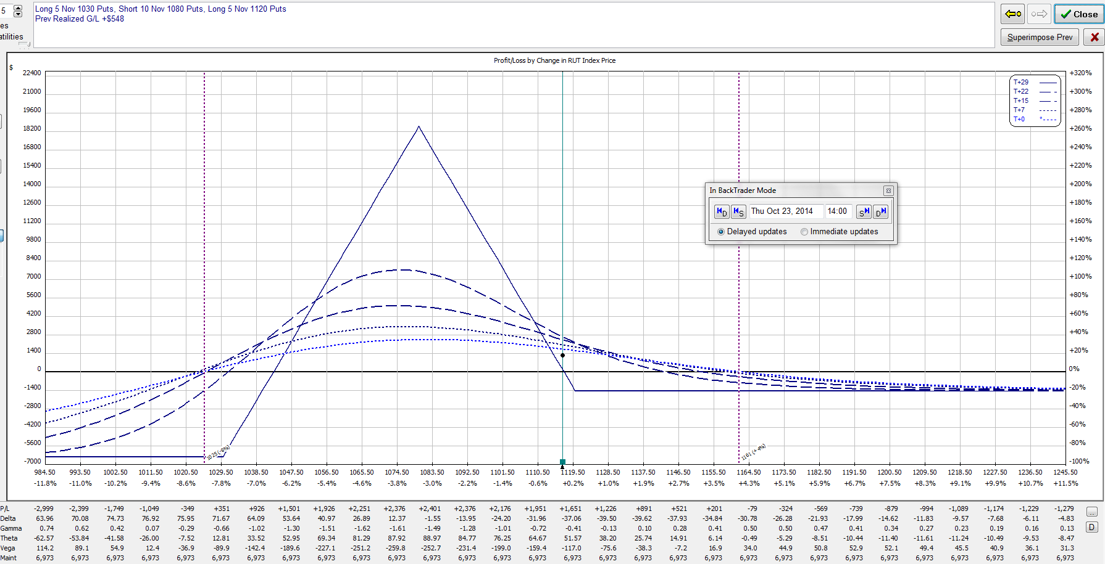
October 23, 2014 – RUT = 1115.4
Delta = -36
Time to add call calendars to reduce negative delta CALENDAR HEDGE PREFERABLE WHEN POSITION IS AT CRUISING ALTITUDE

Slide 12
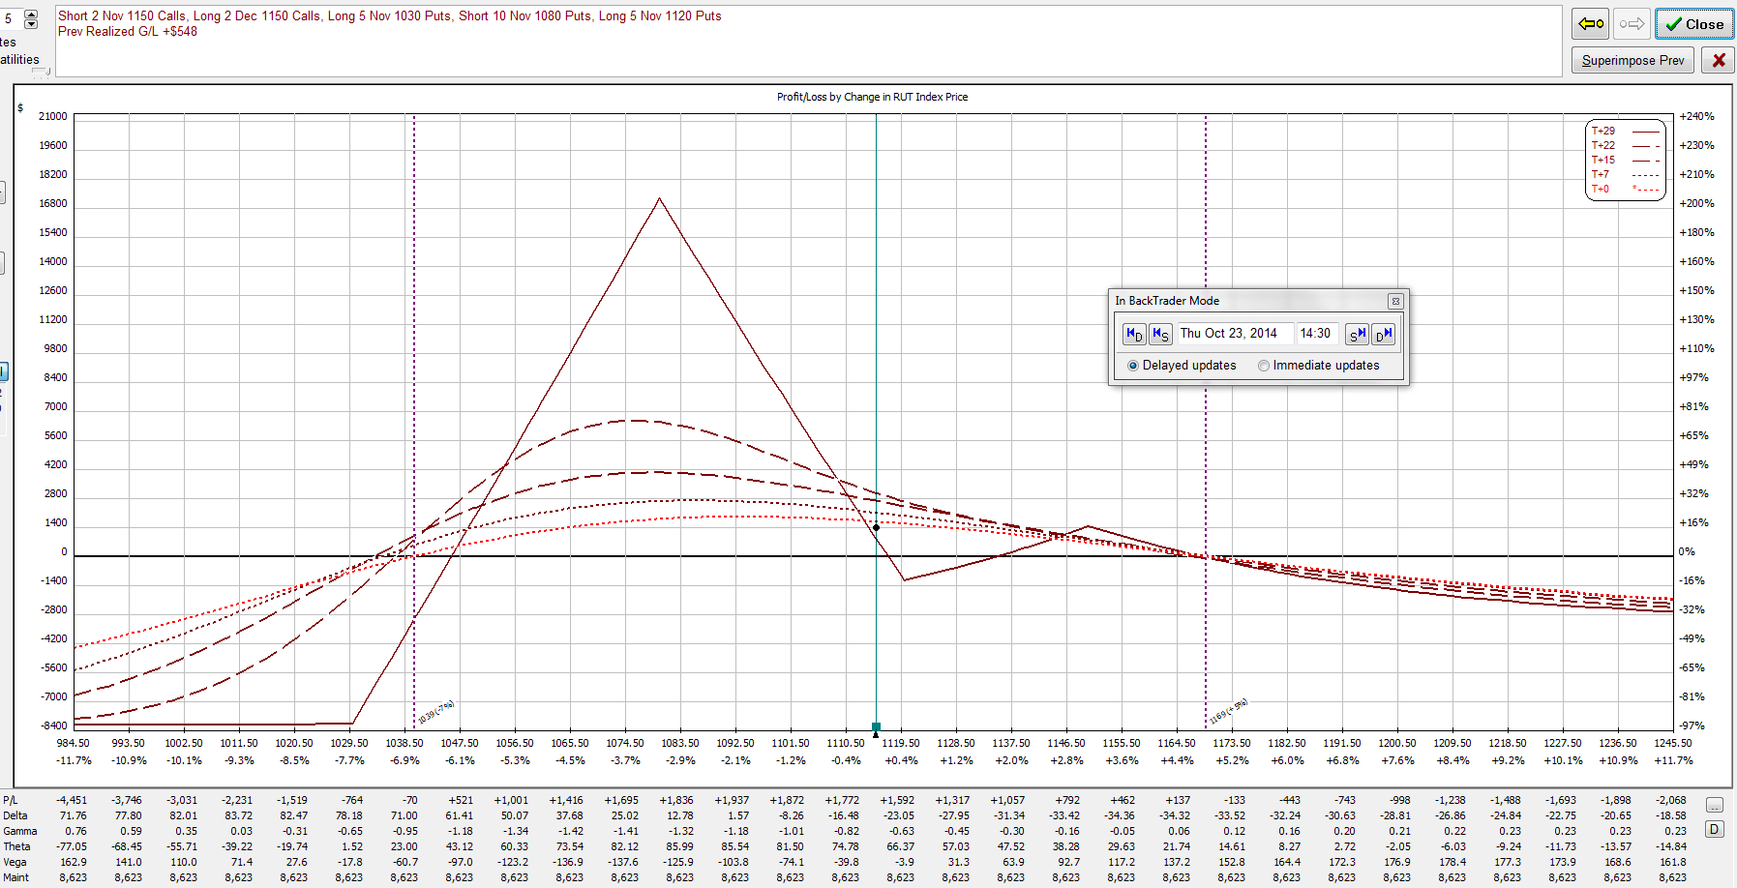
October 23, 2014 – RUT = 1115.4
Bought (2) NOV/DEC 1150 call calendars
Delta = -20

Slide 13
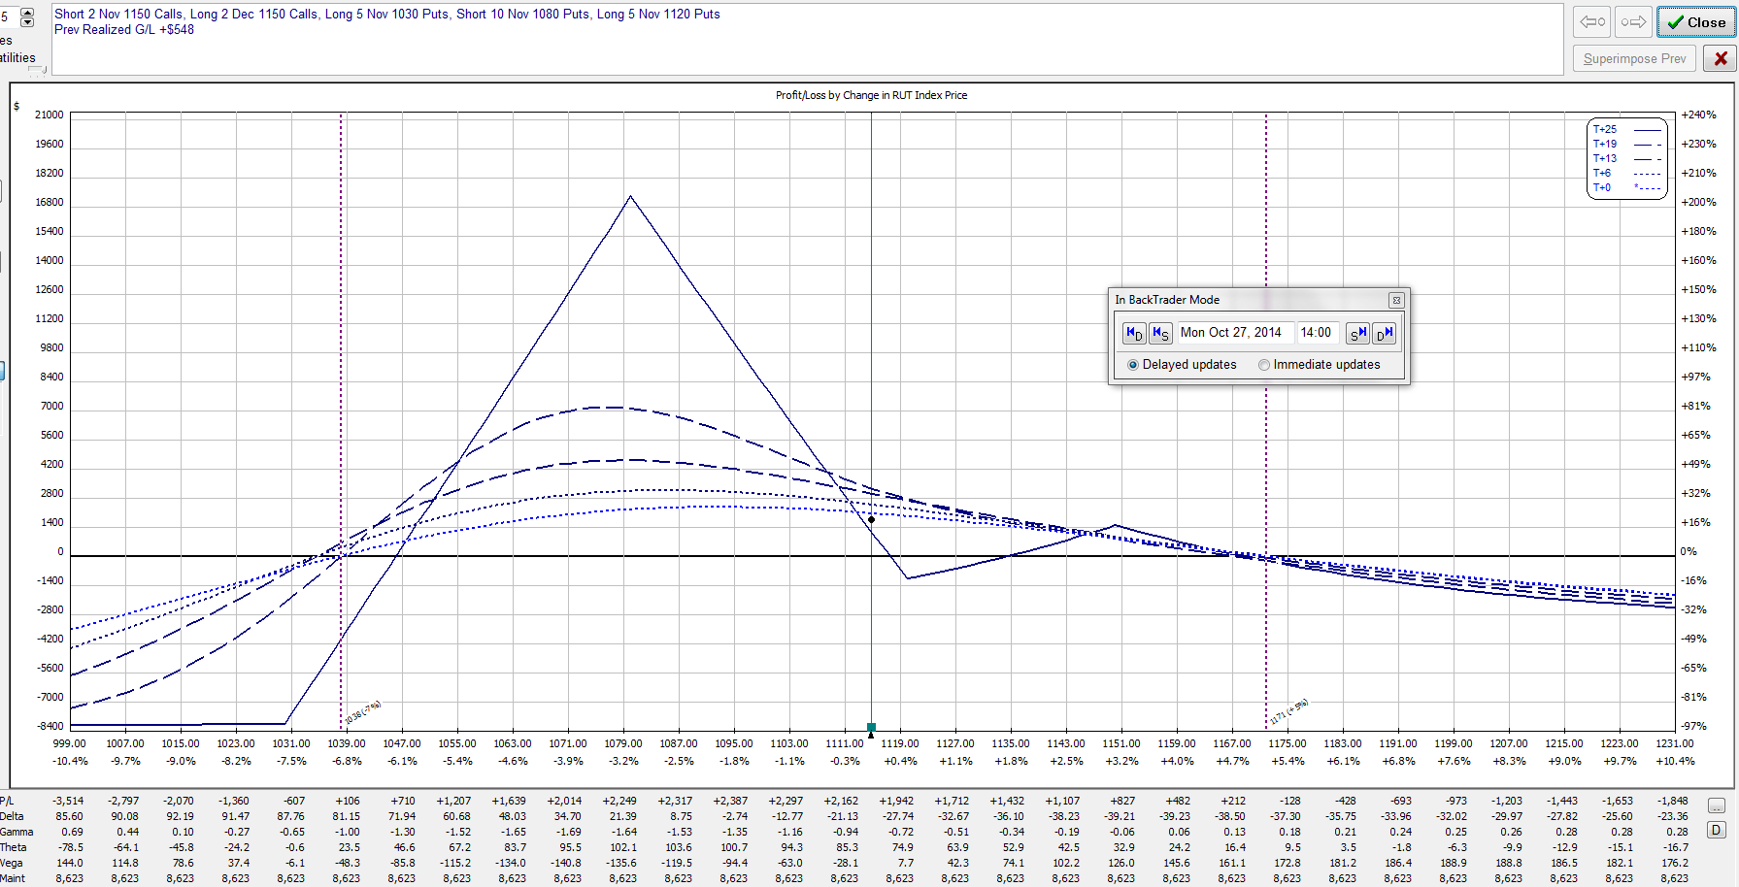
October 27, 2014 – RUT = 1115.3
Reduced profit target achieved with 25 DTE
Closed entire position for a profit of $1822 (7.3%) in 52 days
RUT was 1169.0 when trade was opened.
Life of trade: High = 1174.2, Low = 1040.5, Range = 133.7

Slide 14
Significant Up Move
April 2015
Days in Trade = 54
Profit = 6.5%

Slide 15
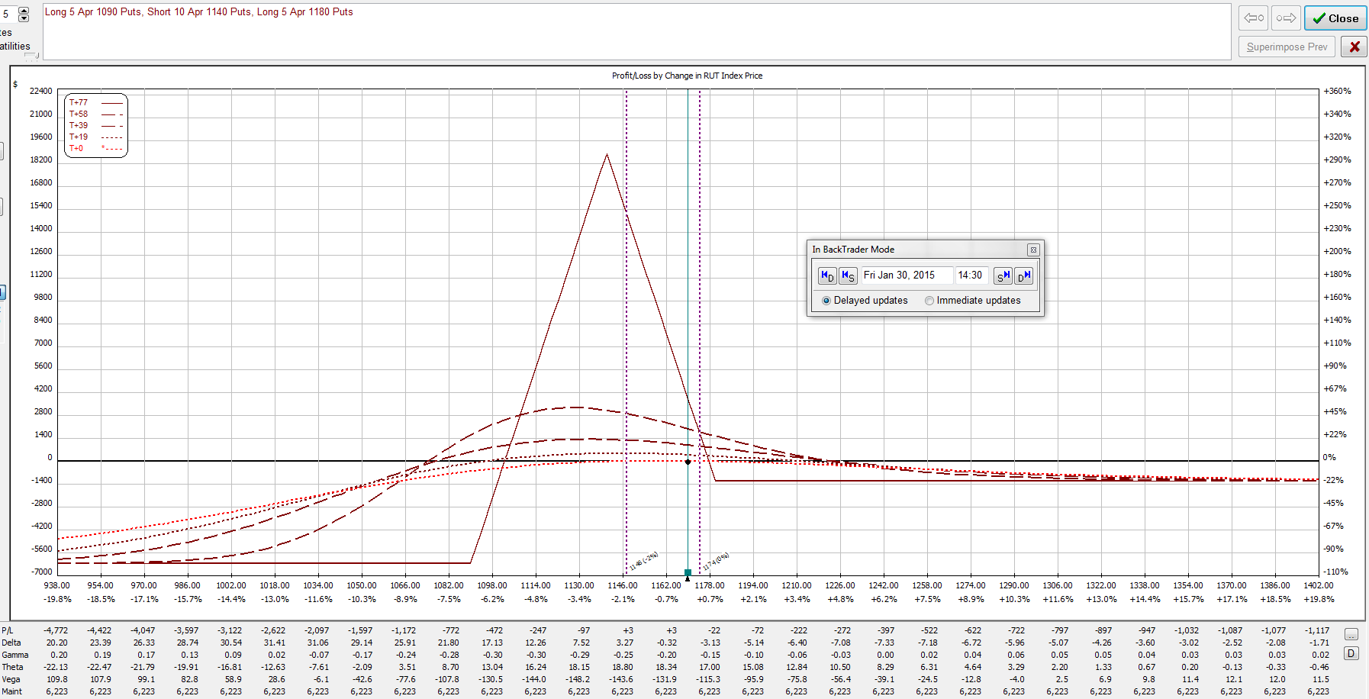
January 30, 2015 – RUT = 1170.0
Bought (5) 1180/1140/1090 put BWB’s
Delta = -2

Slide 16
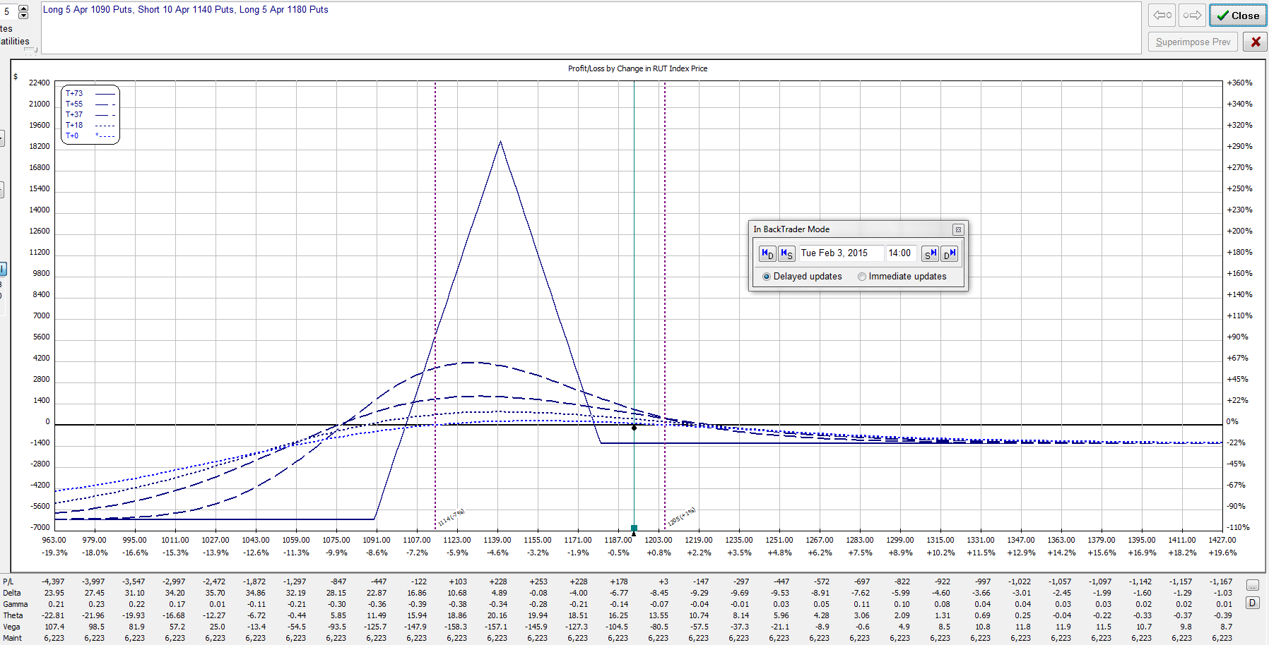
February 3, 2015 – RUT = 1193.7
RUT over 10 points above upper long strike
Time to scale into second half of position
Delta = -7

Slide 17
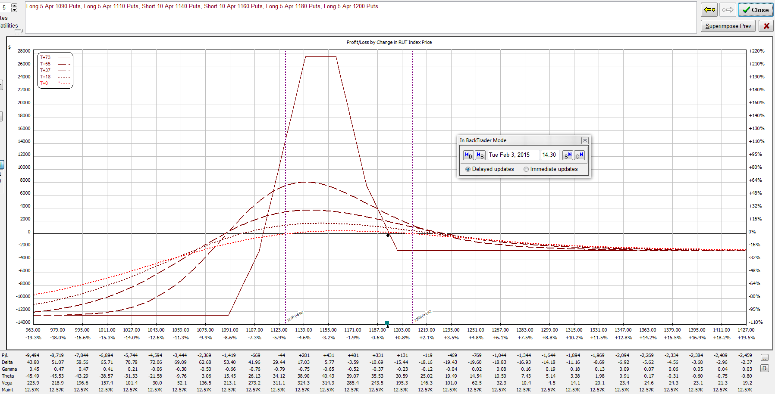
February 3, 2015 – RUT = 1193.7
Bought (5) 1200/1160/1110 put BWB’s
Delta = -13

Slide 18
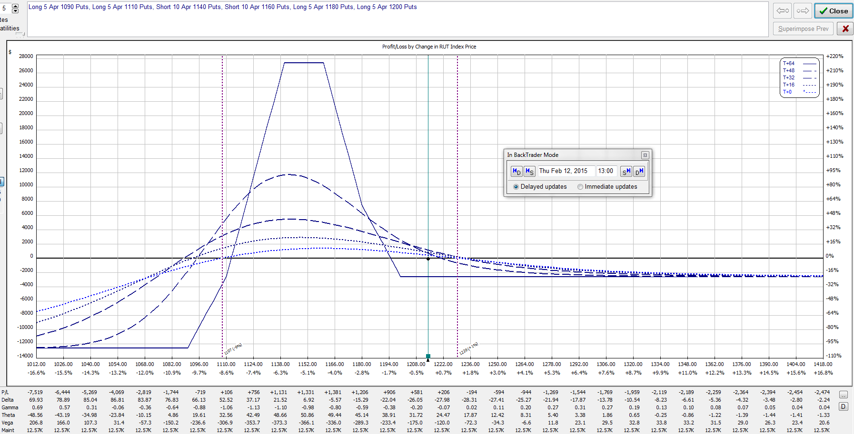
February 12, 2015 – RUT = 1213.7
Delta = -27
Need to buy call calendars to reduce negative delta

Slide 19
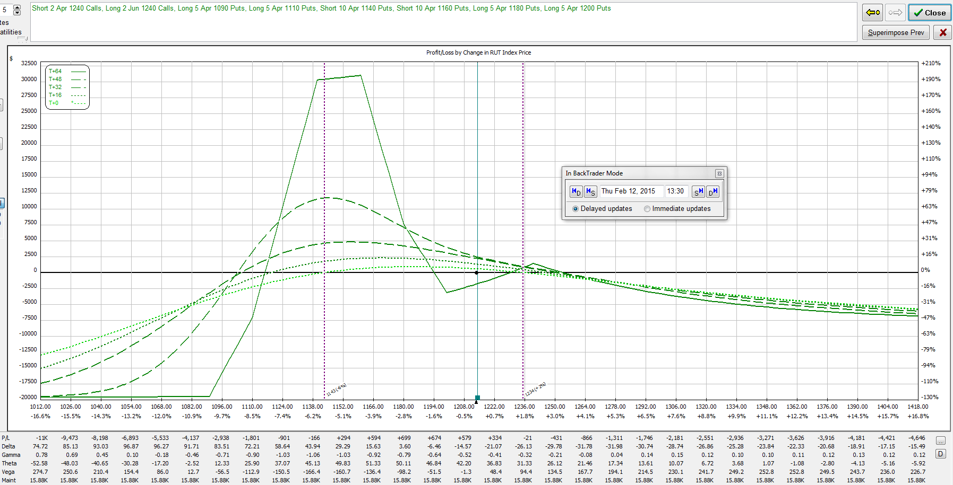
February 12, 2015 – RUT = 1213.7
Bought (2) APR/JUN 1240 calendars
Delta = -17

Slide 20
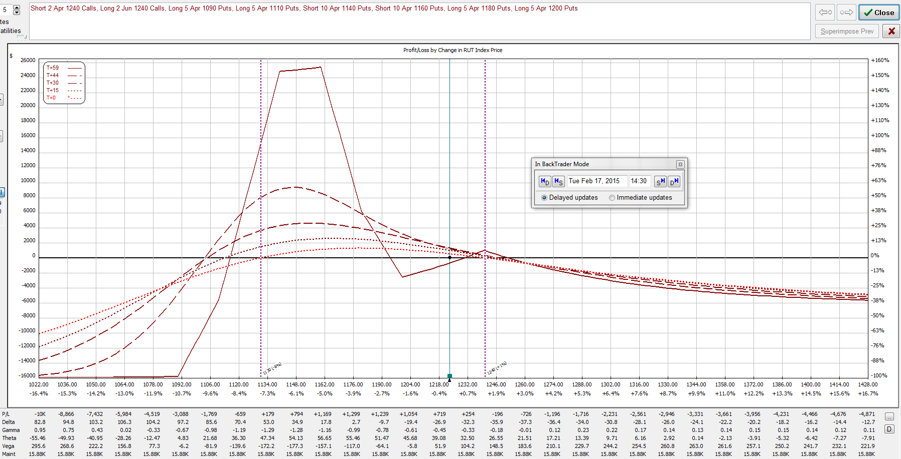
February 17, 2015 – RUT = 1223.2
Delta = -29
Need to buy call calendars to reduce negative delta

Slide 21
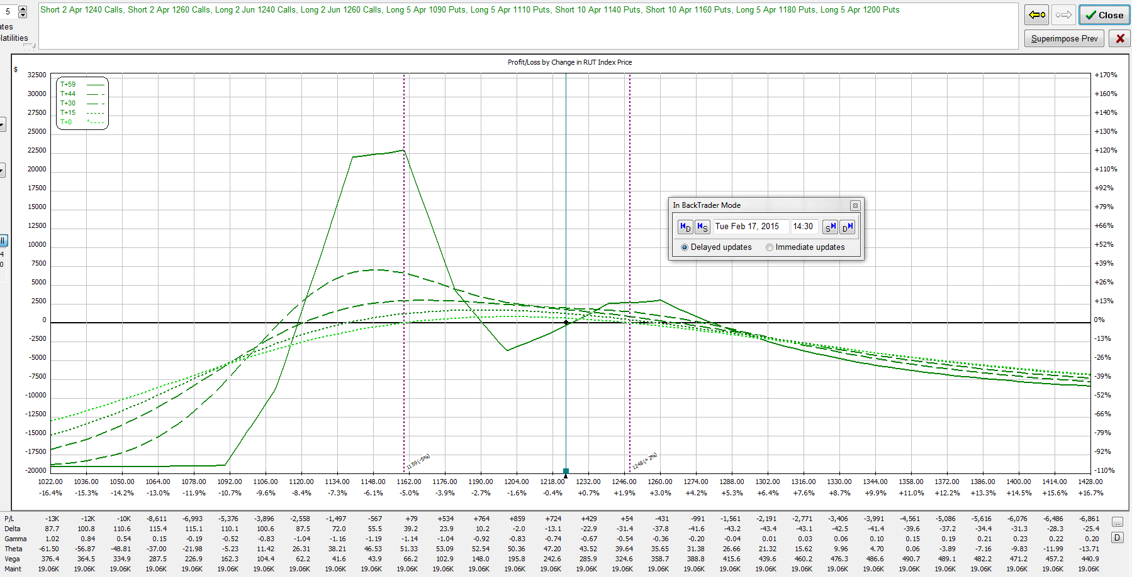
February 17, 2015 – RUT = 1223.2
Bought (2) APR/JUN 1260 calendars
Delta = -17 THAT IS THE ORIGINAL RHINO RULE: NOW CHANGED FOR RH UPPER LONGS AND/OR DIAGONAL BUT NO DOUBLE CALENDARS

Slide 22
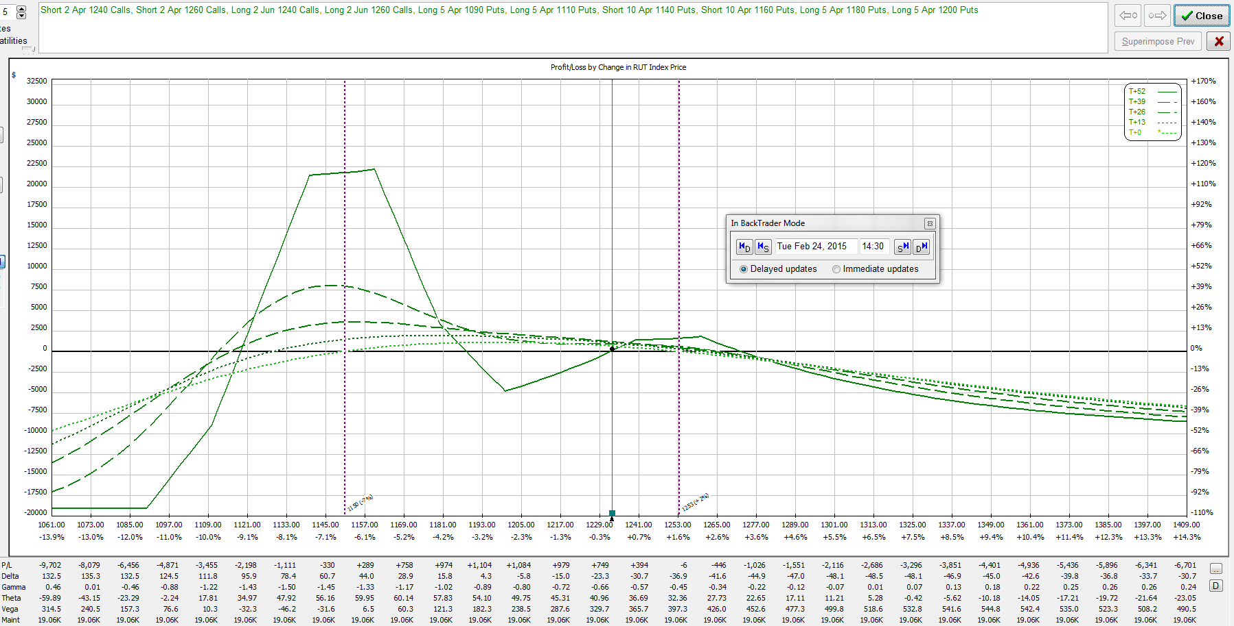
February 24, 2015 – RUT = 1232.8
Delta = -26
Need to reduce delta
This time, choose to roll forward half of lowest short puts

Slide 23
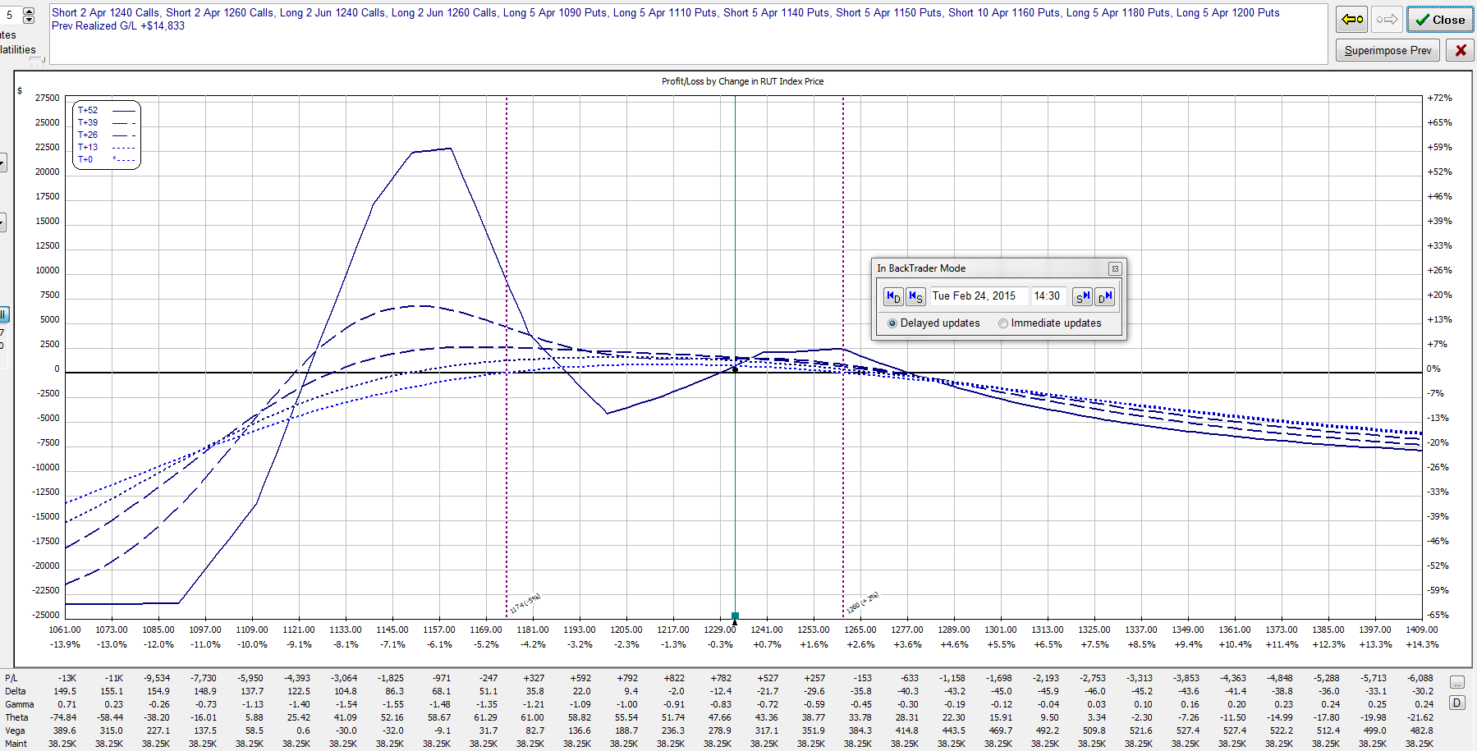
February 24, 2015 – RUT = 1232.8
Sold (5) 1150/1140 put verticals
Delta = -15

Slide 24
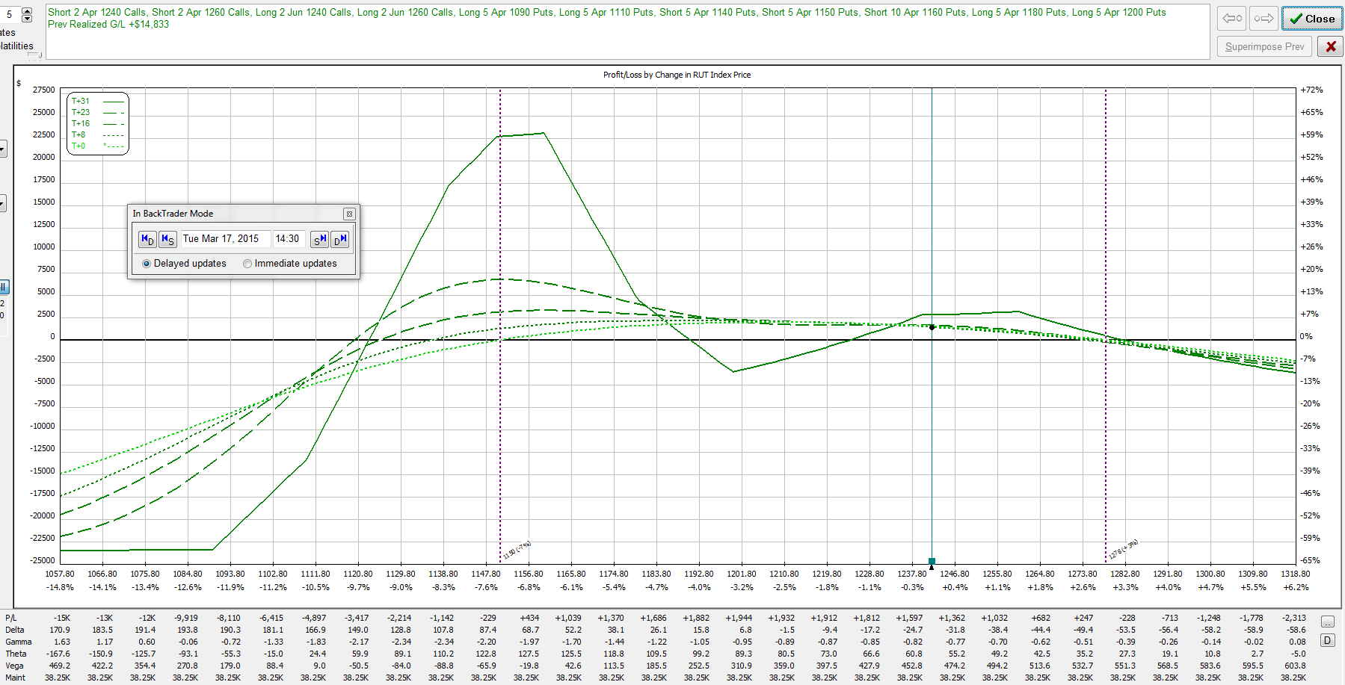
March 17, 2015 – RUT = 1241.9
Delta = -28
Could choose many different methods to reduce delta
This time, I choose to replace calendars with call BWB’s

Slide 25
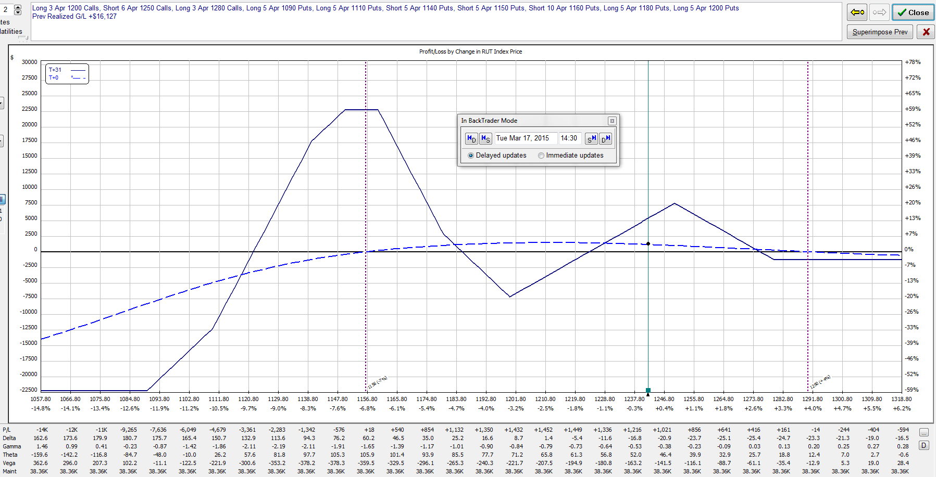
March 17, 2015 – RUT = 1241.9
Sold (2) APR/JUN 1240 call calendars
Sold (2) APR/JUN 1260 call calendars
Bought (3) 1200/1250/1280 call BWB’s
Delta = -19

Slide 26
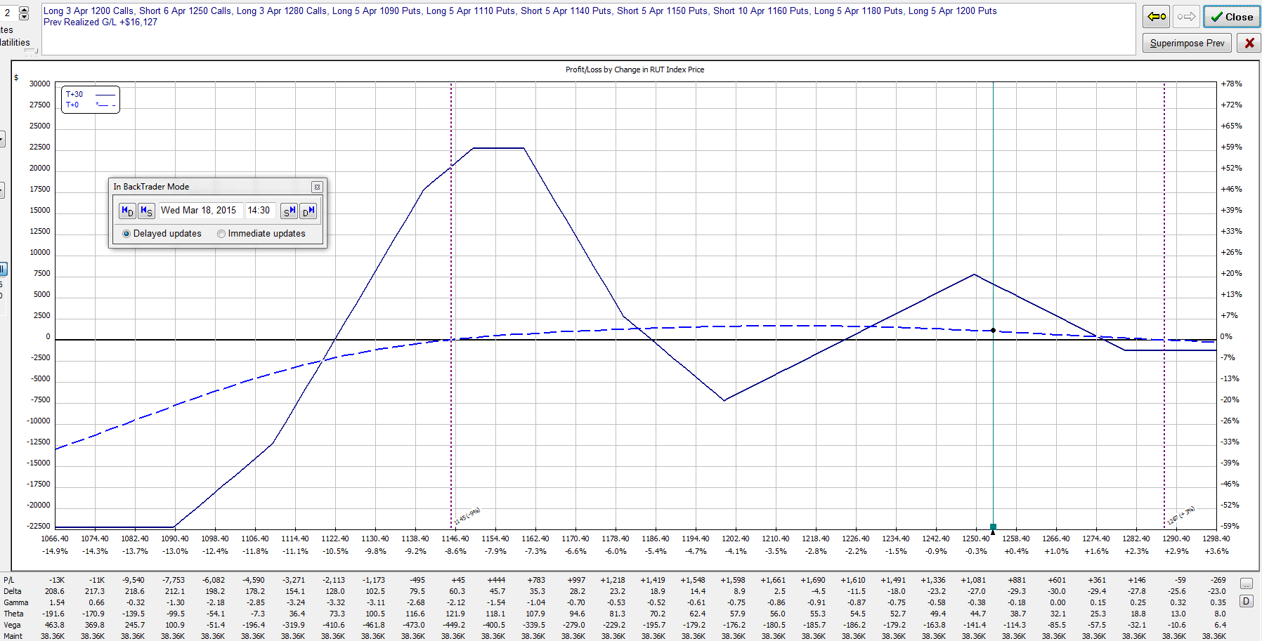
March 18, 2015 – RUT = 1253.8
Delta = -28
Choose to roll (1) short call up 10 points

Slide 27
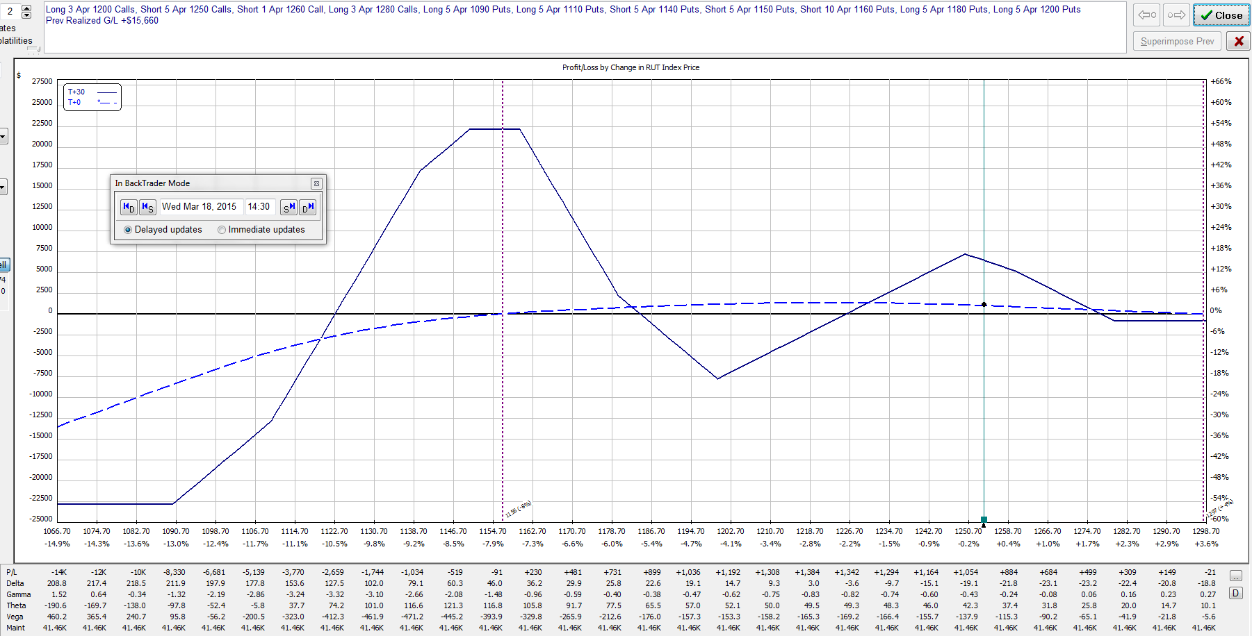
March 18, 2015 – RUT = 1253.8
Sold (1) 1260/1250 put vertical
Delta = -20

Slide 28
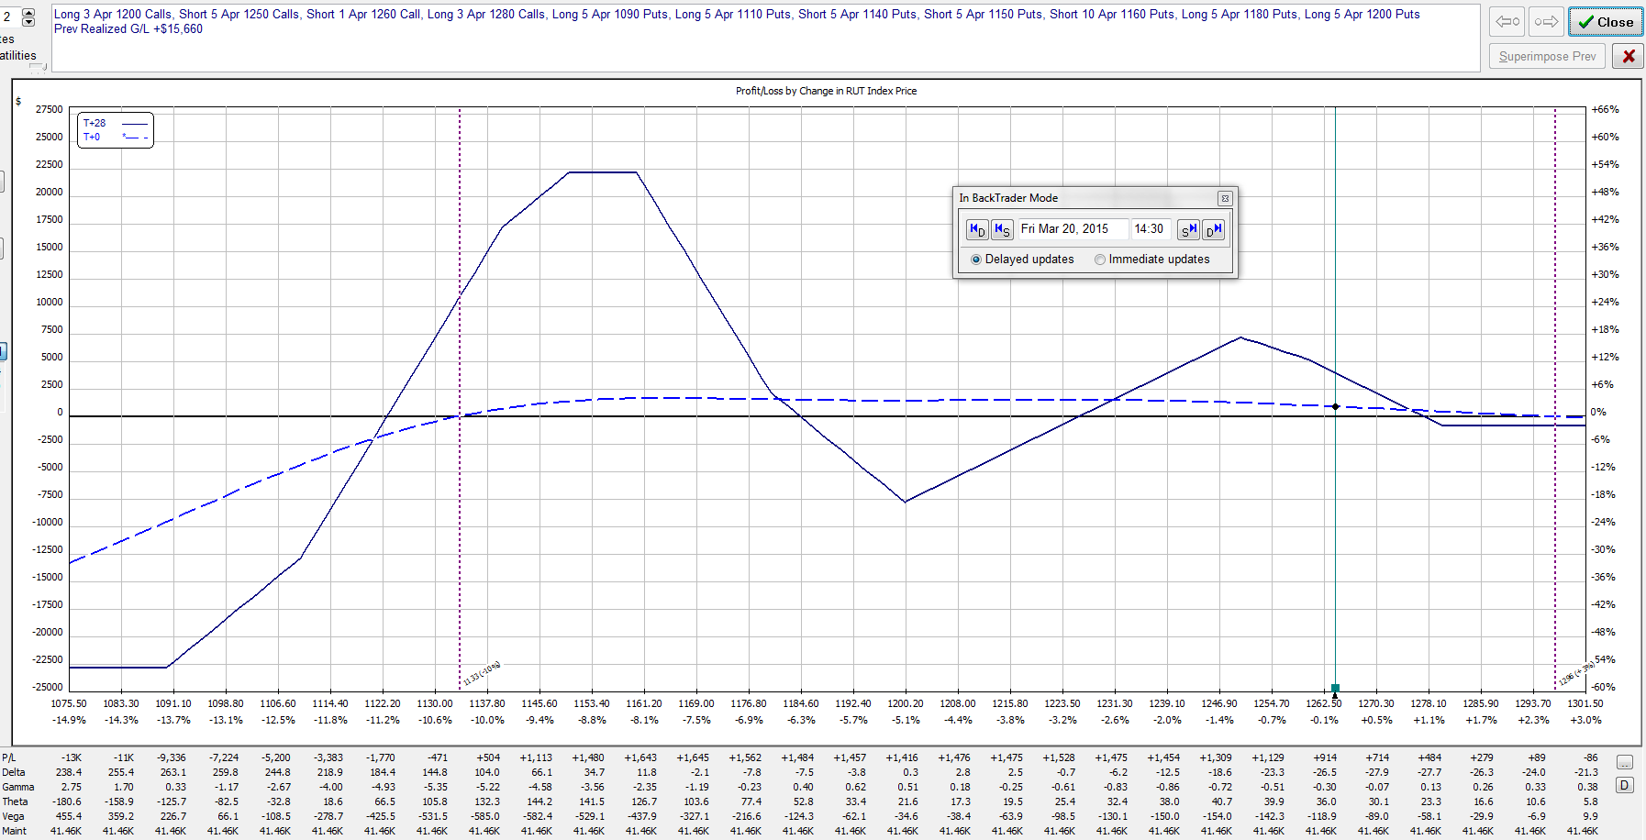
March 18, 2015 – RUT = 1264.1
Delta = -27
Choose to roll (1) short call up 10 points

Slide 29
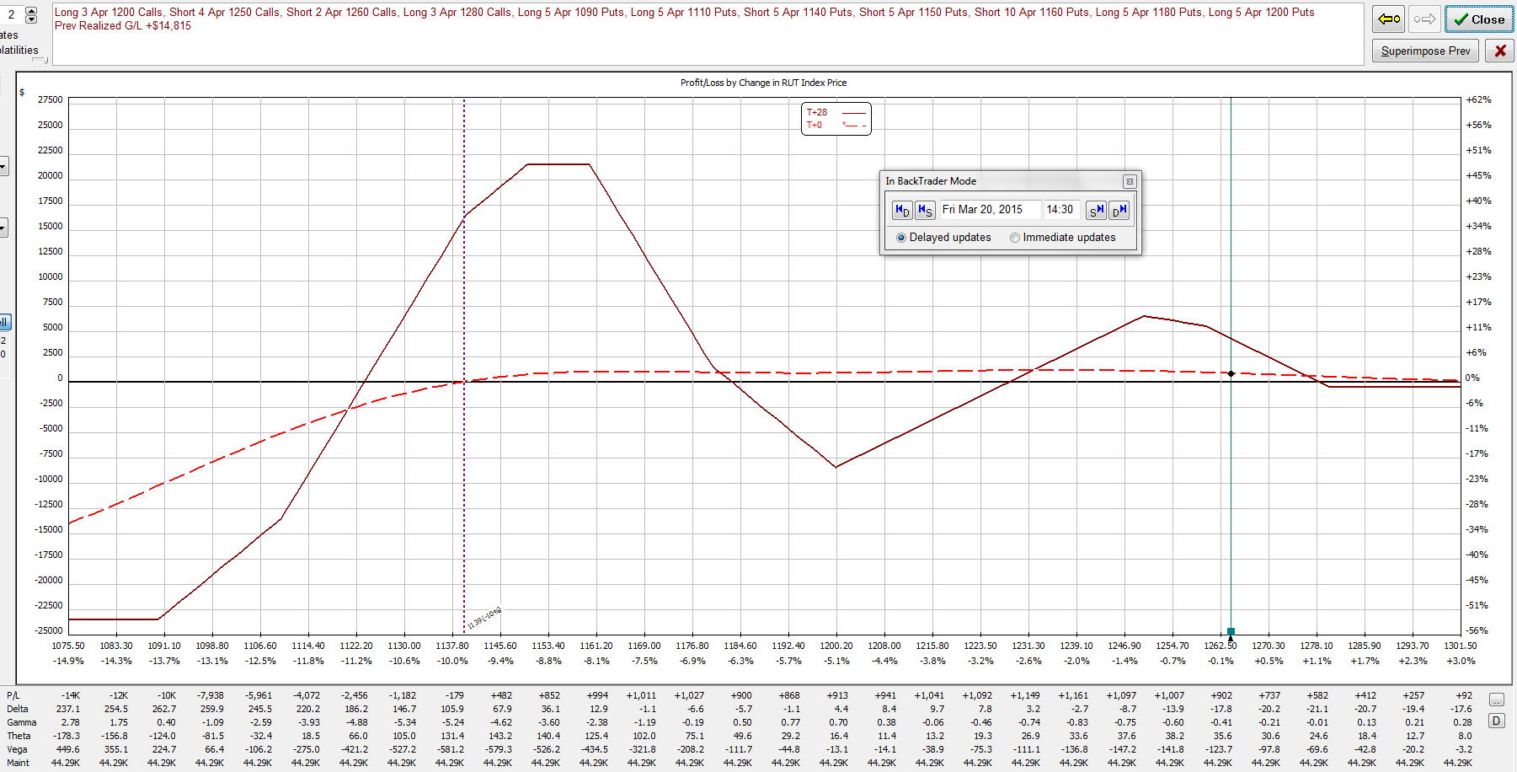
March 18, 2015 – RUT = 1264.1
Sold (1) 1260/1250 call vertical
Delta = -18

Slide 30
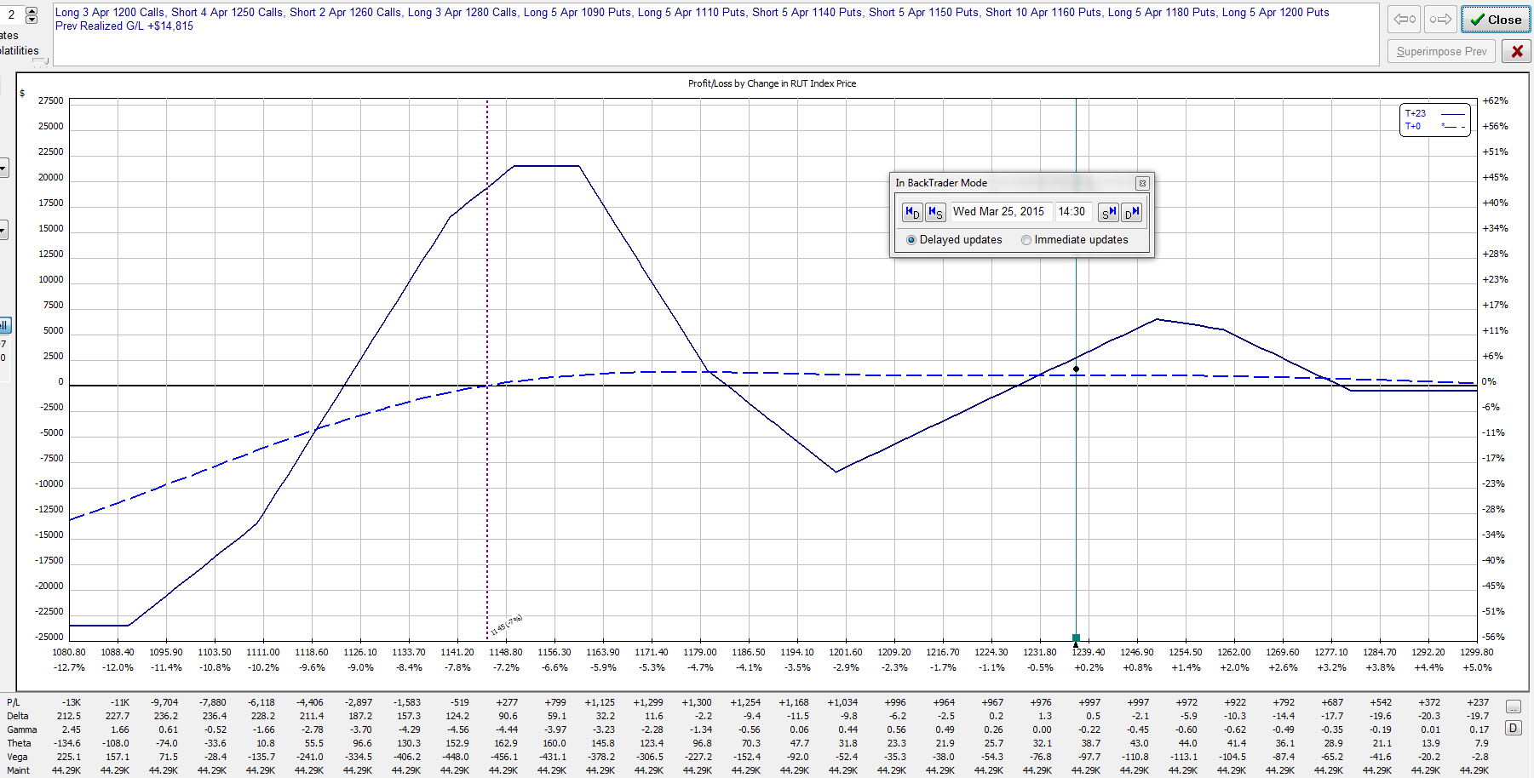
March 25, 2015 – RUT = 1237.4
Reduced profit target achieved with 23 DTE
Closed entire position for a profit of $1633 (6.5%) in 52 days
RUT was 1170.0 when trade was opened.
Life of trade: High = 1268.2, Low = 1153.8, Range = 114.4

Slide 31
Whipsaw $50K Trade (with poorly timed rollback)
November 2015
Days in Trade = 39
Profit = 4.1%
*Deltas may not be exact due to OptionVue issues

Slide 32
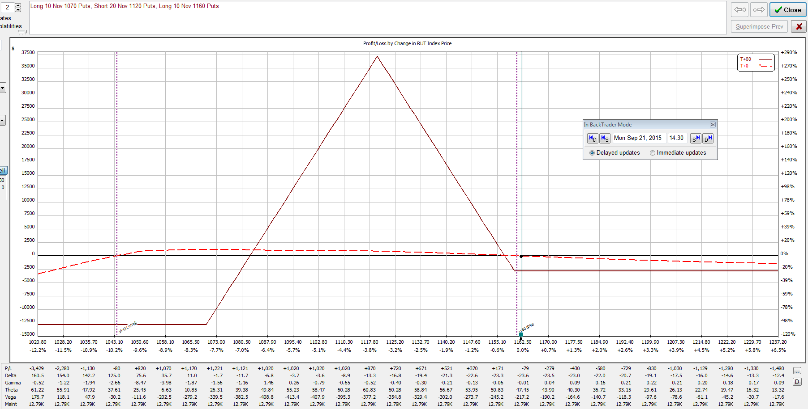
September 21, 2015 – RUT = 1162.0
60 DTE Entry – Missed 77 DTE & waited for down move
Bought (10) 1160/1120/1070 put BWB’s
Delta = -24 (deltas double due to 2X size)

Slide 33
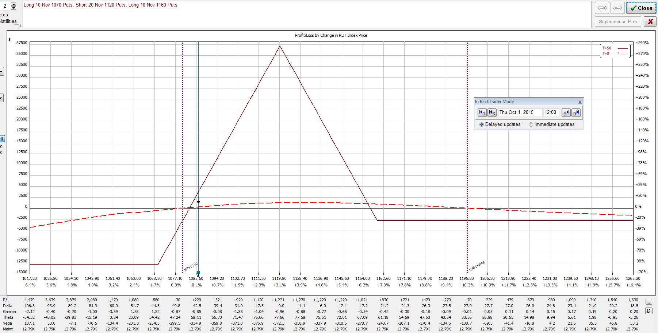
October 1, 2015 – RUT = 1086.5
Second time RUT pierced expiration breakeven line
Delta = +42 (deltas double due to 2X size)
Chose to roll butterflies back

Slide 34
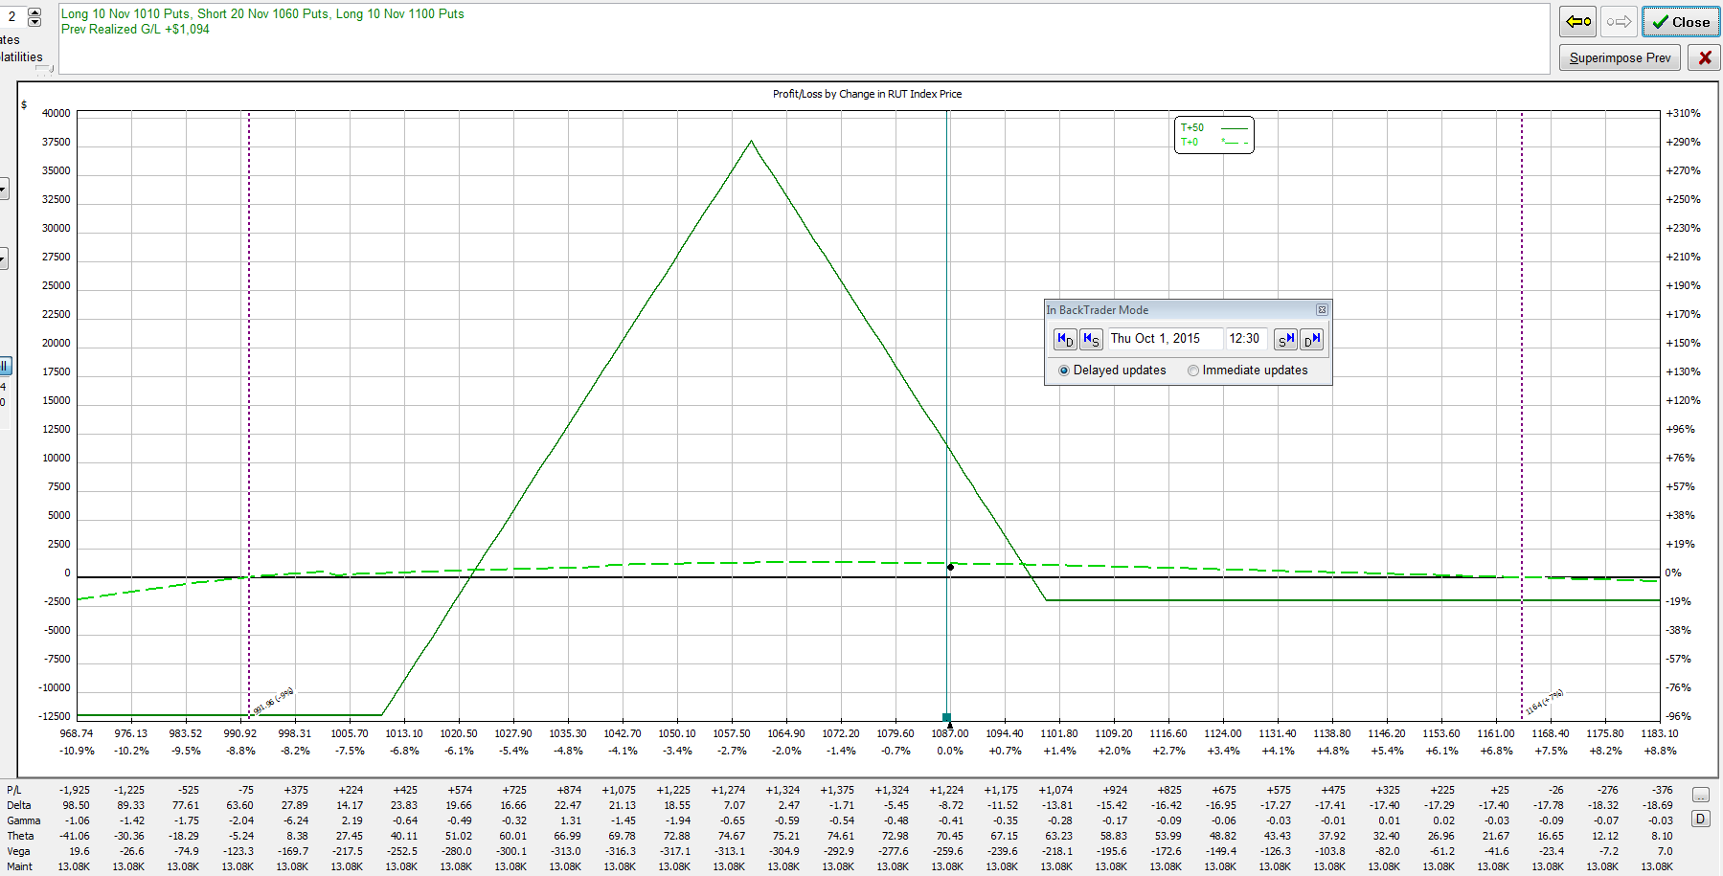
October 1, 2015 – RUT = 1086.5
Sold (10) 1160/1120/1070 BWB’s
Bought (10) 1100/1060/1010 BWB’s
Delta = -9 (deltas double due to 2X size)

Slide 35
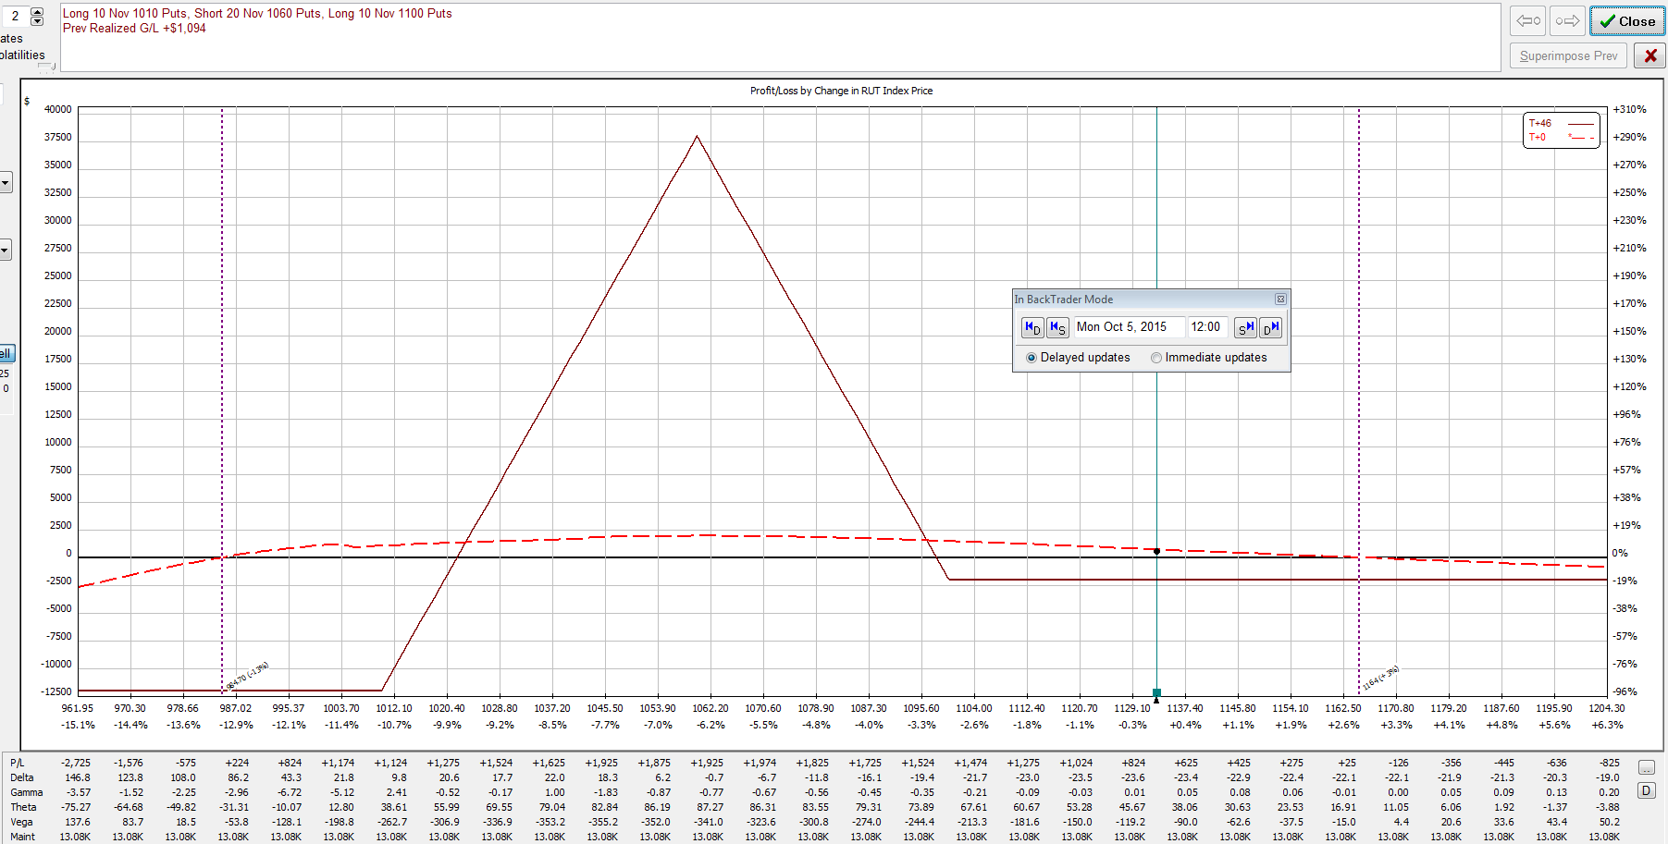
October 5, 2015 – RUT = 1134.2
Delta = -24 (deltas double due to 2X size)
Delta not over limit, but price far away from tent
Prefer not to scale in after rolling back
Chose to add call calendars to improve delta and theta

Slide 36
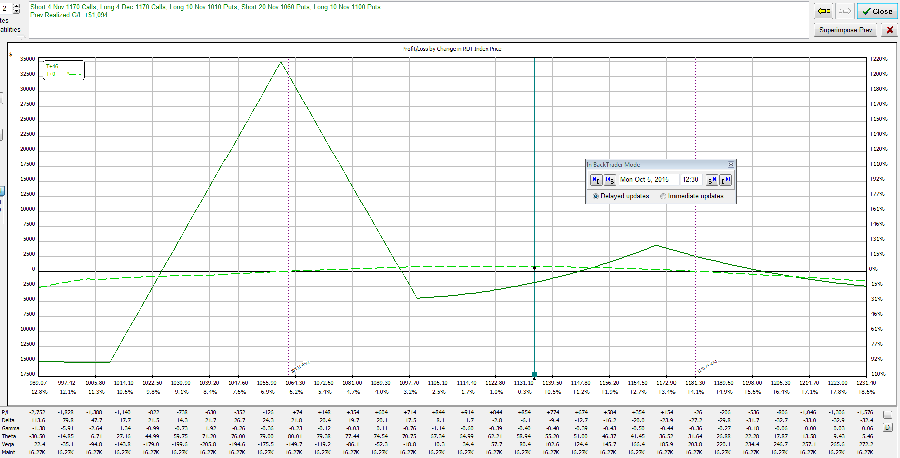
October 5, 2015 – RUT = 1134.2
Bought (4) NOV/DEC 1170 call calendars
Delta = -7 (deltas double due to 2X size)

Slide 37
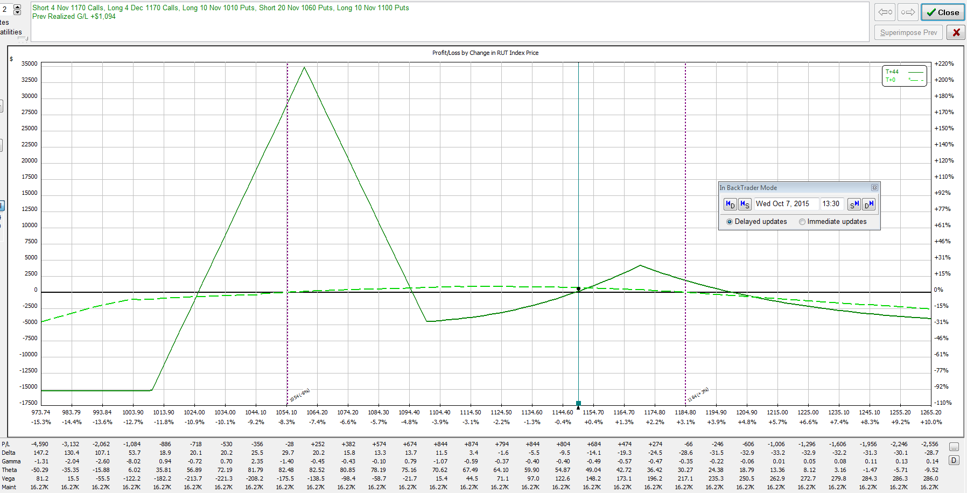
October 7, 2015 – RUT = 1149.7
Delta = -12 (deltas double due to 2X size)
Getting close to moving into single calendar
Chose to add more calendars to increase theta

Slide 38
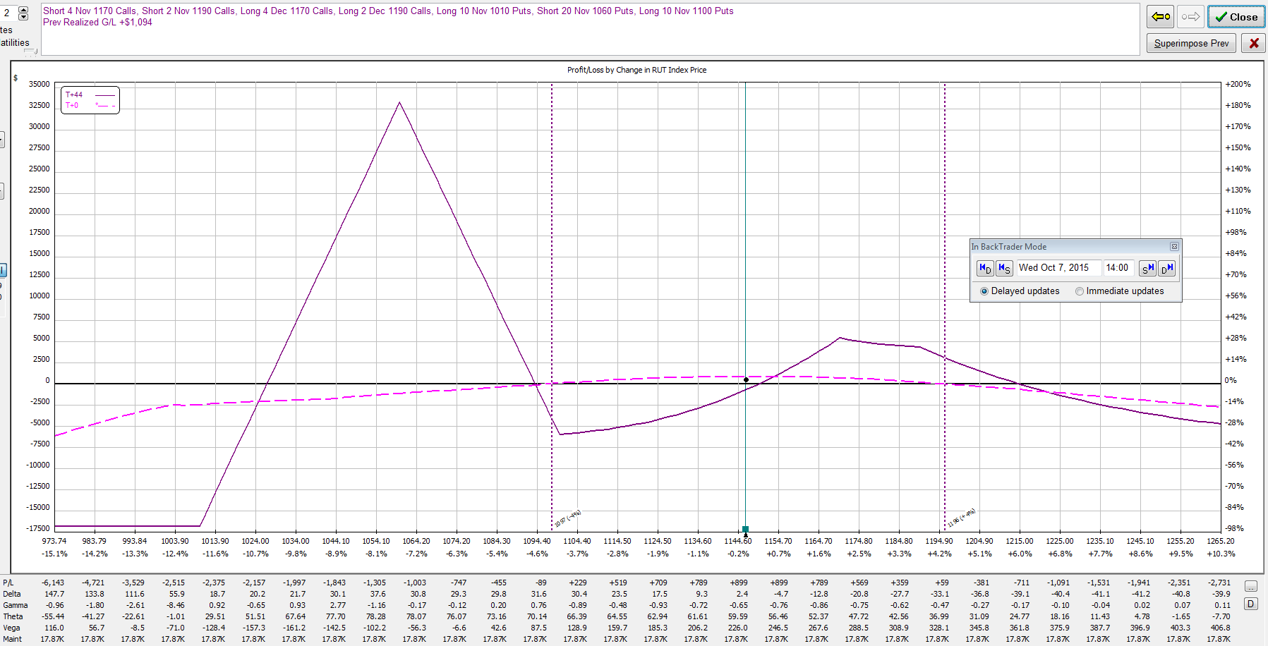
October 7, 2015 – RUT = 1149.7
Bought (2) NOV/DEC 1190 call calendars
Delta = +1 (deltas double due to 2X size)

Slide 39
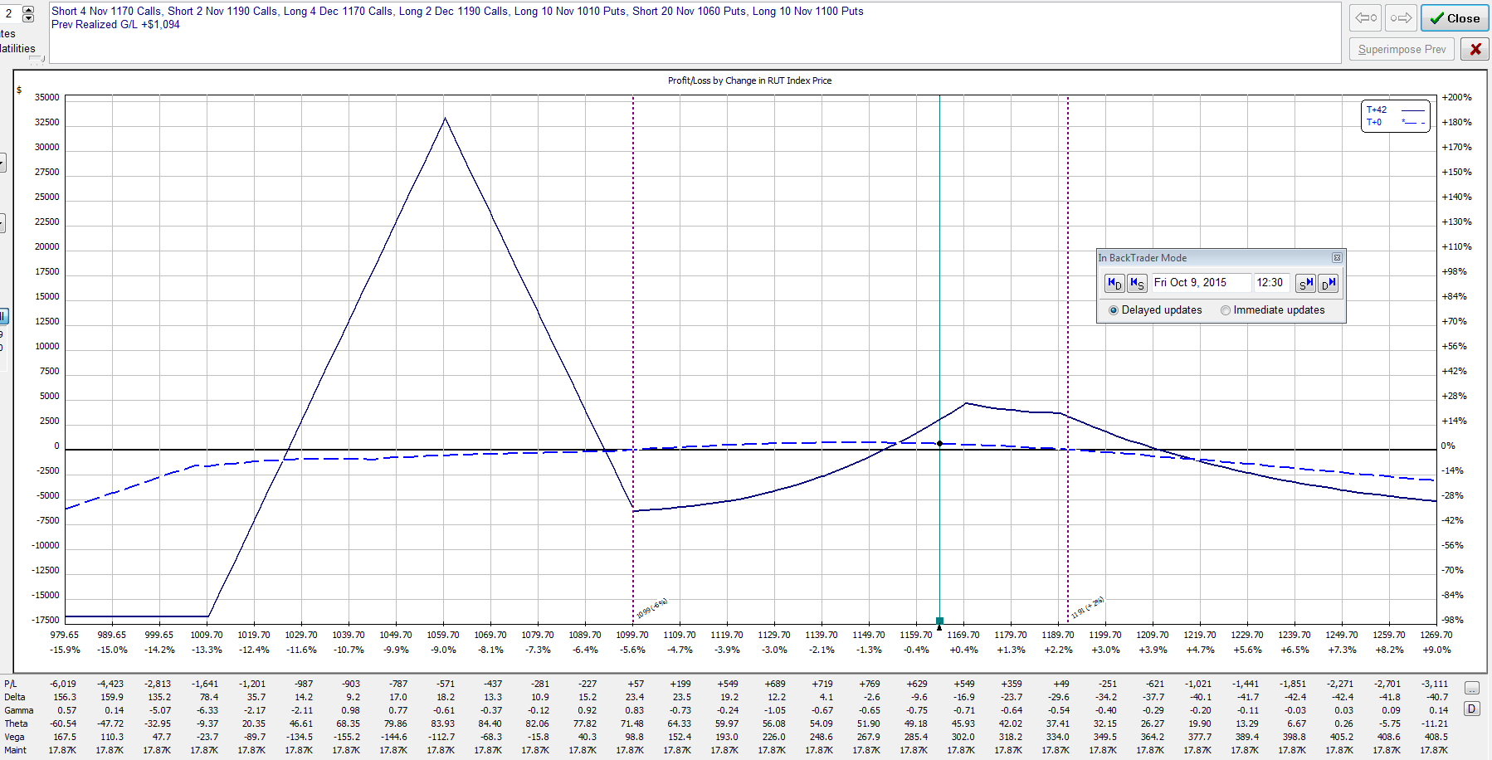
October 9, 2015 – RUT = 1164.5
Delta = -13 (deltas double due to 2X size)
Delta is fine, but theta is low because BWB is too far away
Chose to roll up BWB

Slide 40
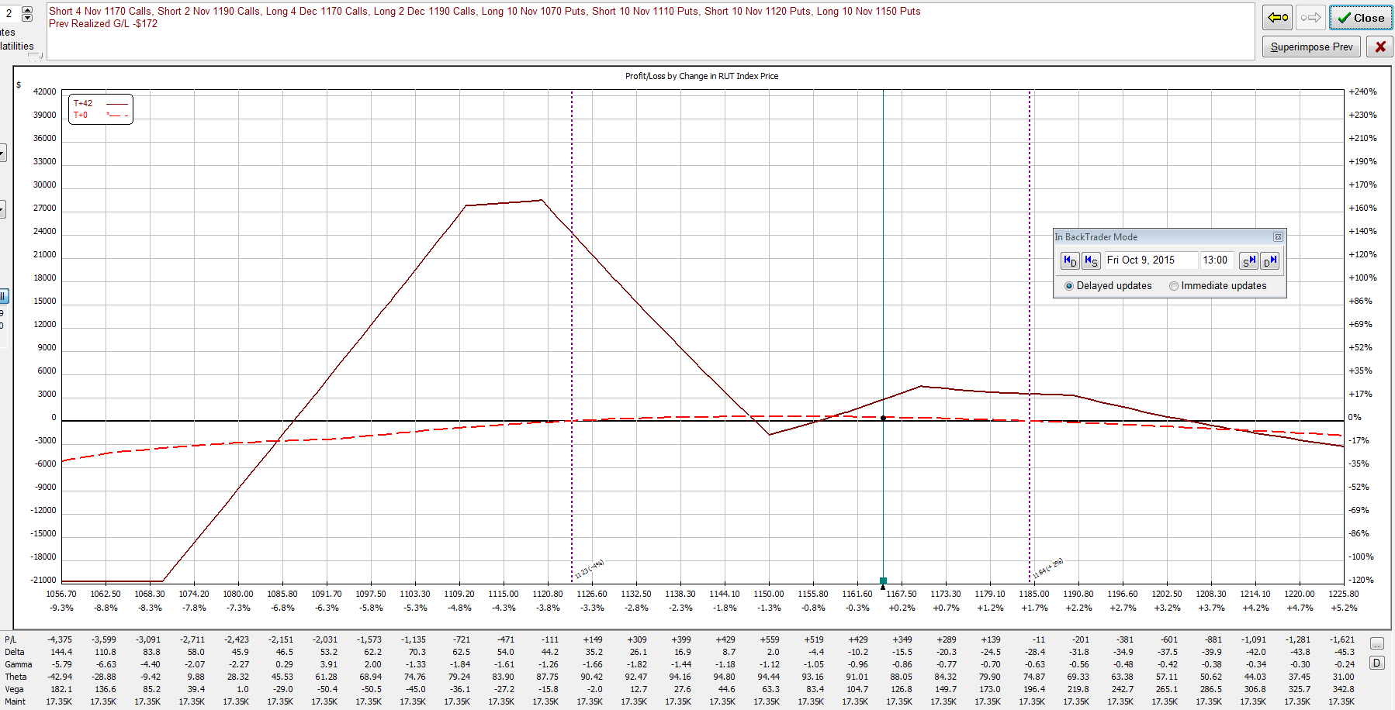
October 9, 2015 – RUT = 1164.5
Sold (10) 1100/1060/1010 put BWB’s
Bought (10) 1150/1120/1110/1070 put broken-wing condors
Delta = -13 (deltas double due to 2X size)

Slide 41
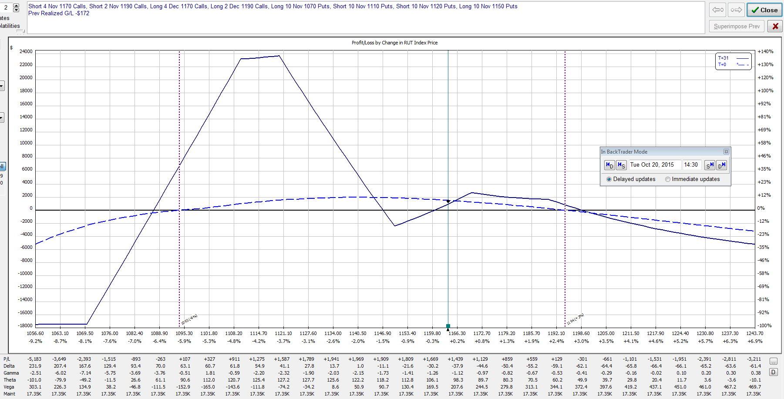
October 20, 2015 – RUT = 1163.9
Delta = -35 (deltas double due to 2X size)
RUT making strong move up after retrace
Managing deltas a bit tighter due to lower capital in trade
Chose to add a couple more calendars

Slide 42
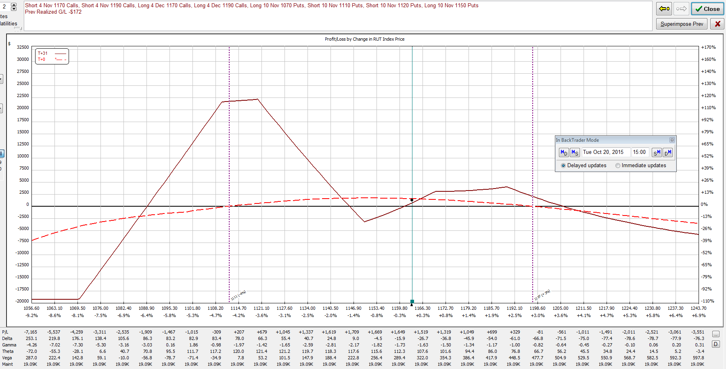
October 20, 2015 – RUT = 1163.9
Bought (2) NOV/DEC 1190 call calendars
Delta = -22 (deltas double due to 2X size)

Slide 43
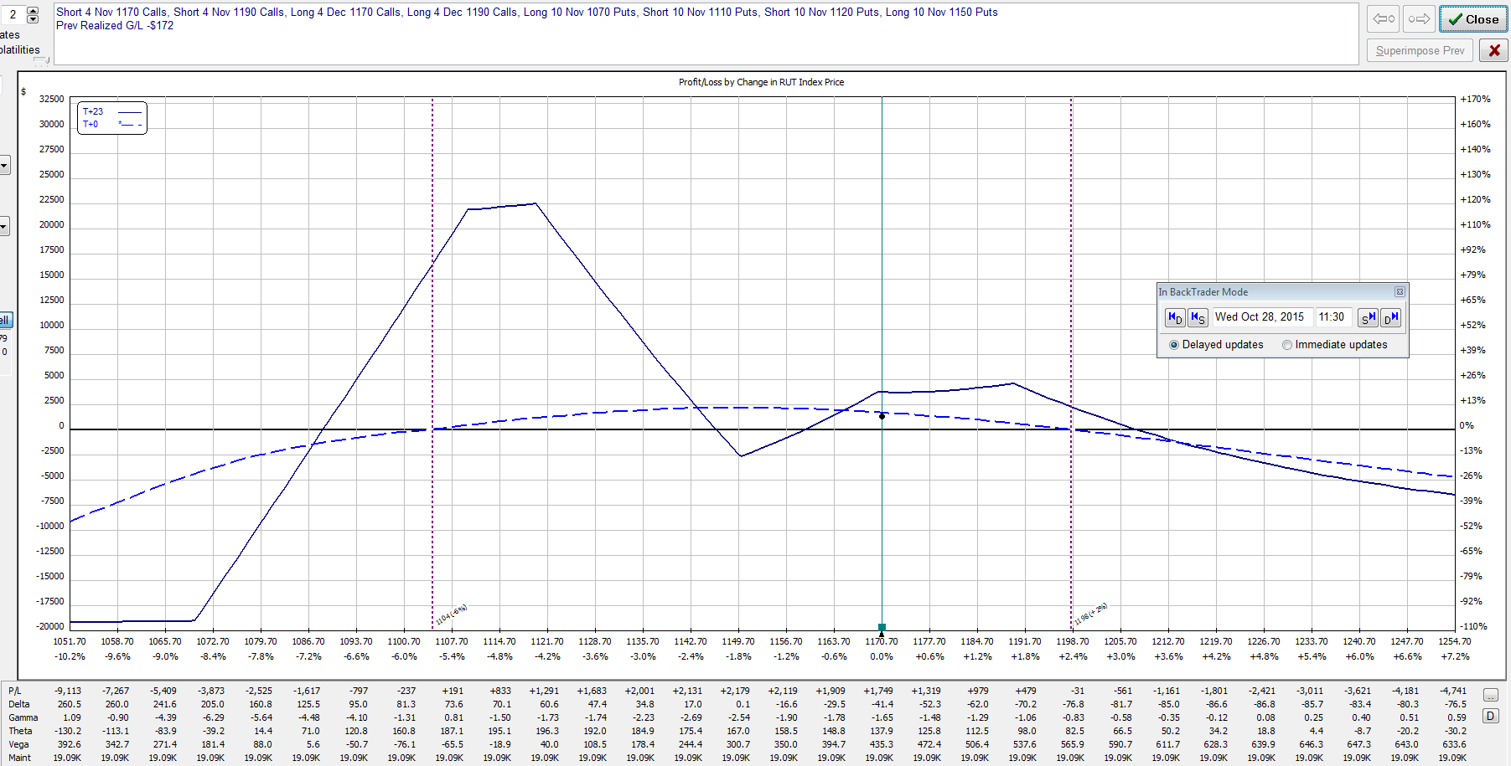
October 28, 2015 – RUT = 1170.7
Delta = -42 (deltas double due to 2X size)
Want to reduce negative delta ahead of Fed meeting
Would like to add theta and negative vega at the same time
Chose to roll a few of the upper long strike puts back

Slide 44
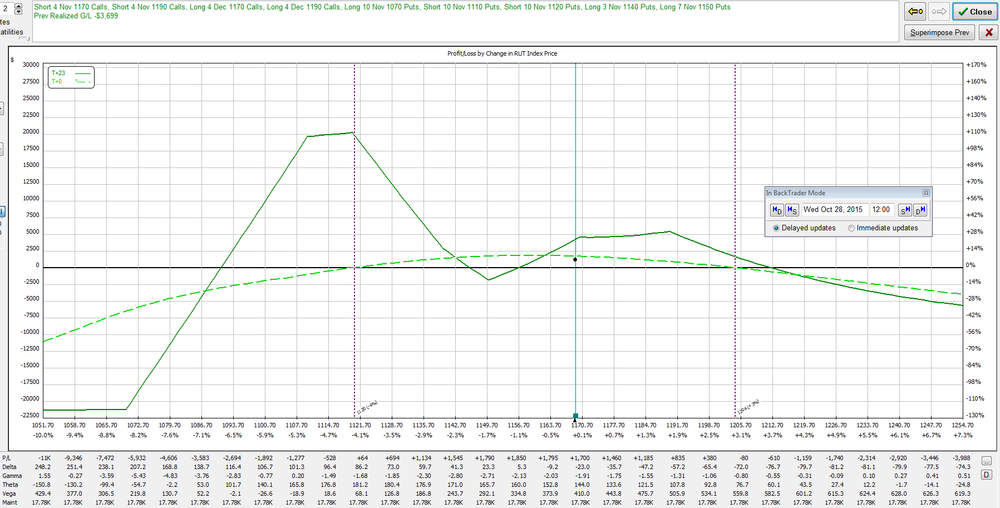
October 28, 2015 – RUT = 1170.7
Sold (3) 1150/1140 put verticals
Delta = -20 (deltas double due to 2X size)

Slide 45
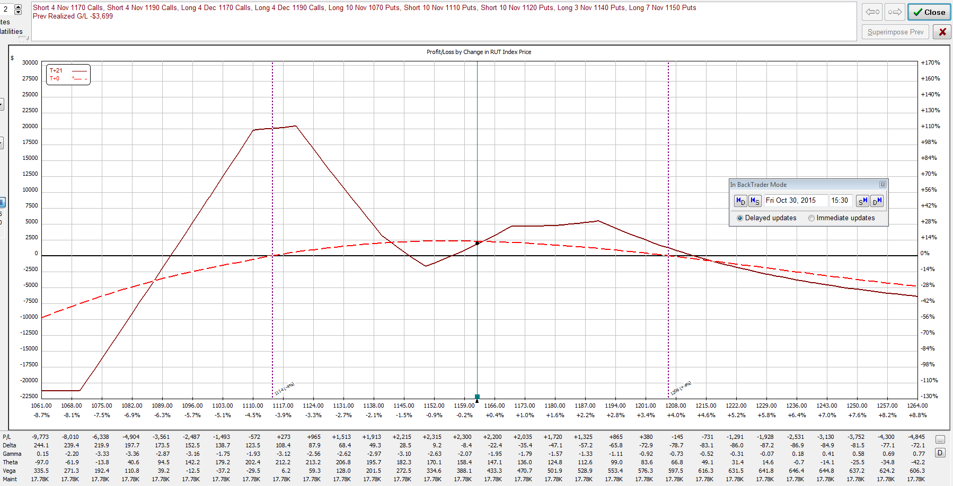
October 30, 2015 – RUT = 1161.9
Reduced profit target achieved with 21 DTE
Closed entire position for a profit of $2045 (4.1%) in 39 days
RUT was 1162.0 when trade was opened.
Life of trade: High = 1178.8, Low = 1078.6, Range = 100.2

Slide 46
Appendix “The Big Crash”
November 2008
Days in Trade = 68
Profit = 4.9%

Slide 47
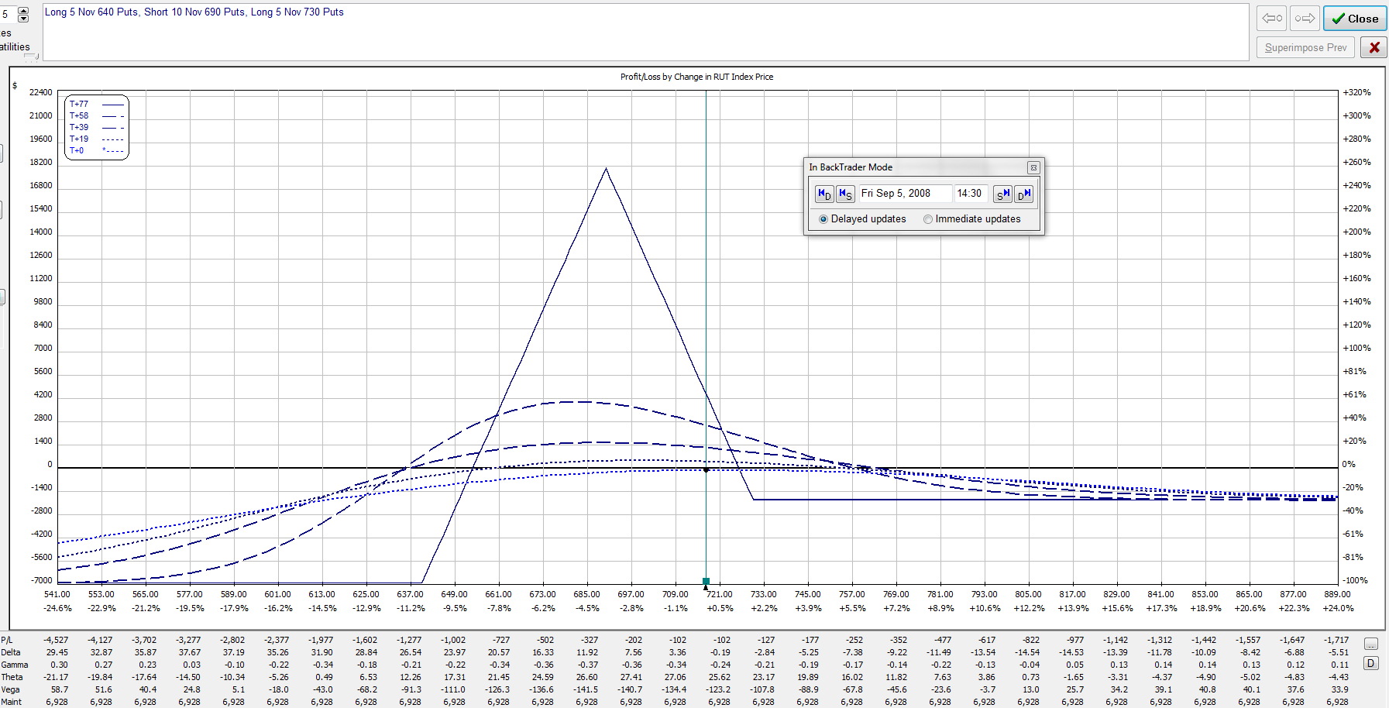
September 5, 2008 – RUT = 717.2
Bought (5) 730/690/640 put BWB’s
Delta = +1

Slide 48
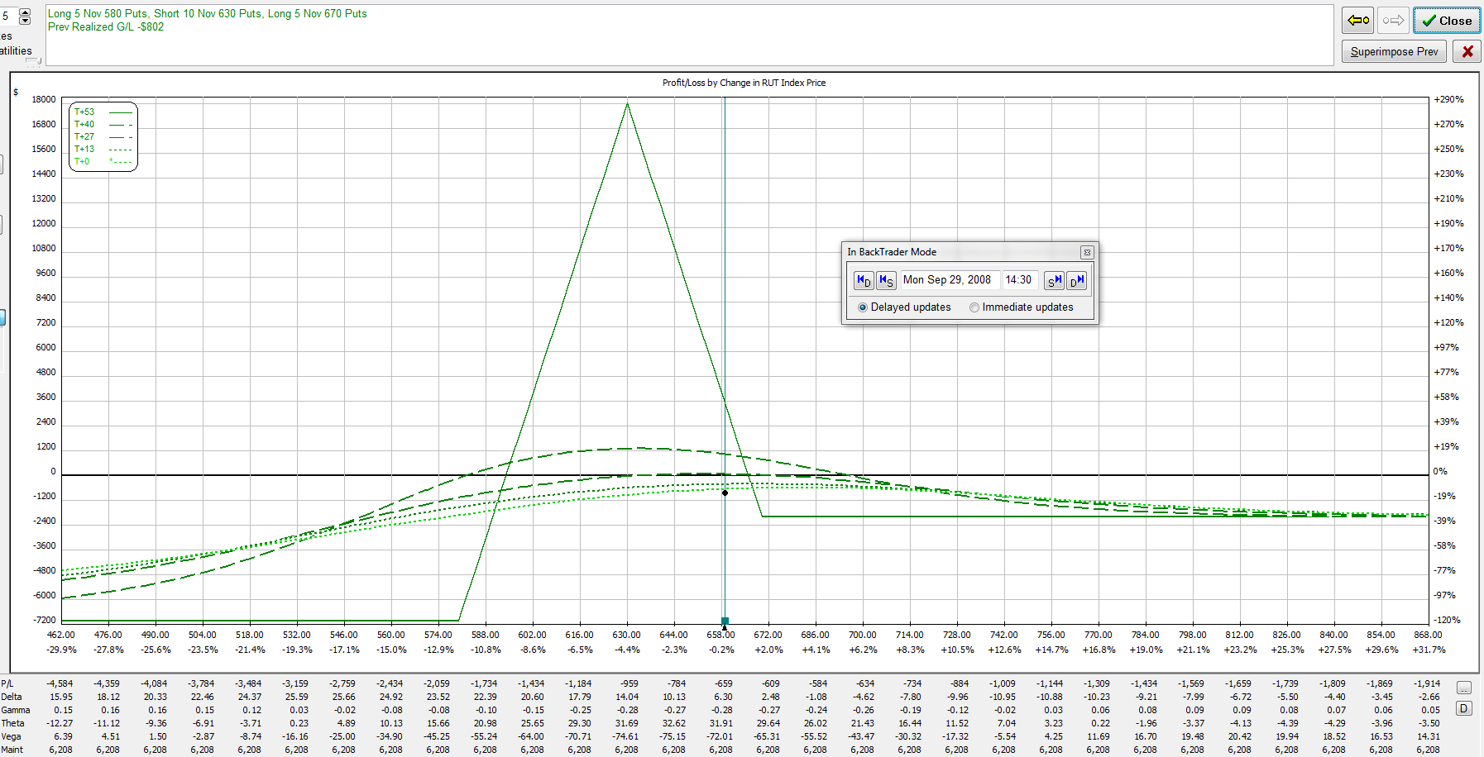
September 29, 2008 – RUT = 659.0
RUT moved down through BWB’s – rolled butterflies back
Sold (5) 730/690/640 put BWB’s
Bought (5) 670/630/580 put BWB’s
Delta = +6

Slide 49
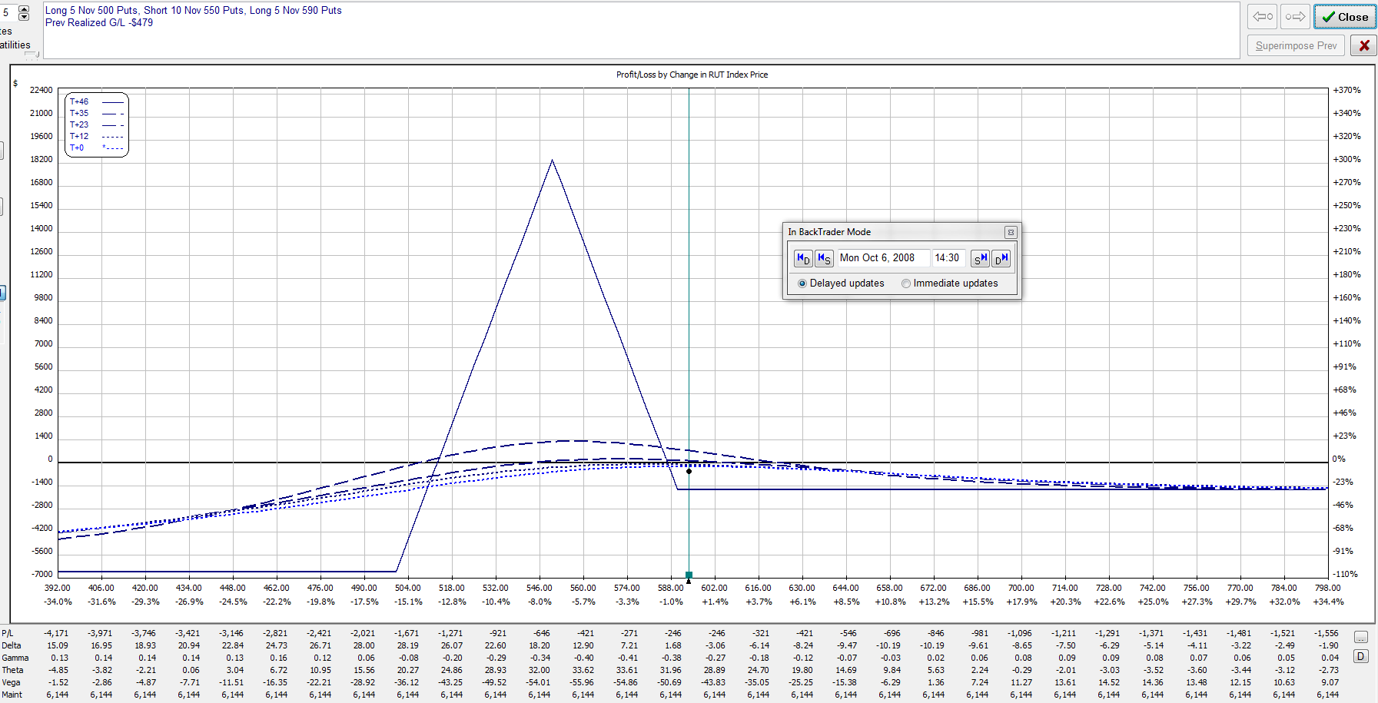
October 6, 2008 – RUT = 593.7
RUT moved down through BWB’s – rolled butterflies back
Sold (5) 670/630/580 put BWB’s
Bought (5) 590/550/500 put BWB’s
Delta = 0

Slide 50
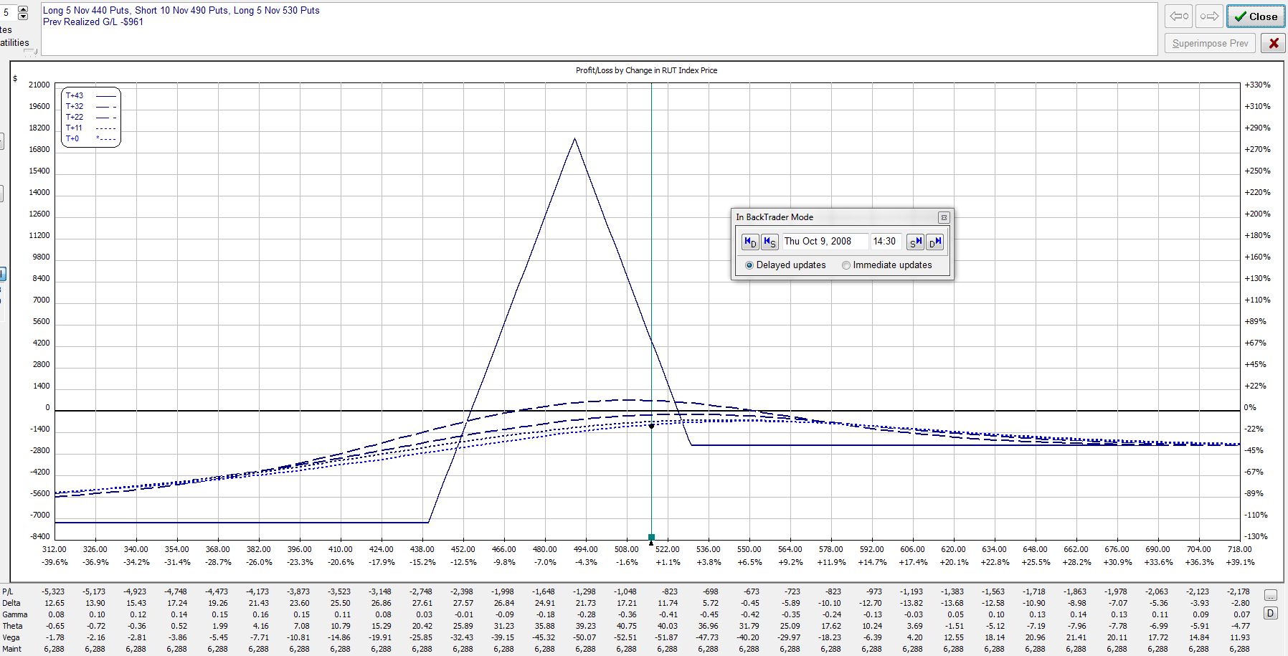
October 9, 2008 – RUT = 516.4
RUT moved down through BWB’s – rolled butterflies back
Sold (5) 590/550/500 put BWB’s
Bought (5) 530/490/440 put BWB’s
Delta = +14

Slide 51
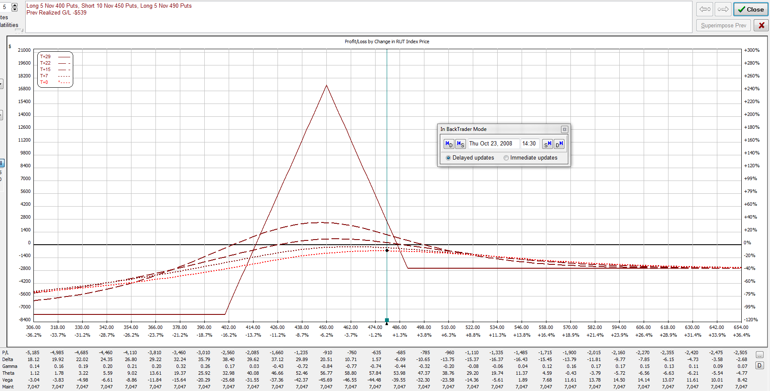
October 23, 2008 – RUT = 479.6
RUT moved down through BWB’s – rolled butterflies back
Sold (5) 530/490/440 put BWB’s
Bought (5) 490/450/400 put BWB’s
Delta = -2

Slide 52
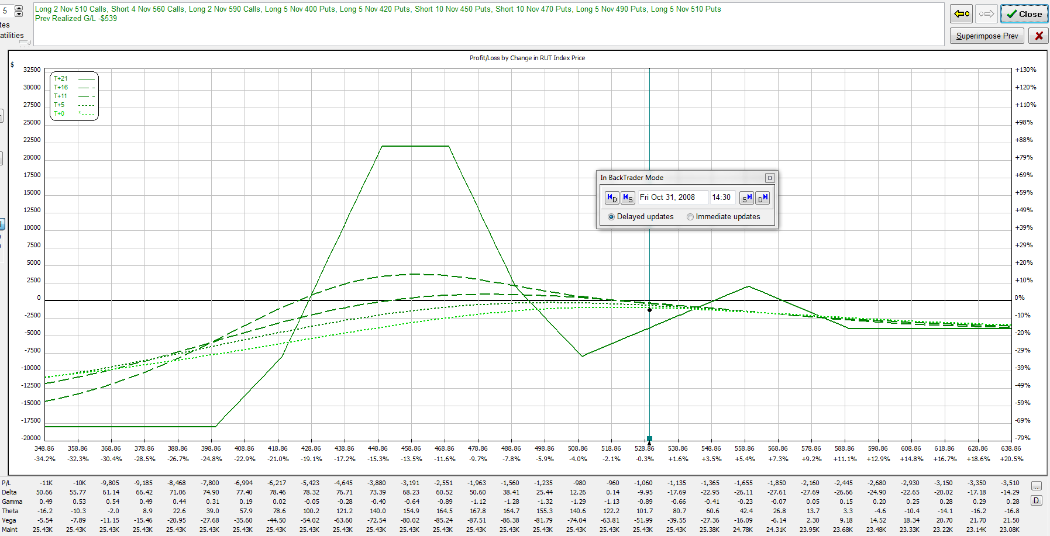
October 31, 2008 – RUT = 530.2
RUT far above upper long puts – time to scale in
Bought (5) 510/470/420 put BWB’s
Bought (2) 510/560/590 call BWB’s
Delta = -11

Slide 53
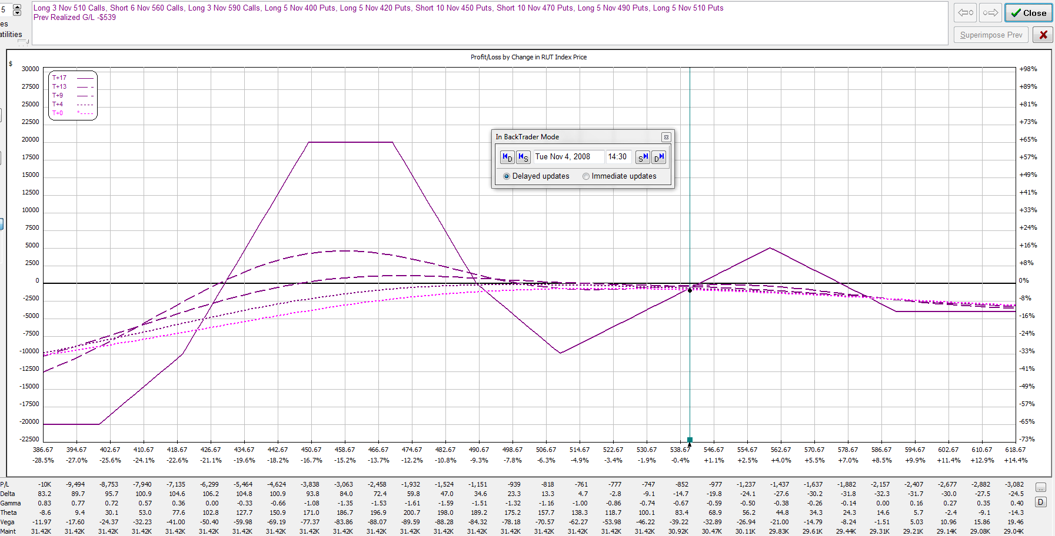
November 4, 2008 – RUT = 540.9
Delta too negative – add 1 more call BWB
Bought (1) 510/560/590 call BWB’s
Delta = -16

Slide 54
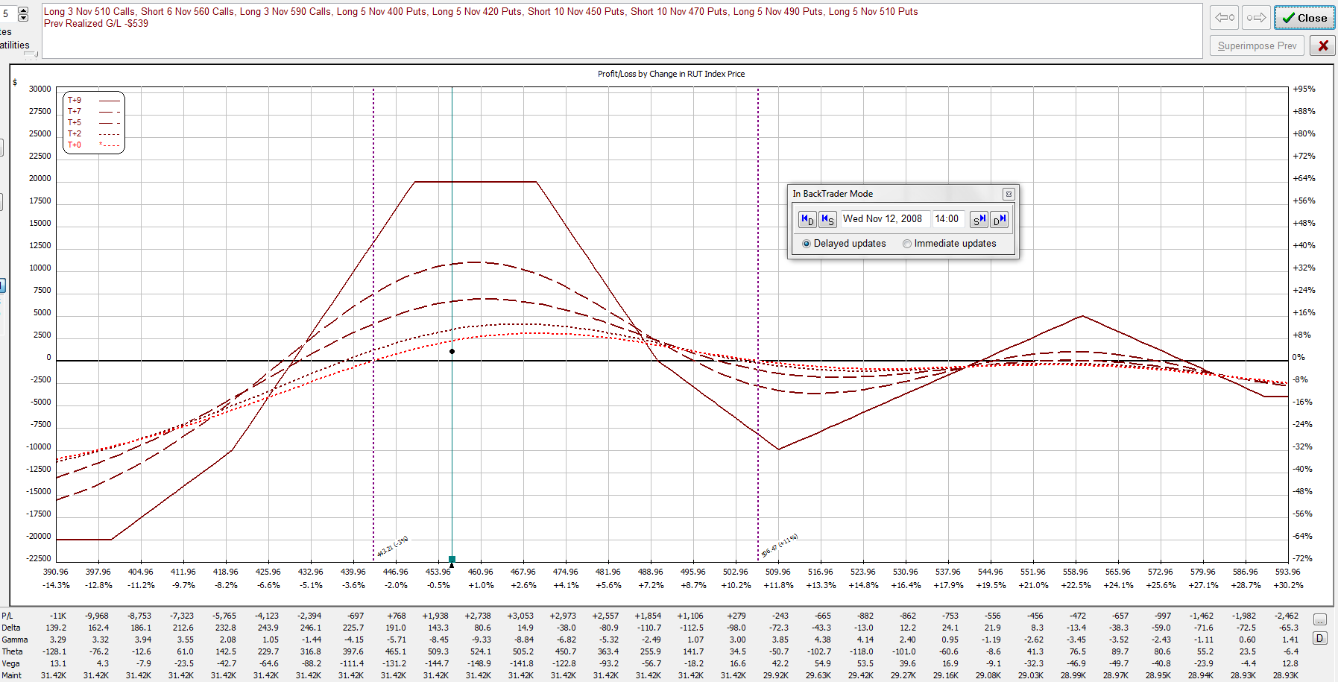
November 12, 2008 – RUT = 457.4
Reduced profit target achieved with 9 DTE
Closed entire position for a profit of $1233 (4.9%) in 68 days
RUT was 717.2 when trade was opened.
Life of trade: High = 761.8, Low = 441.9, Range = 319.9 (44.6%!!!)

Slide 55
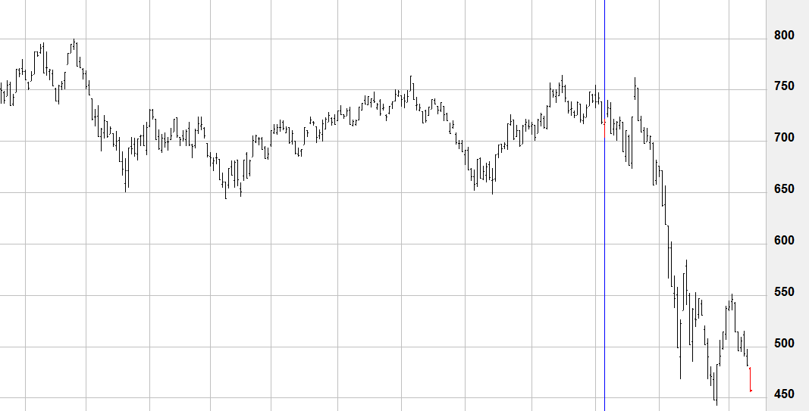
November 12, 2008 – RUT = 457.4
Entered on 9/5/08 (red bar marked with blue line)
Exited on 11/12/08 (final red bar)
Total down move from entry = 38.4%
Could have exited at any time for a small loss (or small profit)

Slide 56
Bruno’s Rhino Trade Alerts
This is a very popular broken wing butterfly strategy with a very flat T+0 line with the ability to survive large market moves.
The paid service has now started:
Per month: $119 or ~ 105 Euros
Per quarter: $339 or ~300 Euros (100/month)
Bi-annually at $639 or ~570 Euros (95/month)
Annually at $1189 or ~1056 Euros (88/month)
Visit http://cdurl.us/rhino for more information or to sign up

